Slide 1

Utilizing syndromic surveillance systems for climate-related outcomes
Laurel Harduar Morano
International Society of Disease Surveillance
Notes:
Thank you. Today, I will be talking about utilizing syndromic surveillance systems for climate-related outcomes. This presentation is a summary of a guidance document that is was created by the current climate and health syndromic surveillance workgroup. The document is currently being routed and hopefully will be available near the end of the summer.
This project arose out of need identified by the previous climate and health syndromic surveillance workgroup led by Matt Roach (AZ) and Kristin Raab (MN) in 2015. And was funded by CSTE.
That group developed a great guidance document for creating a heat-related illness query (I will have a link at the end) and helped conduct a survey to gather information on how SyS is being used in the US for detecting and reducing outcomes related to extreme weather events and climate change. Matt Roach presented on the preliminary results at a CSTE webinar in March.

Slide 2
Why did we create the document?
Climate change → broad range of adverse outcomes
Climate and health surveillance embryonic phase [Moulton 2017]
Syndromic surveillance systems (SyS) can help
  Situational awareness
  Unique data fields/sources
Notes:
So why did we need to create the document. [click] We know that there are broad range of adverse outcomes associated with climate change. Examples include exacerbations of chronic conditions, diseases and injuries associated with natural disasters, increased presentation and differing distribution of vector-borne and zoonotic diseases, and mental health outcomes associated with displacement and interruption of care. Additionally, adverse outcomes may arise from climate change adaptation and mitigation efforts, such as injuries to pedestrians and cyclists if non-motorized transport is promoted without concurrent increases in infrastructure development (e.g., bike lanes or sidewalks)
However, [click] as identified by a recent paper, climate and health surveillance in the US is still in the embryonic phase. And while some jurisdictions are using their SyS for climate and health surveillance, more could benefit.
SyS [click] provides near real-time data which can be used for rapid response - including situational awareness, which may inform an ongoing response, help to activate a response, or potentially determine how response resources are distributed. For instance, in the aftermath of Hurricane Irene (2011) North Carolina used their syndromic surveillance system to identify an increase in heat-related illness associated with power outages. Vulnerable populations in specific counties were identified and information was shared with public health preparedness, emergency management
SyS also have unique data sources and fields which may be used for evaluating adverse health outcomes over time or in relation to an exposure(s). For instance, some systems collect urgent care data, poison control calls, or school absenteeism. Most systems across the US collect at the minimum Emergency department or ED visits. Collected fields my include pre-admission data such as chief complaint, triage notes, or patient vitals.

Slide 3
GOAL = General instruction on using SyS for climate and health surveillance
Identify an outcome
Creating a case definition,
Combining SyS data with environmental data
Data display and interpretation
Engaging with partners
Notes:
The goal of this document was to provide general instruction on using SyS for climate and health surveillance. We wanted to get jurisdictions who do syndromic surveillance and may not be thinking of (or doing any) climate and health surveillance to maybe start thinking about it. And for those jurisdictions who already do climate and health surveillance (or work) to broaden their surveillance data sources.
Since most systems collect ED data – the document focuses on this data source.
There are five main areas that the document covers… And there is also a nice strengths and limitations section.
We have tried to include many real-world and hypothetical examples, as well as, tables and figures to help illustrate the presented instructions. In some way the document may be a bit repetitive but it allows the reader to jump around and read sections that are of interest or important to their current needs.
For each of the first 3 sections listed on the slide, the document includes a simple process outline at the start of each section.
Finally, the document is well referenced

Slide 4
Quick note
Climate = long-term variation in weather patterns
Public health surveillance: climate = short term and long-term meteorological events
Notes:
Just a quick note – Climate means long-term variation in weather patterns.
However, for public health climate and health surveillance – climate encompasses both short-term meteorological events (i.e., weather related) such as floods or winter storms, in addition to long-term variation. An example of long-term variation would be droughts and increased wildfire activity due to decades of warmer temperatures .

Slide 5
Identifying an outcome
Section I
Directly related to current/forecasted weather patterns
Related to environmental exposures
Notes:
So lets start with the first area – Identifying an outcome. For this section, the key is in understanding the relationship between a climate factor and a health outcome. This can be identified in many ways, for instance - a literature search of both peer review or grey literature, jurisdiction specific research, or gleaning information from participating in workgroups.
[Click] You want to be able to identify outcomes directly related to current or forecasted weather patterns such as high temperatures resulting in increased morbidity or mortality or drowning from floods.
Second [Click] is identifying outcomes that are related to environmental exposures such as higher temperatures and low precipitation (that is drought conditions) can increase the number and severity of wildfires… resulting in reduced air quality… leading to increases in respiratory and cardiovascular outcomes. Another example, shortening winter season and warmer winters allows for changes in the tick development cycle… resulting in increased numbers of ticks and Lyme disease
[Click] Additionally a single event may have multiple outcomes

Slide 6
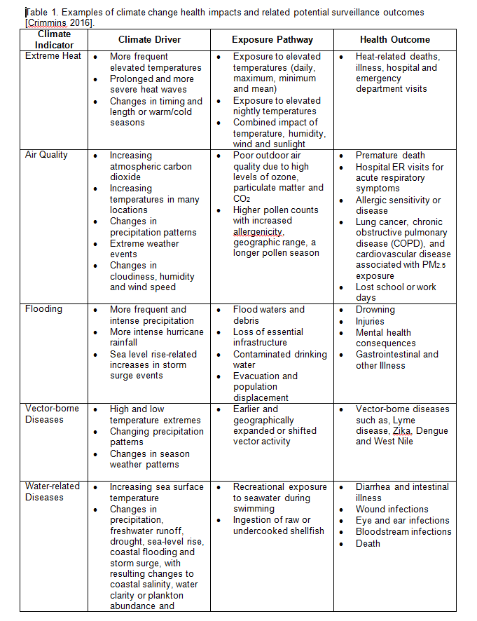

Slide 7
Identifying an outcome
Section I
Directly related to current/forecasted weather patterns
Related to environmental exposures
Understand/account for multiple outcomes for a single event
Notes:
Additionally a single event may have multiple outcomes

Slide 8
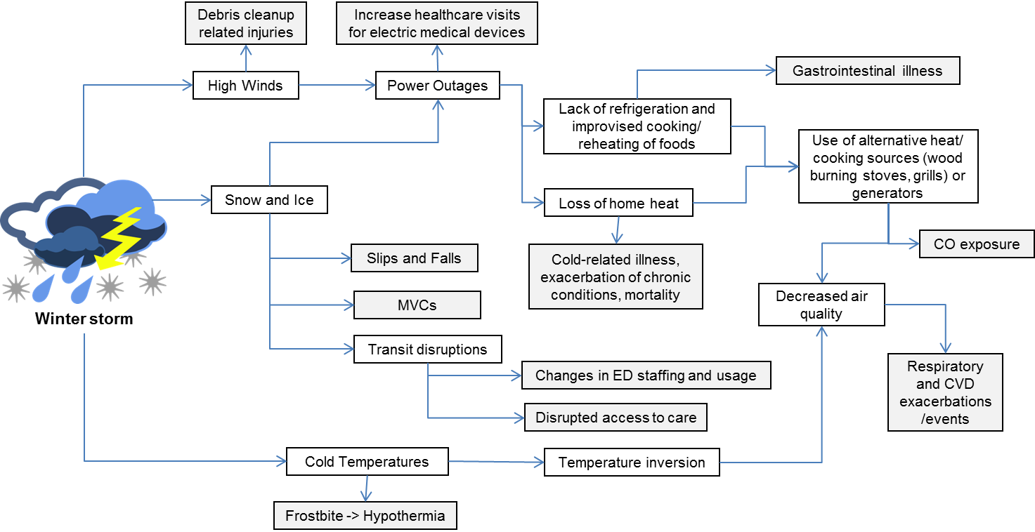
Single event → multiple outcomes
Section I
Notes:
In this figure we can see three potential exposures from a winter storm: [click] High winds, [click] snow and ice, and [click] cold temperatures
Cold temperatures may lead to [click] frostbite or hypothermia which is pretty direct. Snow and Ice can result in [click] power outages which may lead to [click] lack of refrigeration or improvised cooking and reheating methods resulting in [click] gastrointestinal illness.

Slide 9
Identifying an outcome
Section I
Directly related to current/forecasted weather patterns
Related to environmental exposures
Understand/account for multiple outcomes for a single event
How/where/when - health impacts will vary by regions/cities and populations
Notes:
Lastly need to think about the How, where, and when. Health impacts will vary by geographical area and populations or sub-populations. This will play into how you use the results from the SyS or how the outcome is defined. Some areas or populations may be more susceptible to a health outcome – during a heat wave elderly individuals may place a larger burden on emergency medical transports. Shifts in the timing of seasonal outbreaks may impact when the SyS results are used. What is considered an important climate factor may also vary by region. Relying on existing expertise and knowledge will help in identifying what is important in your region. It may also be helpful to talk with similar jurisdictions in your region.

Slide 10
Developing a case definition
Section II
Decide surveillance objective
Definition based on keywords, diagnosis codes, or both
Select the keywords and/or diagnosis codes
Validate and refine
Restriction by other factors
Evaluate the effectiveness
Notes:
Developing a syndrome case definition, this is an iterative process. In this document cases are not confirmed they are generally syndromes based on pre-clinical data – basically visits with symptoms of the surveillance outcome. We have used, in the document, the term case definition or syndrome case definition – synonyms include syndrome definition or classifier.
Before developing the case definition make sure your outcome will be captured in the data source. For instance, people typically do not seek care for a minor cold at the ED.
When developing the definition, the first thing [click] is to decide if the definition will be broad or narrow. A broad definition will have a number of false positives while a narrow definition may not capture all the potential cases. Depending on the use it may not be necessary to capture all cases. A narrow definition that represents the distribution of all cases may be more effective. On other hand – a broad definition may be useful for rare outcomes or for new and emerging diseases where the symptomology is not well understood. Sometimes when developing a definition its good to start broad and then refine.
[click] Definitions can be based on keywords from pre-clinical data – chief complaints reported by the patient or triage notes from the nurses. They may also use diagnosis codes which could be admitting diagnosis (pre-clinical data) or discharge diagnosis which is confirmed by the doctor and lab reports. Discharge diagnosis codes while more accurate will take longer to be received maybe, 48 hours to 2 weeks or longer.
[click] Steps 3-6 we will discuss on the next slides.

Slide 11
Keywords
Section II
Identify based on another jurisdiction
Notes:
Keywords can be identified using a number of different methods…. [click] Base on another jurisdiction – in the guidance document we have provided the case definition for Carbon Monoxide poisoning and for work-relatedness from a number of different states.

Slide 12
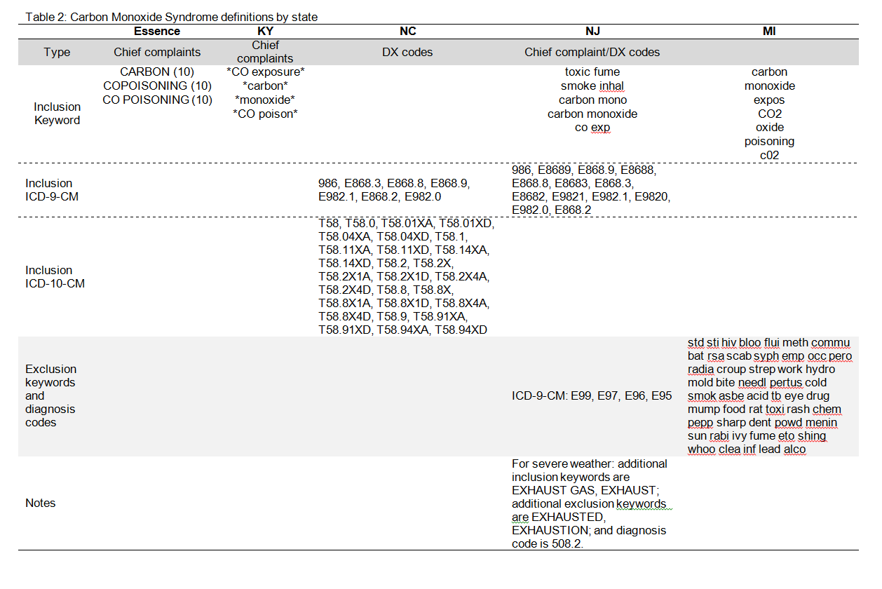
The symbol for wildcard (^ or *) varies by syndromic surveillance system. For ESSENCE a subtotal of ≥6 points are required for a visit to be captured.

Slide 13
Keywords
Section II
Identify based on another jurisdiction
Identify keywords based on diagnosis codes
Identify keywords based on an event
Identify keywords based on an activity
Identify keywords by speaking with partners
Identify keywords by machine learning
Notes:
[Click] The diagnosis code for an outcome may be identified and all records with that diagnosis code pulled. Common keywords are then identified from among those records. Common keywords can be identified, for instance, manually by reading each record or by using a text-mining program.
[click] Keywords can be identified by pulling records related to a particular event such as a heat wave or time period
[click] Keywords can be identified by pulling records related to a particular activity for instance NJ created a case definition to identify injuries to tree workers after a natural disaster, such as those clearing roadways or downed power lines.
[click] Community members, stakeholders, and medical professionals may be able to provide more detailed and granular information for defining keywords or selecting diagnosis codes. Such as keywords in other languages that may be spoken in their community.
[click] Finally, machine learning can be used to create a case definition. The guidance document has a sub-section with step-by-step instructions for conducting simple machine learning.
In general, if starting with a broad definition, the definition can be refined with the addition of exclusion terms or common misspellings. For instance, including CO2 in a carbon monoxide poisoning definition.

Slide 14

Diagnosis codes
Section II
Identify based on another jurisdiction or published papers
Identify by searching the
code manual
*Example only – not an endorsement
Notes:
Just as with keywords diagnosis codes may be selected based on what other jurisdictions have used or on published papers. There do seem to be a larger number of papers with diagnosis codes than with keywords
[click] The ICD-9-CM or ICD-10-CM definitions in the code manual can be searched. However, when doing this one needs to be careful to identify code related to the outcome and exposure – such as hypothermia related to outdoor temperatures versus hypothermia following anesthesia
Diagnosis codes can be found in designated diagnosis fields or as part of the chief complaint or triage notes. If found within the pre-clinical notes these are admitting diagnosis codes and are assigned at patient intake.

Slide 15
Other Factors
Section II
Potentially multiple etiologies (e.g. fire or non-fire related CO poisoning)
Timing (e.g., summer only, event only)
All ED visits
Notes:
Other Factors: There may be multiple etiologies to consider. For instance, fire related carbon monoxide poisoning versus non-fire related carbon monoxide poisoning. During wildfire season it may be appropriate to be looking for fire-related carbon monoxide poisoning while during a winter storm or in the aftermath of a hurricane non-fire related carbon monoxide poisoning due to generator misuse.
[Click] Timing - only using the case definition during the summer or event specific. For instance during the summer the Arizona state health department looks for new vector-borne disease cases twice weekly while in the winter the drop to once a week.
[click] For small populations increases or spikes in an outcome may not be observed. In these situation a case definition that looks for an increase in all ED visits for a sub-population may be appropriate – for instance elementary school children.

Slide 16
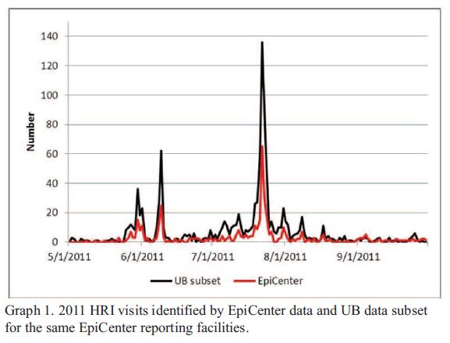
Validate/evaluate effectiveness
Section II
Manual review
Identify a gold standard → calculate performance measures
Temporality
comparison
[Berry 2013]
Notes:
It is important to determine if the case definition is actually capturing the surveillance outcome. [Click] This can be done by manually review all or a random sample of records by reading the pre-clinical notes or doing a medical record review. Counting the number of records identified by each keyword or diagnosis code will provide an idea of which components are important (or not important) to include in the final case definition.
[click] A gold standard may be identified such as using discharge diagnosis codes, and calculating various performance measures such as sensitivity, specificity or positive predictive value. If discharge diagnosis codes are not available in your syndromic surveillance system the data could be linked with an ED discharge data set. Or another data source could be used, such as a review of medical records for identified syndrome cases could be done.
[click] The syndromic surveillance data may also be compared temporally with another system. In this example, a retrospective analysis, New Jersey graphed daily SyS identified heat-related illness cases in red and the uniformed billing data (discharge data) in black – notice that pattern is similar. Note that if the sensitivity and PPV are low but the temporal distribution is highly correlated the syndrome case definition will still be useful.
Finally, keeping in mind that syndromic surveillance is only part of overall surveillance and has limitations – after the event or time period it is a good idea to examine other data sources such as ED hospitalization or death certificates in order to quantify the limitations of the syndromic surveillance system and potentially understand how the identified syndromic cases fit into the overall surveillance of the outcome.

Slide 17
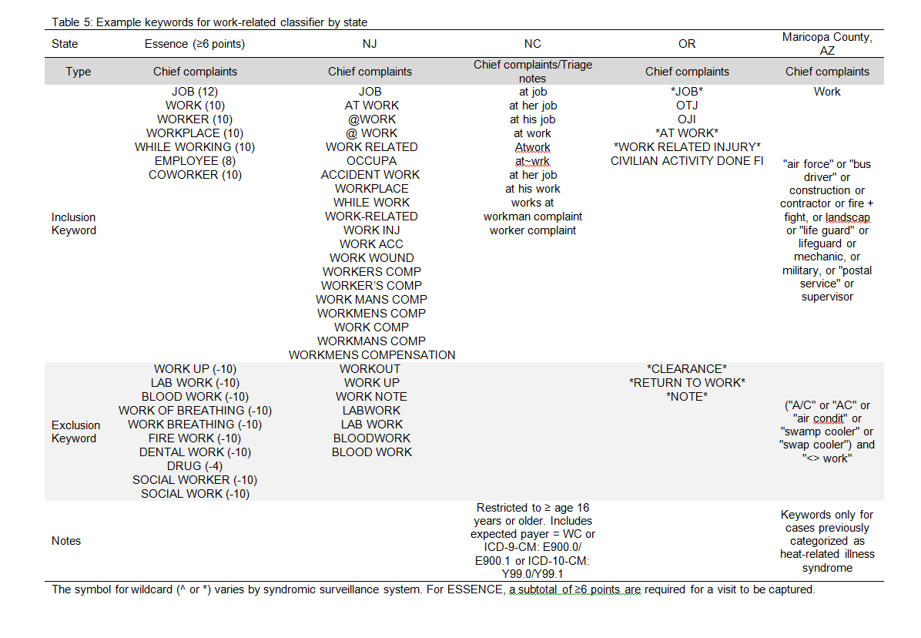
Notes:
In this document we have include a sub-section on creating a work-related case-definition that can be used by itself or in combination with a weather- or climate-related outcome. This was done to because workers may be vulnerable to increased injuries, illness, and death due to climate change and in industries associated with climate adaptation and mitigation efforts. For example workers involved in clean-up or first responders during natural disasters. Or increased exposure to ticks for outdoor workers, including landscapers, oil field and utility workers.
A few states have contributed example keywords to this document.

Slide 18
SyS and Environmental Data
Section III
Identify goal and potential uses of surveillance
Identify the appropriate types of data
Identify data source
Ask permission to use data
Temporally and geographically match the data
Maintain a working relationship with environmental data steward
Demonstrate use
Notes:
Environmental data should be considered valuable “pre-clinical” sources of information for SyS
The specific data will vary based on health outcomes of interest, local availability, and technical ability to incorporate data feeds. Examples of potential sources are: daily meteorological information such as temperature or precipitation data, daily aeroallergen counts, air pollution data, multi-month drought indexes.
Whatever you choose the statistical association between the environmental indicators and health outcomes of interest need to be well-understood. It might help to review existing studies or conduct a retrospective analysis prior to implementing syndromic surveillance.
Start [Click] with identifying the goal and potential uses of surveillance. For instance, if you will be monitoring the outcome on a daily basis then you may need daily environmental data. If you are trying to identify high risk areas for longer term planning – monthly or seasonal data would be fine.
[Click] with identifying the appropriate types of data based on literature, prior work, or consultation with a subject mater expert
[Click] Identify a source for the data, for instance a data steward or an ftp site. [click] Make sure to ask permission to use the data – even with publicly available data accessing the data on a daily basis may be a drain on the data stewards system. Or the data stewards may have an easier way to access the data.
[Click] The data will need to be matched temporally, (that is daily weekly or monthly) to the health data and geographically. For instance, will data from a single weather station be applied to the entire county or the entire state.
[Click] Make sure to maintain a continuous working relationship with the environmental data steward.
[Click] And finally everyone likes know that their data is being used and to see how.

Slide 19
SyS and Environmental Data
Section III
Temporally and geographically match the data
Add environmental data as a new data to SyS
Validate environmental data
Maintain a working relationship with environmental data steward
Demonstrate use
Notes:
There are two additional steps that need to be included for the environmental data to be incorporated directly into the SyS. Work with your syndromic surveillance coordinator to add the data as a new data source. And then validate the environmental data – is it being incorporated properly.

Slide 20
Interpretation and display
Section IV
Case definitions applied to differing geographic levels
Data presented in tabular form, graphs, maps
Stratified by demographic group
Counts, percent of total visits, rates
Notes:
Interpretation and displaying data…
[Click] Case definitions can be applied to different geographic areas – state, county, zipcode. Or it may be useful to apply the definition to a selection. For instance, during hurricane Matthew the GA department of public health reviewed syndrome query results for the four affected public health districts.
[Click] Data may be presented in tabular form, graphs, or maps. This may be internal and created by the SyS or the data may be extracted and reports external to the system created. External summarization and presentation will be more flexible and potentially have a nicer overall design. I will provide some examples in a shortly.
[Click] They may be stratified by demographic groups to provide further information on the populations affected.
[Click] Finally, how should the data be displayed – for instance as counts, percent of total visits, or rates – the latter two allow for some comparability across regions.

Slide 21
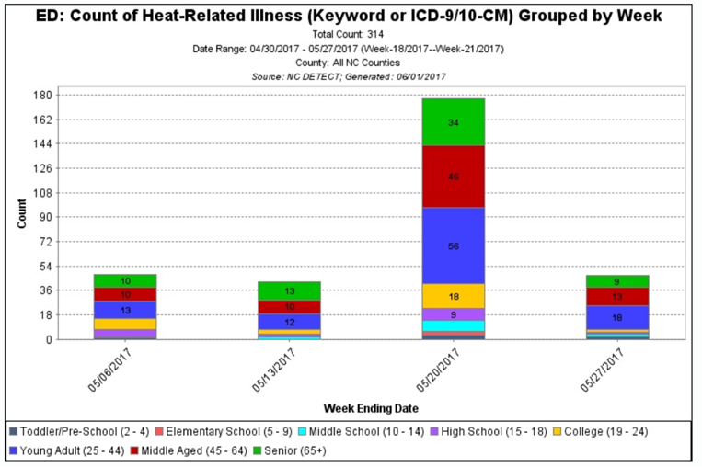
Section IV
Notes:
This graph is available to authorized users of North Carolina’s SyS. It is statewide counts of heat-related illness for the month of May stratified by age group

Slide 22
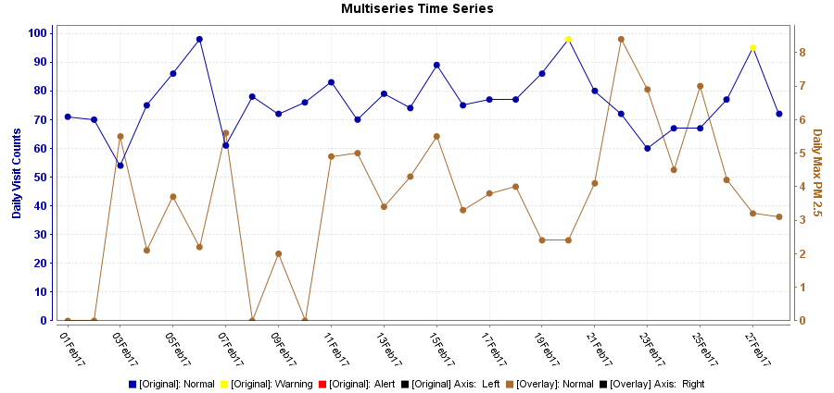
Section IV
Asthma-like Visits from Multnomah County Residents and Portland Air Quality, February 2017
Notes:
This figure is available to authorized users of Oregon SyS. Counts of daily Asthma like visits in February are in blue and Portland air quality data in brown.
Caption: This figure provides an example of quickly visualizing a health outcome of interest with environmental data that is integrated into a syndromic surveillance system. The time series graph below shows asthma-like visits made by Multnomah County residents during February 2017 overlaid with 24-hour maximum PM 2.5 measurements (μg/m3) in from a Portland, OR air quality monitoring station. In Oregon ESSENCE, visit information is collected from emergency departments (EDs) and urgent care centers across the state. Currently, all 60 eligible hospitals are sending ED data every day for syndromic surveillance. Some urgent care centers are currently reporting, including several in the Portland metro area. Air quality data are available from monitors statewide.

Slide 23
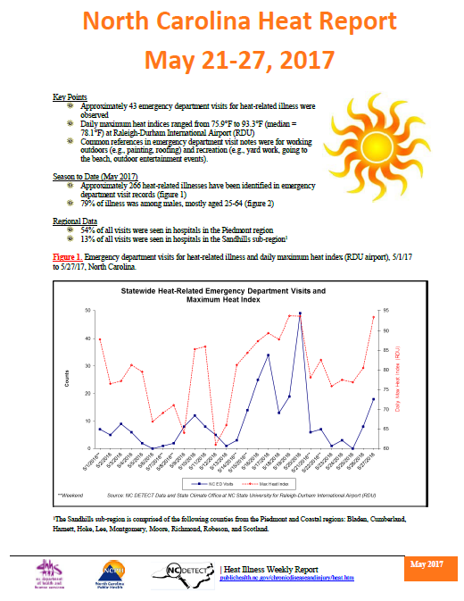
Notes:
Here is example of combining environmental data with syndromic surveillance data. This is page 1 of North Carolina’s Heat report which goes out to stakeholders via email each week during the summer and is available online. The blue line are daily NC heat-related ED visits and the red line is maximum daily heat index.

Slide 24
Identify/engage partners
Section V
Identify partners early
Use your data to identify partners
Expand and build your network
Share your data
Notes:
We all know that to be effective, our work requires partnerships. [Click] When developing projects related to climate and health SyS it is good to identify partners early in the process. These partners may be able to help with choosing the surveillance outcome or developing the case definition.
[click] One of the ways to identify partners may be through finding areas in your state where there a geographic or temporal hots spots of a particular outcome. For instance, heat-related illnesses around an annual marathon. For instance you may be able to partner with city officials or the marathon coordinators. The data may also be used to identify a sub-population of individuals seek care at a particular facility or from a particular local. Working with local partners may help identify what is happening at that particular facility and, if needed, help to develop an intervention. Reviewing the pre-clinical information or obtaining medical records may provide addition information to help in developing interventions. Keep in mind partners may also be found through already established working relationships.
[Click] When developing partnerships think about what you might need – for instance do you need subject matter experts related to the outcome or the exposure? Or do you need community members familiar with the populations and who and how to target interventions. Coalitions often develop from small but expanding networks – make sure to formalize these relationships and provide some structure. Involve the coalition in decision making and accountability.
[Click] It is also important to share data with your partners. This could be done using weekly or monthly reports. For instance, many state health departments send out a weekly heat-related illness report during the summer to their partners. Or during a 2012 winter storm New York City was able to share data with citywide emergency response and public messaging to alert the population about the dangers of living in unheated housing.
There may also be varying levels of partnership. A key partner may be able to provide feedback on how best to present the data while other partners are users or disseminators of the data. Finally, you will have to decide what level of information should be provided to each partner. For instance, some partners may want case specific information while others require aggregated results or simple graphs and figures with quick take-home messages. Part of this will depend on the level of data accessibility for each entity and your organizations data sharing rules.
Finally, there may be limitations on how your organizations works with partners or how much time and resources you are willing to invest.

Slide 25
Conclusion: Guidance Document
Initial steps to develop and expand surveillance of weather- and climate-related health outcomes
Chock full of examples and references
Notes:
While syndromic surveillance does not replace traditional epidemiologic surveillance it can be a valuable part of overall surveillance. This guide provides initial steps to develop and expand surveillance of weather- and climate related health outcomes. It is chock full of examples and references and I am very excited about it. We don’t have an official timeline when the document will become available. Hopefully near the beginning of August. The document is currently being routed in the authors states and CSTE. But in the mean time, to get you started, these resources are available

Slide 26
References
Berry M, Fagliano J, Tsai S, McGreevy K, Walsh A, Hamby T. Evaluation of Heat-related Illness Surveillance Based on Chief Complaint Data from New Jersey Hospital Emergency Rooms. Online Journal of Public Health Informatics. 04/04 2013;5(1):e125.
Moulton AD, Schramm PJ. Climate Change and Public Health Surveillance: Toward a Comprehensive Strategy. J Public Health Manag Pract. 2017 Feb 6.

Slide 27
Currently available resources
Heat-related illness syndrome query: a guidance document for implementing heat-related illness syndromic surveillance in public health practice (http://www.cste.org/group/ClimateChange)
Utilizing syndromic surveillance systems for climate-related outcomes (CSTE Webinar Library: http://www.cste.org/?page=WebinarLibrary)
Notes:
Resources created by the prior workgroup

Slide 28
Laurel Harduar Morano, PhD
  International Society for Disease Surveillance
  onarom.lh@gmail.com
  ISDS website: www.healthsurveillance.org
  Thank you to CSTE for funding this project!
Notes:
Thank you to CSTE for funding this project.

