Slide 1
Communities of Practice:
Advancing the Practice of Surveillance
Thursday, August 23, 2018
Public Health Informatics Conference
Atlanta, GA
Catherine Tong, MPH
Program Coordinator,
ISDS
Shandy Dearth, MPH
Executive Director,
ISDS
Notes:
1 – 2 min
Cat
Welcome to this 60-minute sharing session where we’ll be sharing our experiences at ISDS with setting up and managing communities of practice. We will focus specifically on the National Syndromic Surveillance Program Community of Practice but we hope today’s discussion can translate to the work you all are doing in your own CoPs.

Slide 2
To start…
What is a Community of Practice?
Notes:
2 min
Cat
Ask the audience! Who knows what a CoP is?

Slide 3
Agenda
Overview of the Community of Practice
National Syndromic Surveillance Community of Practice (NSSP CoP) Accomplishments
Stories of the CoP in Action
Next Steps for Engagement
Notes:
<1 min
1 & 2: Cat
3 & 4: Shandy

Slide 4
What is a CoP?
A Community of Practice (CoP) is defined as “a group of people who share a concern, a set of problems, or a passion about a topic, and who deepen their knowledge and expertise by interacting on an ongoing basis.¹”
Source: Wenger, Etienne, McDermott, Richard, Snyder, William M. Cultivating Communities of Practice. Harvard Business School Press. Boston, MA. 2002.
Notes:
2-3 min
Cat
Source: Wenger, Etienne, McDermott, Richard, Snyder, William M. Cultivating Communities of Practice. Harvard Business School Press. Boston, MA. 2002.

Slide 5
What is a CoP?
The three distinct elements that comprise a CoP are:
A community that enables interaction (such as discussions, collaborative activities, and relationship building);
A shared domain of interest (such as syndromic surveillance);
A shared practice of experiences, stories, tools, and ways of addressing recurring problems
This approach enables public health professionals to grow and mature while focusing on efforts to share knowledge and solve problems.
Source: Wenger, Etienne, McDermott, Richard, Snyder, William M. Cultivating Communities of Practice. Harvard Business School Press. Boston, MA. 2002.
Notes:
2-3 min
Cat
Source: Wenger, Etienne, McDermott, Richard, Snyder, William M. Cultivating Communities of Practice. Harvard Business School Press. Boston, MA. 2002.

Slide 6
NSSP
Community of Practice
MISSION
The National Syndromic Surveillance Program Community of Practice (NSSP CoP) serves the needs and interests of the Syndromic Surveillance (SyS) community through leveraging the expertise and resources of its members and strengthens health surveillance capabilities nationwide by advancing SyS practice and the utilization of SyS platforms (including the NSSP BioSense Platform).
Source: NSSP Community of Practice Charter located on www.healthsurveillance.org/NSSPCOP under “Mission, Vision, Goals”
Notes:
1 min
Cat

Slide 7
NSSP
Community of Practice
VISION
Increased availability of SyS training, learning and knowledge-sharing events for SyS community members
Confidence and trust among community members in the utility of SyS data
Increased sharing of SyS data among community members (where appropriate and state/local laws allow)
Common strategies, products, and best practices to mitigate or to address the identified obstacles with cross-jurisdictional data sharing
Source: NSSP Community of Practice Charter located on www.healthsurveillance.org/NSSPCOP under “Mission, Vision, Goals”
Notes:
1 min
Cat

Slide 8
ISDS and the NSSP
Community of Practice
The ISDS collaboration with the NSSP is designed to build on the existing community of practice, strengthen surveillance infrastructure, and support the needs of the surveillance community by fostering collaboration among organizations and across sectors through multiple mechanisms.
Project Title: National Syndromic Surveillance Program Community of Practice (NSSP-CoP): Strengthening Health Surveillance Capabilities Nationwide
Cooperative Agreement #5 NU50OE000098-02-00
Notes:
1 min
Cat

Slide 9
Why should surveillance practitioners participate?
access to experts across the nation—including CDC and syndromic surveillance grantees, partners, and stakeholders
increased capacity to conduct syndromic surveillance through enhanced coordination across jurisdictions and organizations
versatile forums for solving problems and sharing solutions
established mechanism for receiving technical assistance
more efficient use of resources through collaborative efforts
peer-to-peer mentoring
access to a curated repository of syndromic surveillance tools and resources
shared success stories and lessons learned
Notes:
1 – 2 min
Cat

Slide 10
Discussion
What are your reasons for participating in a Community of Practice?
Notes:
5 min
Cat
Doesn’t have to be the NSSP CoP. Please state which CoP you are currently a member of.
If get question about what other CoP’s, say large network of groups that provide a platform for members to share ideas and related issues.
***Where Amy chimes in***
FOLLOW-UP QUESTIONS:
- What value do you find with participating in a CoP?
- If you wanted to participate in a CoP, what would be the reason?

Slide 11
NSSP
Community of Practice
Notes:
2 min
Cat
Overview of Groups
ISDS time is used to support the two user groups we have: the R Group and ESSENCE User Group.
This first version of the graphic was recently created
Colored are supported by NSSP resources
All groups are encouraged
Doesn’t show all collaborations
But shows all working groups that people can participate in

Slide 12
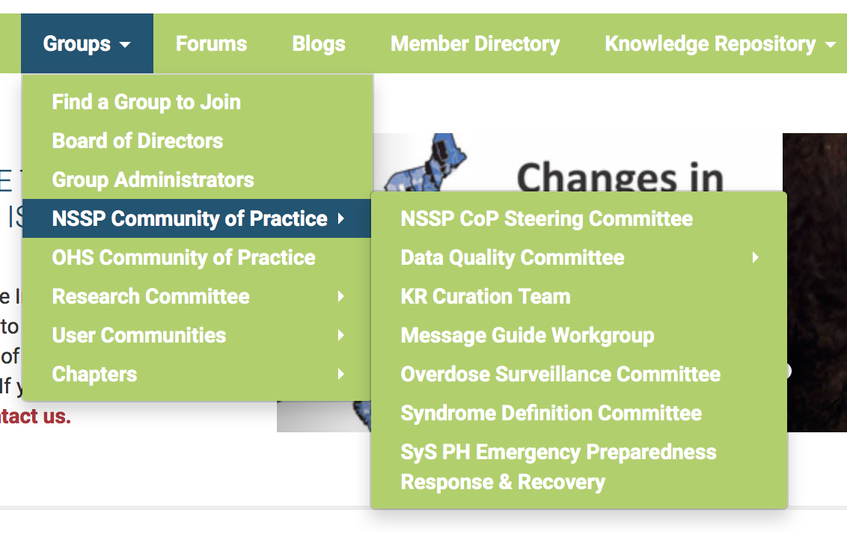
How do you join the NSSP CoP?
Register for a free account on www.healthsurveillance.org
Join the NSSP
Community of
Practice Group
(www.healthsurveillance.org/NSSPCOP)
Notes:
Cat

Slide 13

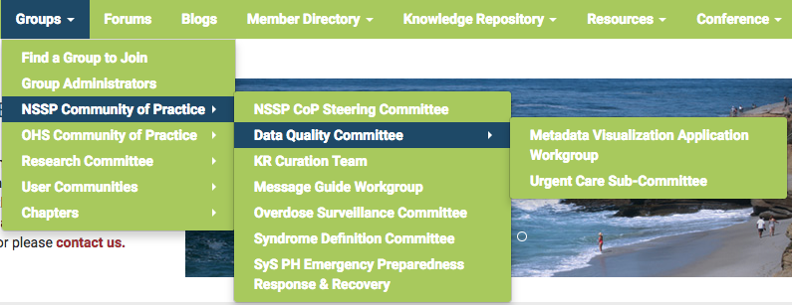

NSSP CoP Accomplishments
379 Members
6 Committees
1 Sub-Committee
3 Workgroups
139 Group and Community of Practice Calls
Notes:
2 min
Cat
Started with members in surveillance around the country but we didn’t have funding specifically to form and grow the group. This was already an organic group.
Additionally, we offer a community forum as well as forums within groups for further discussions. We track these posts as a metric for engagement.
NOTE: 139 calls since the beginning of the CoP
Received the CoAg two years ago

Slide 14
NSSP CoP Accomplishments
Knowledge Sharing
Events
Webinars
  Opioid Surveillance Webinar Series
  Public Health Data and the Law
  Update on Digital Bridge Electronic Case Reporting
  Virtual Speed Networking Event with the Analytic Solutions Committee
Trainings
R Group for Biosurveillance calls
ESSENCE Trainings and Q & A’s
What is a success story and how do I write one?
NSSP’s Master Facility Table (MFT) Module Overview
Collaboration
Urgent Care Justification Workgroup (now Sub-Committee) and the Literature Review Sub-Committee for a conference abstract
Metadata Visualization Application Workgroup and the R Group for Biosurveillance for a proof of concept tool on visualizing data quality and EHR vendor information across jurisdictions
Notes:
3 min
Cat
CoP members were also invited to attend a number of knowledge sharing events and trainings. Some webinars of relevance to our members (and I’m only listing a few) include:
The opioid surveillance webinar series presented June-July 2017
Had a session on Public Health Data and the Law presented April 2017
Update on Digital Bridge Electronic Case Reporting (eCR) Project presented July 2018 by PHII
A Virtual Speed Networking Event with the Analytic Solutions Committee held in January 2018
We’ve also had trainings of relevance for our CoP members including:
Regular R Group for Biosurveillance beginner and intermediate webinars, held monthly
ESSENCE Trainings and Q&A sessions, led by the ESSENCE lead at Johns Hopkins and NSSP team
A success story training presented in March earlier this year
An overview of the new MFT module presented by the CDC Analytic Data Management team
There have also been collaborative projects between groups within the CoP and groups outside of the community. For instance:
We had a Urgent Care Justification workgroup (before it became a Sub-Committee) that worked with our Research Committee’s Literature Review Sub-Committee to find current articles on urgent care data to inform their case for the importance.using urgent care data. Their findings in the literature was summarized in an abstract and presented at our recent ISDS conference. We’ll hear more about their work later.
Recently, the Metadata Visualization Application Workgroup created an application as part of a proof of concept tool containing jurisdiction specific information on Electronic Health Record (EHR) vendors, EHR vendor products, aggregate data quality metrics(timeliness, validity and completeness), and facility types participating in syndromic surveillance. The goal of the tool was that jurisdictions could use to help us connect and collaborate to: resolve issues in our work with EHR vendors, share best practices regarding work with different facility types including data quality success stories and challenges. The application was developed in RStudio Professional as a Shared Project Shiny app, and so some members of the R Group were recruited for the project.

Slide 15
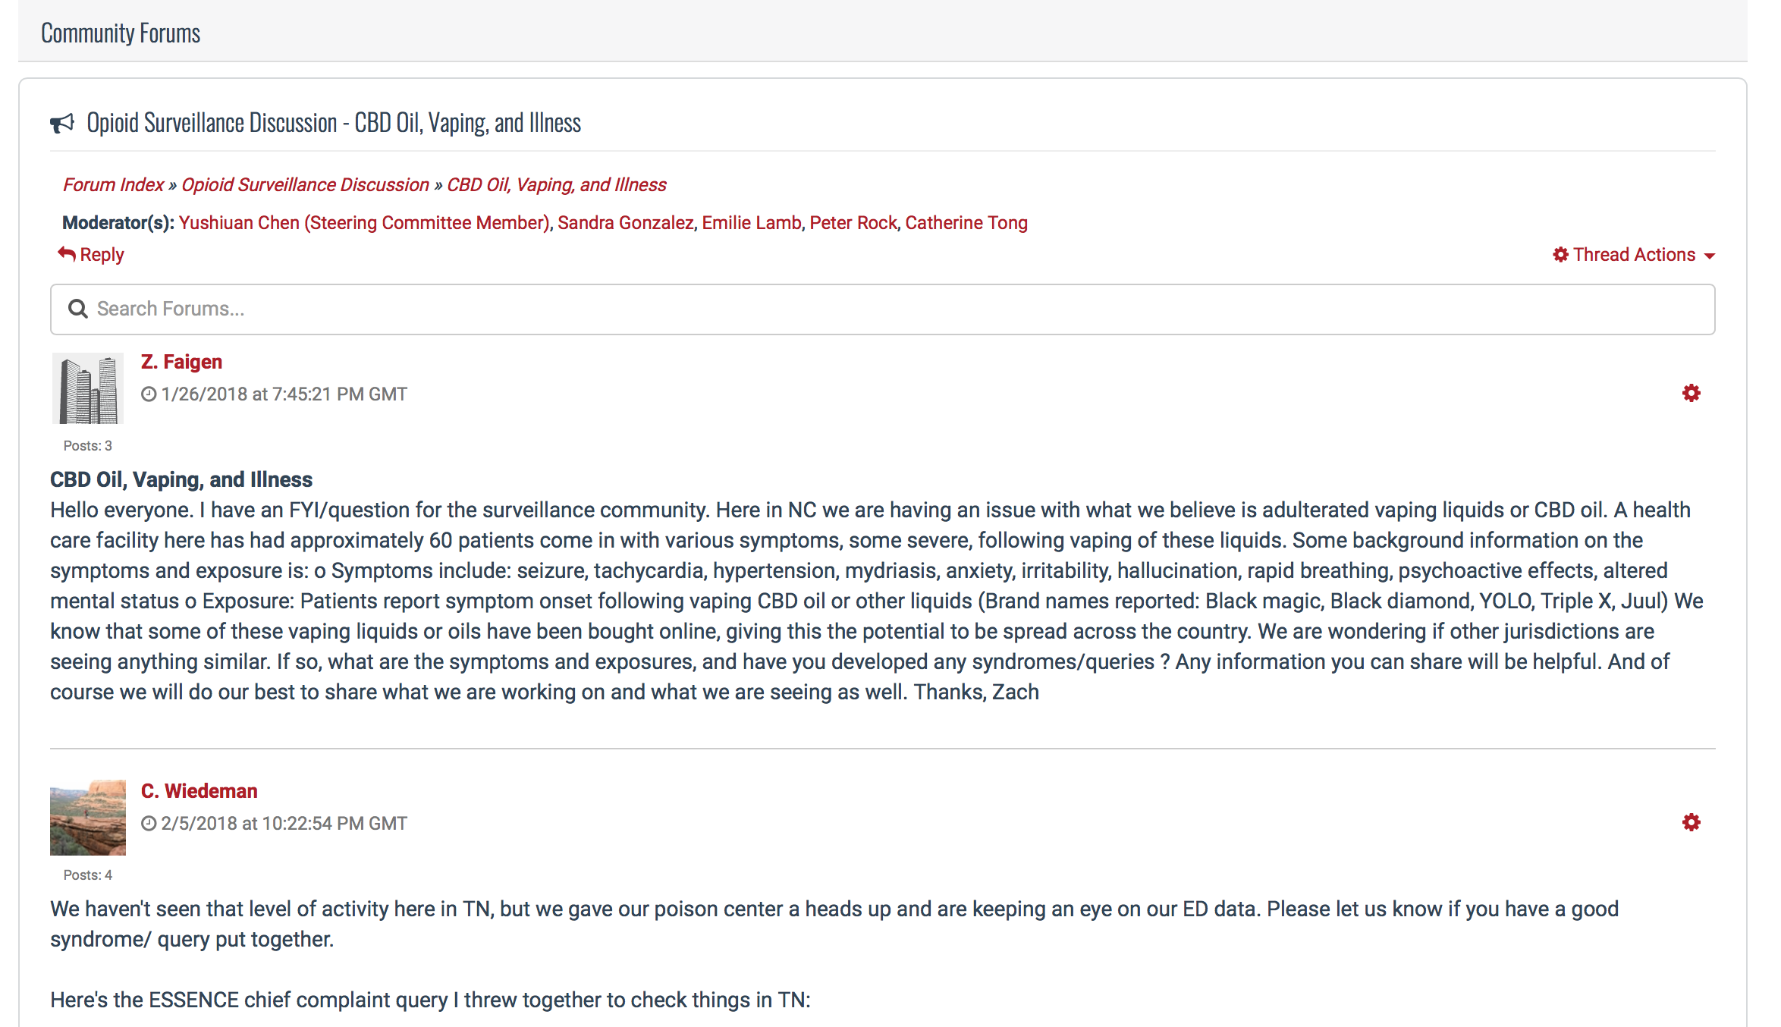
NSSP CoP Tools
Virtual meeting space and tools on www.healthsurveillance.org
  Community & Group Calendars
  Member
  Directory
  Forums
  Shared
  Documents
  Latest News
  Messaging
Notes:
3-4 min
Cat
To help build up the CoP, we built up our website
If have time, demo and focus on:
Community Calendar
Member Directory

Slide 16
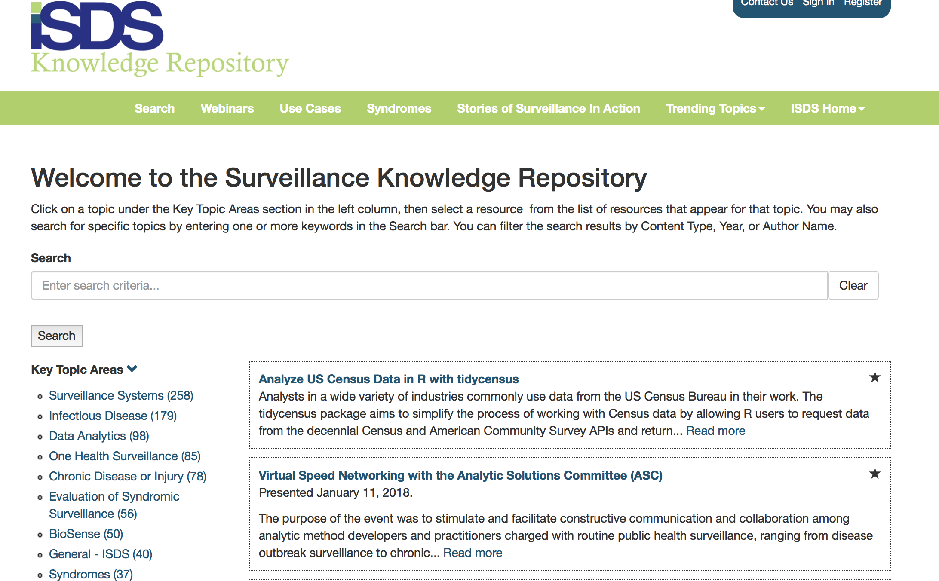
NSSP CoP Tools
Surveillance Knowledge Repository (KR) (www.surveillancerepository.org)
  Webinars
  Use Cases
  Syndrome
  Definitions
  Stories of
  Surveillance
  in Action
Notes:
5-8 min
Cat
The KR has thousands of resources! You can find all our past conference abstracts.
Demonstration of the KR, including the different libraries within the KR, follows this slide.
NOTE: remember you need sign in to access the syndrome and success story submission forms
Username: stest
Password: password

Slide 17
NSSP CoP: Beyond the Tools,
Stories of the CoP in Action
Arizona
  Collaborated through participation in the Data Quality Committee with partners in Alabama, Ohio, North Dakota, NSSP team
  Identified reporting inconsistencies among vendor partner
  Shared option to lengthen chief complaint character limit with vendor assistance
  Able to improve quality of data for syndromes used in BioSense Platform and surveillance practice
Notes:
2 min
Shandy

Slide 18
NSSP CoP: Beyond the Tools,
Stories of the CoP in Action
New Jersey
  Built improved notification pathways following an exposure investigation that was assisted by the NSSP team
  Highlighted the increased utility of using the state’s system and the additional tools in BioSense
  Established new alerts in BioSense to get a broader picture of trends and patterns
Title in the Knowledge Repository: Two Unique Syndromic Surveillance Systems: State and Federal Collaboration to Identify Spike in “Visits of Interest”
Notes:
2 min
Shandy

Slide 19
NSSP CoP: Beyond the Tools,
Stories of the CoP in Action
- New Hampshire
  Suggested developing formal justification for onboarding SyS urgent care clinic data in ISDS CoP Presentation
    Validated this shared need with the NSSP CoP
  Lead Urgent Care (UC) Justification Workgroup, which formed to develop
    (1) The justification, (2) syndromic surveillance talking points, (3) strategy for creating a jurisdictional UC facility listing, and (4) best practices for onboarding SyS UC facilities
Notes:
2 min
Shandy
This was mentioned earlier during the point about collaboration between groups.

Slide 20
NSSP CoP: Beyond the Tools,
Stories of the CoP in Action
New Hampshire cont.
  The Workgroup presented and validated these documents at the 2018 ISDS Annual Conference
  The group is now the UC Sub-Committee (based on continued interest), which meets quarterly
Abstract in the Knowledge Repository: Justification for Collecting Urgent Care Data to Broaden Syndromic Surveillance
Notes:
1 min
Shandy

Slide 21
NSSP CoP: Beyond the Tools,
Stories of the CoP in Action
Other highlights
  Data Quality Committee
    Continues to invite EHR vendors to participate in monthly calls
  Syndrome Definition Committee
    Developed a Self-harm and Suicide-related syndrome that’s now in the Knowledge Repository
    Creating a guide for developing a syndrome that multiple jurisdictions can use
  Metadata Visualization Application Workgroup
    Developed an application to visualize information on EHR vendors, products, data quality metrics and facility types using RStudio Professional
    Created a Standard Vendor Mapping list
Notes:
4 min
Shandy
The Data Quality Committee continues to invite EHR vendors such as EPIC and Cerner to participate in its monthly calls for members to learn more about their products and ask them questions about any issues facilities are reporting or the public health department is facing.
The Syndrome Definition Committee just finished creating a self-harm and suicide-related syndrome that can be used by any jurisdiction. The syndrome is now in the KR and has been tested by at least one state (Washington). The Committee is now working on developing a guide for developing a syndrome that can be used by multiple jurisdictions. They’ve documented their process for developing the suicide-related syndrome. In September and October, during the next two monthly NSSP CoP calls, you’ll have the opportunity to hear more about their work.
The MVA developed an interactive Shiny App in R that can be shared with jurisdictions to resolve common data quality problems. You can also use the example that the Standard Vendor Mapping project produced a list of the top 20 Electronic Health Record Vendor names that has been adopted and implemented as drop down list in the BioSense Platform's Master Facility Table Making the process easier to enter and share with NSSP for the onboarding process as well as providing another tool for jurisdictions to analyze and assess their data quality.

Slide 22
Discussion
What stories do you have to share of your Community of Practice in action?
Notes:
10 min
Shandy
FOLLOW UP QUESTIONS:
- Lessons learned from your CoP in action?

Slide 23

Next Steps
Upcoming Knowledge Sharing Events and Trainings
  ESSENCE Q & A
  “Building a Community of Practice” webinar
  Gun violence surveillance webinar
  Mortality surveillance webinar
  Monthly R Group calls
  Monthly NSSP CoP calls
Implementation Guide for Syndromic Surveillance
  The Message Guide Workgroup is currently reconciling comments from the first HL7 balloting period
  Publication of the Guide as a Standard for Trial Use is expected by the end of the year
Source: HL7 2.5.1 Implementation Guide for Syndromic Surveillance, Release 1 located on the Message Guide Workgroup homepage (https://www.healthsurveillance.org/group/MGWG)
Notes:
3 min
Shandy
There is an ESSENCE Q&A scheduled for September 11.
We also have a webinar on “Building a CoP” that’ll be presented by Deborah Gould, our project office at CDC, on September 27.
Some more upcoming webinars our CoP members can look forward to are:
A gun violence surveillance webinar and a mortality surveillance webinar in October
Monthly R group calls, including tutorials from Rstudio, R Hangouts for Beginners and a presentation on using R to track opioid overdoses (this will be in November)
Monthly CoP calls – in September and October, the Syndrome Definition Committee will be presenting on their work on the self-harm and suicide-related syndrome
We encourage all of you to check out our Community Calendar for upcoming events that could interest you! https://www.healthsurveillance.org/events/event_list.asp
CoP members were recruited to develop an updated implementation guide for syndromic surveillance. This became the Message Guide Workgroup.
Reconciling comments at the moment
STU to be expected by end of year

Slide 24
Next Steps
Improving member engagement
  Helping to facilitate mentee/mentor relationships
    Areas of Expertise search within the Member Directory
    Expert panels
    Networking events/opportunities at the ISDS Annual Conference
  Enhancing member experience with the tools already built
    Improved search in the Knowledge Repository
    More participatory events/webinars
    Forum engagement recognition
Notes:
3 min
Shandy

Slide 25
Next Steps
Improving member engagement cont.
  Supporting Group Leaders
    Engagement performance reports
    Guidance Documents
Notes:
3 min
Shandy
In addition to monthly newsletters that we produce and our monthly email reminders to groups, we have developed engagement reports to help track group performances in terms of website usage, call attendance, and member interaction. We have also developed guidance documents to help Group Chairs transition to their roles in leading and managing groups within the community. These reports and guides will continue to be updated.

Slide 26
Discussion
Where else in your health departments/agencies do you see a need for a Community of Practice?
Notes:
5 min
Shandy

Slide 27
Additional References
Communities of Practice References:
https://www.cdc.gov/phcommunities/resourcekit/references.html
Facilitation Guide References: https://www.cdc.gov/phcommunities/resourcekit/resources.html
Advanced Facilitation Guide
Facilitation Distributed Groups
Facilitation Tip Sheet
Notes:
Cat

Slide 28

2019 ISDS Annual Conference
Harnessing Data Science to Improve Population Health and Public Health Surveillance
January 29 – February 1, 2019
Marriott San Diego Mission Valley, San Diego, California
Abstract Submission Deadline: September 14, 2018
Early Registration Deadline: December 21, 2018
http://www.healthsurveillance.org/?page=conference #ISDS19 #ISDSOH19
Notes:
Cat
http://www.healthsurveillance.org/?page=conference
Come to our conference to see more examples of the Community in Practice in use!
If you would like to meet our NSSP CoP members, the groups and their group representatives, we invite you to attend our 2019 ISDS Conference in sunny San Diego, CA next year from January 29 – February 1, 2019! The abstract submission deadline is September 14 at 11:59 pm ET and the early registration deadline before rates go up is December 21, 2018. You can find all this information on our conference pages on our website through the link presented in front of you. We also encourage you to book your hotel rooms sooner than later. The link is also live on our website now. Furthermore, for students, we offer a scholarship through our Awards for Outstanding Student or Post-Degree Abstract. Two students would be awarded free conference registration, two nights at the host hotel and an opportunity to present an oral at our conference. Up to ten additional students would be eligible for 50% off their conference registrations. They must an abstract by September 14 and then a short application by October 12, 2018.

Slide 29
Contact Information
Catherine Tong
Program Coordinator
ISDS
ctong@syndromic.org
Shandy Dearth
Executive Director
ISDS
sdearth@syndromic.org
ISDS Websites
www.healthsurveillance.org (main)
www.surveillancerepository.org (Knowledge Repository)
Notes:
Cat
Happy to give out business cards
What questions do you have for us? Regarding our experience setting up and managing a Community of Practice?
How did you go about recruiting people to join the CoP?
We already had existing networks of syndromic surveillance practitioners who were looking for a structured and formal platform to raise syndromic surveillance concerns and share best practices.
Other than member engagement, what else is ISDS planning to focus on to help the CoP grow?
Based on the satisfaction survey results, we know that member engagement is our lowest hanging fruit. However, we have already built a number of new tools but we feel that we have not fine-tuned or used each tool to its fullest potential. For instance, though we’ve set up a success story library, we understand that there are numerous barriers to getting people to take the time to submit a success story. These are ongoing challenges, but we would like to explore our system’s existing potential to see what else we can do to help the CoP grow. (btw, I just made this up… Shandy, please feel free to replace!)
Why do you think the NSSP CoP hasn’t been as engaging as hoped?
The metrics don’t accurately reflect what we’ve accomplished over the short period of a just a year and a half. Before the CoP, there were fewer groups, a forum space that had fallen off the radar from disuse, no structure and governance of the groups, and certainly no tools catered towards syndromic surveillance practitioners. Members also had to email us if they wanted to find out who had expertise in certain fields and or simply wanted to connect with another member. We’ve reduced a number of technical and broader barriers to engaging with other members of the CoP.
However, we did ask a subset of members a similar question when we sent out the satisfaction survey – what is preventing you from engaging? The short answer is that most people simply don’t have time. Actively participating in the CoP is secondary to their work. Also, we know that we regularly have a flux of syndromic surveillance epidemiologist at health departments. So are membership is constantly changing and onboarding members takes time to build the connections necessary for a robust community.

