Slide 1
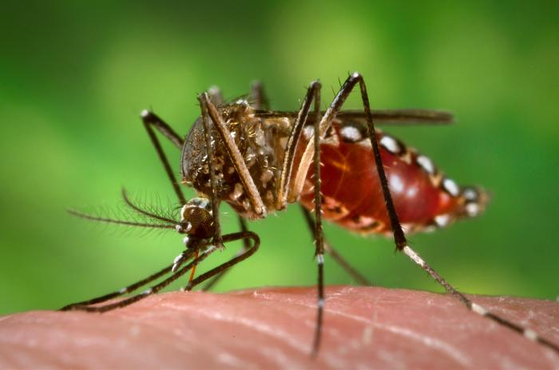
Arizona Consultancy
Analytic Solutions for
Real-Time Biosurveillance:
Assessing Risk for
Emerging Arboviral Disease
Sara Imholte Johnston
ISDS Pre-Conference
December 6, 2016

Slide 2
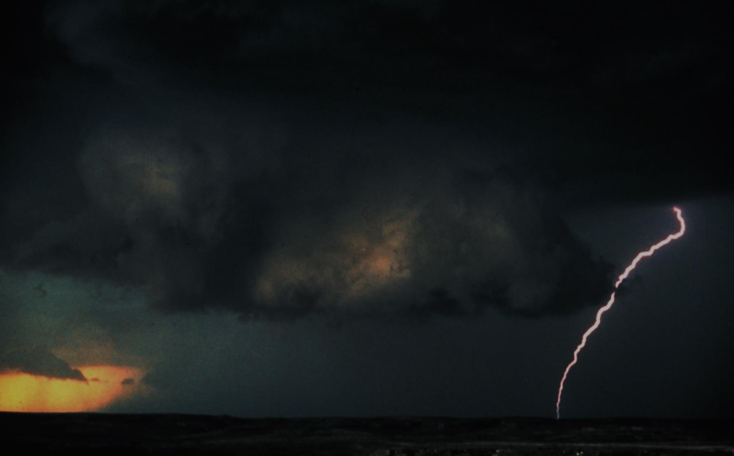
The Problem
Conditions are right
  Travel associated cases (air and land travel)
  Aedes egypti around the state
Need to understand risk,
and focus preventive actions
Notes:
Identifying the areas in Arizona at highest risk for developing locally acquired cases is critical to facilitate rapid response, strengthen public health actions, and reduce the risk of additional disease spread.
This Wikipedia and Wikimedia Commons image/multimedia is from the user Holek and is freely available at //commons.wikimedia.org/wiki/File:Wall_cloud_with_lightning_-_NOAA_-_rotated.jpg under the creative commons cc-by-sa 2.5 Poland license.

Slide 3

The Goal
Integrate laboratory, demographic, syndromic, vector, and climate data into a map
to better understand the areas at greatest risk for importation and local transmission of dengue, chikungunya or Zika viruses
to determine when and where to implement
public health response
actions.
Notes:
<a href="http://www.public-domain-image.com/free-images/nature-landscapes/rain/raindrops-on-water" title="Raindrops on water">Raindrops on water</a>

Slide 4
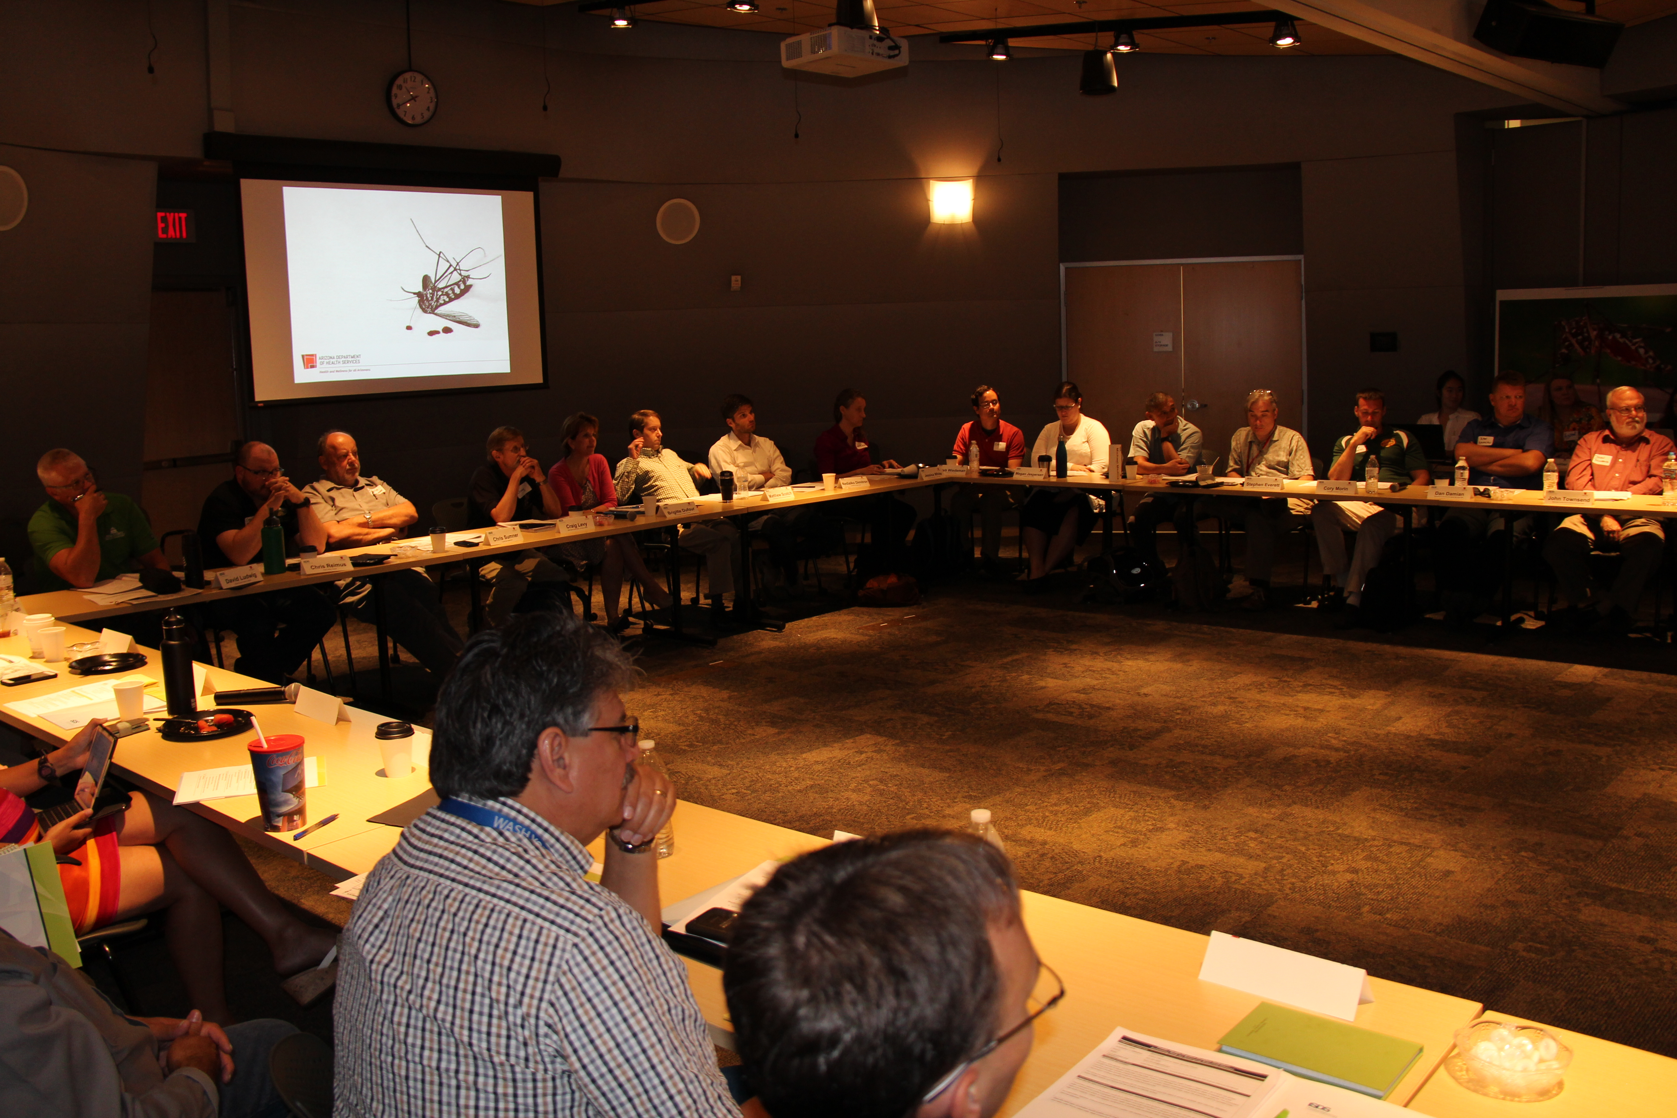
The Group
State and local public health
Local vector control
Academic and research partners from AZ and across the country with experience modeling arboviral disease
ISDS and Defense Threat Reduction Agency (DTRA)
Notes:
<a href="http://www.public-domain-image.com/free-images/nature-landscapes/rain/raindrops-on-water" title="Raindrops on water">Raindrops on water</a>

Slide 5
Guidelines for Evaluating
Surveillance Systems
CDC Morbidity and Mortality Weekly Report; May 6, 1988
And
Updated Guidelines for Evaluating Public Health Surveillance Systems
CDC Morbidity and Mortality Weekly Report; July 27, 2001
Notes:
http://www.cdc.gov/mmwr/preview/mmwrhtml/00001769.htm

Slide 6

Simplicity
In structure and ease of operation
As simple as possible while still meeting objectives
Notes:
Getting data in
Display of information easy to understand for occasional users
https://pixabay.com/en/lisianthus-flower-blossom-bloom-1402830/

Slide 7
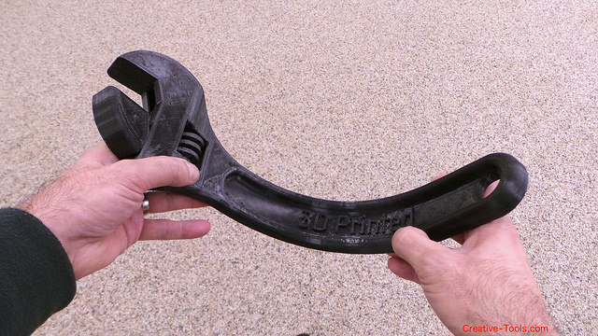
Flexibility
Adapt to changing information needs or operating conditions with little additional time, personnel, or allocated funds.
Can accommodate, for example:
  new health-related events
  changes in case definitions or technology
  variations in funding
  variations in reporting sources
Notes:
Useful in different circumstances: imported cases, initial local transmission, sustained local transmission.
CC BY 2.0 Creative Tools

Slide 8

Data Quality
Data quality reflects the completeness and validity of the data recorded in the public health surveillance system.
Notes:
Give and take – fast but not necessarily complete

Slide 9

Acceptability
Reflects the willingness of individuals and organizations to participate in the system
Notes:
Meets their needs at the local level
Easy to use
Buy in up front since it is an added task for busy staff
CC BY 2.0 Arthur Caranta

Slide 10

Sensitivity
The proportion of cases of a disease (or other health-related event) detected by the surveillance system
The ability to detect outbreaks, including the ability to monitor changes in the number of cases over time
Notes:
Sensitivity changes with disease (won’t catch all Zika cases since many are asymptomatic)
Difficult to determine sensitivity since no local transmission currently
https://pixabay.com/en/chart-graph-icon-red-stocks-up-1296049/

Slide 11

Predictive Value Positive
The proportion of reported cases that actually have the health-related event under surveillance.
Notes:
Difficult to determine since no local transmission currently
May be a trade off between fast information and accurate information

Slide 12
Representativeness
Accurately describes
  the occurrence of a health event over time
  its distribution in the population by place and person
Notes:
Difficult to know since no local transmission currently. Need to be able to detect cases as accurately as possible.
For mosquito risk, many counties don’t have complete data. Model will likely work better in places with more mosquito and other data.

Slide 13

Timeliness
Timeliness reflects the speed or delay between steps in a surveillance system.
Notes:
Important component, but only as fast as the different data feeds that go into it.
CC BY 2.0 Ava Verino

Slide 14

Stability
Reliability (the ability to collect, manage, and provide data properly without failure)
Availability (the ability to be operational when it is needed)
Notes:
Should have very little “down-time”
Pulling in the data from multiple sources may be the biggest issue

Slide 15

Notes:
CC BY-NC-SA 2.0 t.klick

Slide 16
Takeaways
New partnerships
  Help fill gaps in knowledge of modeling and weather data
  Opportunities for future funding/projects
Including local PH and vector control ensured real needs were communicated
Academic/research partners had better understanding of PH needs and limitations

Slide 17
The Outcome… so far
New partnerships, new potential opportunities
  ADHS letters of support for grant applications by research partners
  Assistance with understanding and pulling weather data for an unrelated project
  Assistance with pulling weather shape files for mapping

Slide 18
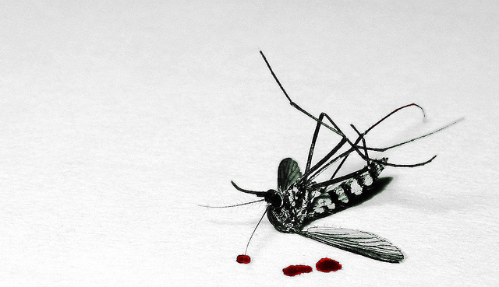
Conclusions
Public health, vector control and researchers have different needs and limitations
Funding (and time to obtain it/spend it) is a driving factor for everyone
Partnerships are key to filling gaps with real expertise

Slide 19
THANK YOU
Sara.Imholte@azdhs.gov
azhealth.gov
@azdhs
facebook.com/azdhs
Special Thanks to ISDS and DTRA

