Slide 1
Using R shiny to Share Surveillance Data
Kelley Bemis
R Group for Biosurveillance
November 21, 2017

Slide 2
Agenda
Why we’re using a shiny app
How we built the shiny app
Code

Slide 3
Seasonal Influenza Surveillance
Monitor influenza activity year round
Produce weekly surveillance reports from October (Week 40) to May (Week 20)
Disseminated to hospitals, long-term care facilities, laboratories, schools, etc.

Slide 4
Uses for Surveillance Data
Situational awareness
Ordering supplies (test kits, etc.)
Prescribing antivirals
Increased public messaging and signage
Implementing temporary visitor restrictions

Slide 5
Traditional Reporting
Create a picture from several data sources, including:
  Emergency room visits → % of ED visits for ILI
  Sentinel laboratories → % of specimens positive for flu
  ICU hospitalizations → # of cases associated with flu
  Mortality data → % of deaths associated with flu
Notes:
Local ESSENCE instance

Slide 6
Traditional Reporting
Data stored in excel spreadsheets
Excel graphs pasted into a Word document
Saved as a PDF and emailed to our flu listserv on Fridays
Posted on CCDPH website

Slide 9
Limitations
Graphs are small, difficult to see exact data points
Limited in the amount of historical data displayed
Cannot customize or extract data
Difficult to access online
No room for spatial data

Slide 10
Solution
Create an online application!
But how…?

Slide 11

shiny Steps In
Started learning R in January
Started shiny tutorials in late July
App deployed on October 13th
  Emailed to flu listserv (~180 people)
  Posted link on CCDPH website

Slide 12
Feedback so far…
Google analytics: 179 sessions from 105 unique people (as of 11/20/17)
In person meeting with ~30 infection preventionists and LTCF staff: all reported they have used or will use the app this flu season

Slide 13
A Quick Tour
https://ccdphcd.shinyapps.io/weekly_influenza_surveillance_beta/

Slide 14
So you want to build a shiny app...

Slide 15
Step 1: Get inspired
See examples of complete apps and shiny widgets at https://shiny.rstudio.com/gallery/
Watch the shiny video tutorials at https://shiny.rstudio.com/tutorial/
Watch the Feb. 26th, 2015 R Group webinar: How to Develop a Simple Shiny App at https://sites.google.com/site/rapplicationforbiosurveillance/home/meetings

Slide 16
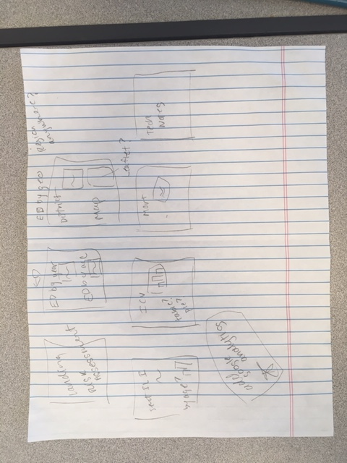
Step 2: Draft the vision
Know the end goal
Get a sense of what widgets and layouts you’ll need

Slide 17
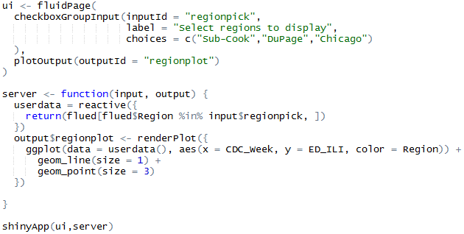
Step 3: Break it down into one piece
Start with just one user control and one output (e.g. a plot)

Slide 18


shiny: A Brief Refresher
shiny apps consist of two functions
  a ui function (for user interface) that creates the layout of the application and the user controls
  a server function that creates the content based on the user’s selections

Slide 19
inputId and outputId
The ui and server functions talk to each other to create an interactive app
  The ui function collects user-selected values though the inputId variable and sends that information to the server function
  The server function uses the inputId to create content that is fed back to the ui function for display
  The content is tagged with an outputId variable so the ui function knows where to display it

Slide 20
inputId and outputId
1. User chooses what regions to display

Slide 21
inputId and outputId
2. Choices are stored in input$regionpick

Slide 22
inputId and outputId
3. Filtered data set is created using inputID

Slide 23
inputId and outputId
4. Filtered data set is sent to a render* function to create content

Slide 24
inputId and outputId
5. Rendered plot is stored in object with the outputId “regionplot”

Slide 25
inputId and outputId
6. Rendered “regionplot” plot is sent to the designated space for it on the ui

Slide 26
inputId and outputId
6. Rendered “regionplot” plot is sent to the designated space for it on the ui

Slide 27
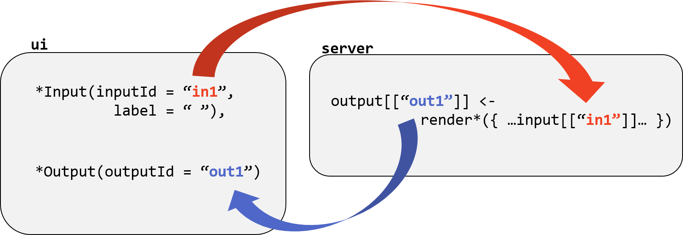
inputId and outputId
Image Credit: National Socio-Environmental Synthesis Center
https://sesync-ci.github.io/basic-Shiny-lesson/

Slide 28
Step 4: Build iteratively
Use your working mini-app as a recipe to create additional plots or features
Build a more advanced user interface with shiny’s pre-built lay-outs
  sidebarLayout
  navbarPage
Test continuously!!!
Comment extensively

Slide 29
Step 5: Customize the ui with HTML/CSS
shiny functions that build your user interface are creating HTML code under the hood
Tweaking or adding HTML/CSS content can customize the look of your app
  Change the relative size of panels
  Add additional elements (e.g. headers, paragraphs, links to other content)
  Change colors, fonts, and spacing

Slide 30
Step 5: Customize the ui with HTML/CSS
Tweaking lay-outs:
  Utilize the fluid “shiny grid system”
  Rows sub-divided into 12 columns
  Based on popular HTML framework called “Bootstrap”
fluidRow()
fluidRow()
column(1, )
fluidRow()
column(4, )
column(4, )
column(4, )
fluidRow()
column(6, )
column(6, )
column(width = x)
where x is between 1 and 12

Slide 31
Step 5: Customize the ui with HTML/CSS
Adding elements:
  HTML elements are building blocks used to create webpages
  Elements are surrounded by “tags”
    <p>I will become a paragraph.</p>
    <h1>I will become a large header.</h1>
  shiny has 110 functions, called tags functions, that create HTML elements
    tags$p(‘I will become a paragraph.’)
    tags$h1(‘I will become a large header.’)
  The most common tags functions have helper functions where you can drop the ‘tags$’ part
    p(‘I will become a paragraph.’)
    h1(‘I will become a large header.’)

Slide 32
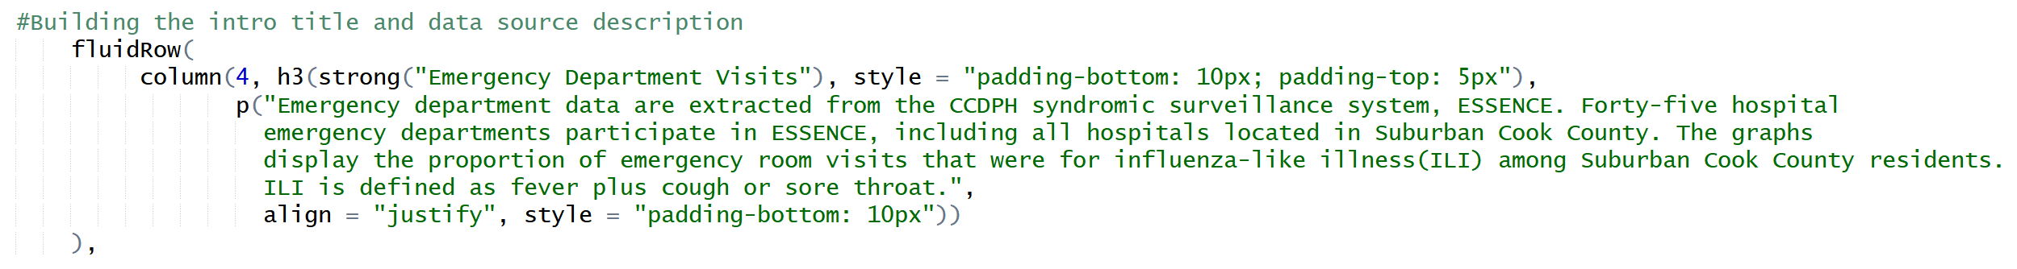
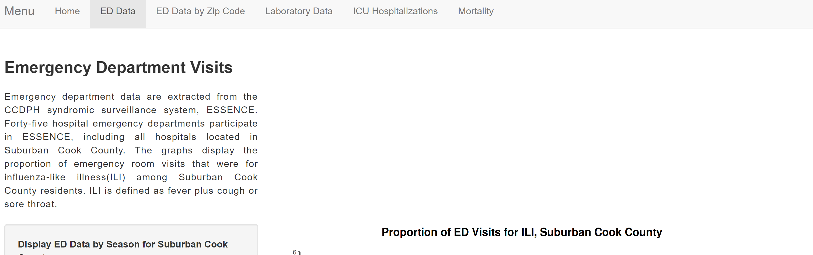
Step 5: Customize the ui with HTML/CSS

Slide 33
Step 5: Customize the ui with HTML/CSS
Resources for learning HTML/CSS
  FreeCodeCamp: www.freecodecamp.org
  Learn to Code HTML & CSS: https://learn.shayhowe.com/html-css/
Applying HTML/CSS to your shiny apps
  Understanding the shiny grid system: https://shiny.rstudio.com/articles/layout-guide.html
  Customizing your ui with HTML and CSS: https://shiny.rstudio.com/articles/html-tags.html; https://shiny.rstudio.com/articles/css.html
  shiny tags$ glossary: https://shiny.rstudio.com/articles/tag-glossary.html

Slide 34
Step 6: Share your app
Two options:
  Download shiny server and host it yourself
  Use R Studio’s hosting service: shinyapps.io
Hosting on shinyapps.io
  Free plan with <25 “active hours” per month
  “Publish” from within Rstudio
  Upload your data along with your code

Slide 35

Final Thoughts
“Borrow” code liberally and Google often
Test by both running locally AND publishing
Don’t let the perfect be the enemy of the good

Slide 36

Contact Information
https://github.com/kb230557/Flu_Shiny_App
Kelley Bemis
Epidemiologist IV
Communicable Disease
708-836-8666
kbemis@cookcountyhhs.org

