Slide 1


Slide 2

Director, Health Services, Odisha
Vice-President, Federation of Obst & Gync Societies of India- 2009
President, Indian Menopause Society (IMS) 2015-16
President, Asso of Obst & Gync ohf Odisha-2015-16
President,Indian Medical Association,Cuttack<Odisha-2016-17
Governing Council Member, ICOG – 2011-2014
National Corresponding Editor, FOGSI Journal – 2012-2015
Chairperson, Geriatric Gynaecology Committee, FOGSI 2004-2008
DR. H.P. PATTANAIK,
M.D., M.I.C.O.G., F.I.C.O.G., F.I.C.M.C.H.
Consultant Obstetrician and Gynaecologist, Cuttack
Director, Health Services, Odisha
Ph: (0671) 2443410 (R), 094370 29020 (M)
E-mail: harapattnaikscb@gmail.com

Slide 3
MALARIA IN ODISHA–
A SUCCESS STORY
Dr HARA PRASAD PATTNAIK
DIRECTOR OF HEALTH SERVICES
GOVERNMENT OF ODISHA

Slide 4
Odisha STATe’s MALARIA REDUCTION SUCCESS-ROLE Of INFORMATION FOR ACTION
SITUATION IN PAST
PROBLEMS OF THE STATE
INTERVENTIONS DONE
SURVEILLANCE
SUPPORTING AGENCIES
SUCCESS STORY

Slide 5
Global malaria situation
Disease Burden
Estimated number of malaria cases & deaths in 2017 are 219 million and 435 thousand, respectively
Economic Burden
In 2017, 3.1 billion dollars have been invested in malaria control and elimination efforts
Surveillance System
"Even in countries that have reporting rates of 100% in the public sector, some have testing rates as low as 70%, and public health sector treatment seeking rates of below 60%."
Priority Challenges
Weak surveillance and reporting system
Emerging drug and insecticide resistance
Global malaria situation is at crossroads–
15 countries in sub-Saharan Africa and India together contribute 80% of the global malaria burden.
4 out 5 highest burden countries are following NO DECLINE
India is setting a global example of success in declining malaria burden with more than 20% decline in malaria cases.

Slide 6

4th highest malaria burden country
>90% population at-risk
Malaria case reporting rate by surveillance system in less than 50%

Slide 7
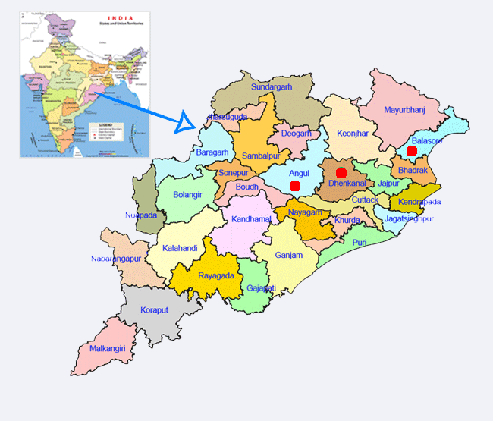
ODISHA AT A GLANCE
Covers 4% of the India’s land area; 34% forest cover
Population: 42 million (3% of the India’s population) Rural : 82% , Urban : 18%; 22% scheduled tribe & 16 % scheduled caste
Rapid urbanization; mining and industrial activities
Contributed >40% of malaria burden of India in 2016

Slide 8
ODISHA STATE PROFILE
30 Districts
314 CHCs
Primary Health Center (20-30K pop)
4-5 PHCs per block
Sub-center (5K pop)
(4-5 SCs per PHC)
52,000 villages (0.5-1K pop per village)
GEOGRAPHY
Odisha’s geologic formations vary considerably in both age and character.
Four natural divisions: the northern plate, the Eastern Ghats, the central tract, and the coastal plains.
RIVERS
Mahanadi, Subarnarekha, Budhabalanga, Baitarani, Brahmini, Rushikulya, Vamsadhara
CLIMATE
Tropical climate.
Summer temp. increases to >40 degree C
Southwest monsoon from June through September

Slide 9
HISTORY OF MALARIA PROGRAMME
India’s malaria programme started in 1953– National Malaria Control Programme (NMCP) in 1953, when malaria was a major public health problem with 75 million cases and 0.8 million deaths.
Tremendous achievements made in bringing down the malaria burden with the overwhelming success of the NMCP leading to the launch of the National Malaria Eradication Programme (NMEP) in 1958
NMEP was also initially a great success with malaria incidence dropping to 0.1 million cases with no deaths reported in 1965
Resurgence of malaria due to technical, operational and financial complexities resulted in an escalation of incidence to 6.4 million cases in 1976
With the Urban Malaria Scheme (UMS) implemented in 1971–1972 and a renewed focus and commitment, in 1977 the Modified Plan of Operation (MPO) and the Plasmodium falciparum containment programme (PfCP) were launched and malaria incidence was reduced to around two million cases per year by 1984
Intensification of malaria programme started in late 1990s with The World Bank support and continued through the last two decades with support from The World Bank initially, but later with The Global Fund.

Slide 10
Malaria PROBLEM in Odisha
Technical Challenges
Afebrile cases
Drug resistance
Insecticide resistance
Paradigms: Forest, Tribal. Urban, Industrial, mining, plains and coastal paradigm
Heterogeneity of Risk Paradigms
Malaria Cases and Deaths
>40% of reported malaria burden of India &
>1/3rd of malaria burden of SE Asia
Operational Challenges
Inaccessibility
Poverty and marginality in tribal population
Formal and informal private health sector
Lack of staff for Active Surveillance

Slide 11



Problem statement
Malaria remains a major public health problem in Odisha
Inaccessible areas are highly vulnerable. Such villages / hamlets are largely inhabited by tribal & PVTG population
Complex socio cultural practices & Poor health seeking behaviour of the community affects functioning of health service delivery system
Problem of asymptomatic malaria is intense in these villages and there is inherent poor surveillance mechanism due to distantly placed ASHA or inaccessibility
Malnutrition is also an inherent problem in these areas which increase vulnerability to malaria and vice versa

Slide 12

Malaria surveillance is a challenge in odisha
Surveillance is a core intervention under Global Technical Strategy.
Surveillance is a challenge in Odisha given its difficult terrains, forest areas and primitive tribes at places.

Slide 13
PROBLEM STATEMENT FOR MALARIA SURVEILLANCE
HARD TO REACH AREAS
Difficult for fever patients to travel to health facilities
Referral is also difficult
REMOTE AND ISOLATED VILLAGES AND HAMLETS
ASHAs are often not available
Difficult for fever patients to travel to ASHAs house for malaria detection and treatment
AVAILABILITY OF MICROSCOPY FACILITY
Microscopy is available upto CHCs
New PHCs are being equipped, case load is high.
SHORTAGE OF HUMAN RESOURCES
Male Health Workers who carry out active surveillance are not adequate in number.

Slide 14
10 YEAR TREND OF MALARIA IN ODISHA

Slide 15
Change in Malaria API – 2016 vs 2017
Major Epidemiological improvements
There was 20% reduction of cases & 69% reduction of malaria deaths in 2017, compared to 2016
No. of Districts with API>10 have come down to 9 in 2017 from 13 in 2016
Angul, Sambalpur, Deogarh & Sundergarh have come down to less than 10 API
Nuapada, Boudh have come down to <5 API
Sonepur, Balangir & Nayagarh have come down to the category API 2-5; Previously they were in API 5-10 category
Dhenkanal API has come down to less than 1
2016

Slide 16
High impact Interventions– 2017
Intervention –II
Large scale Mass screening activity was conducted in inaccessible areas of 22 malaria endemic districts
Intervention Period : August - November

Slide 17
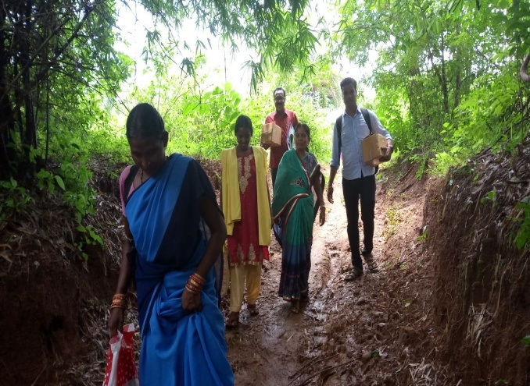
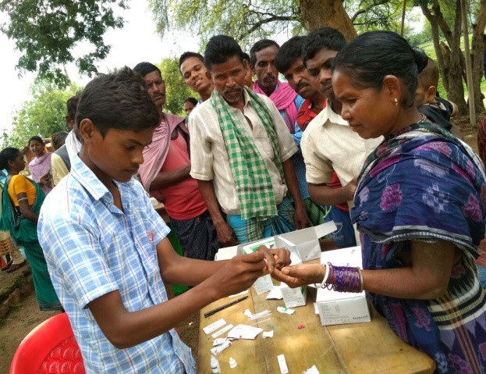
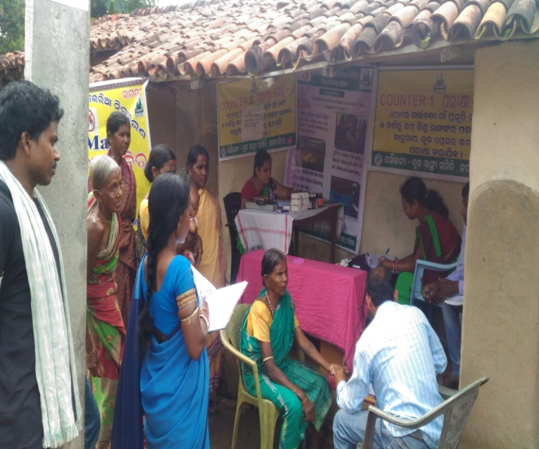
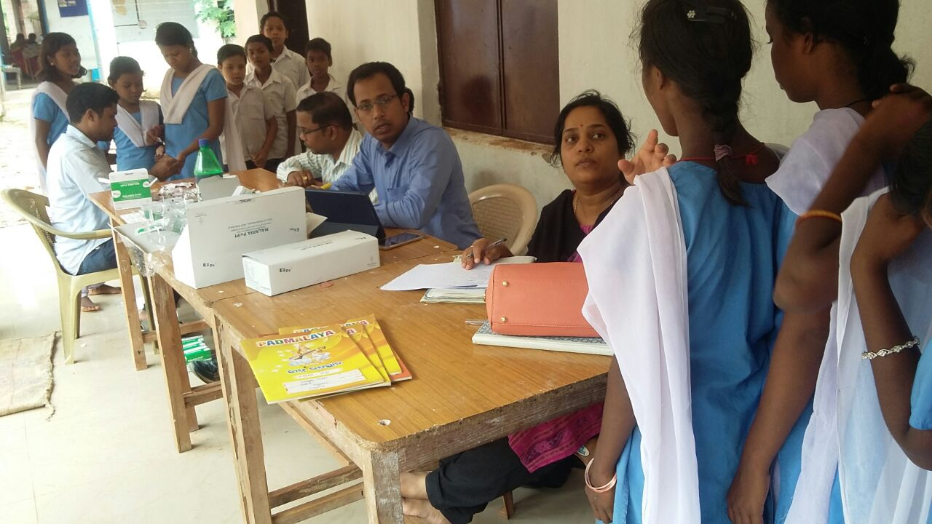
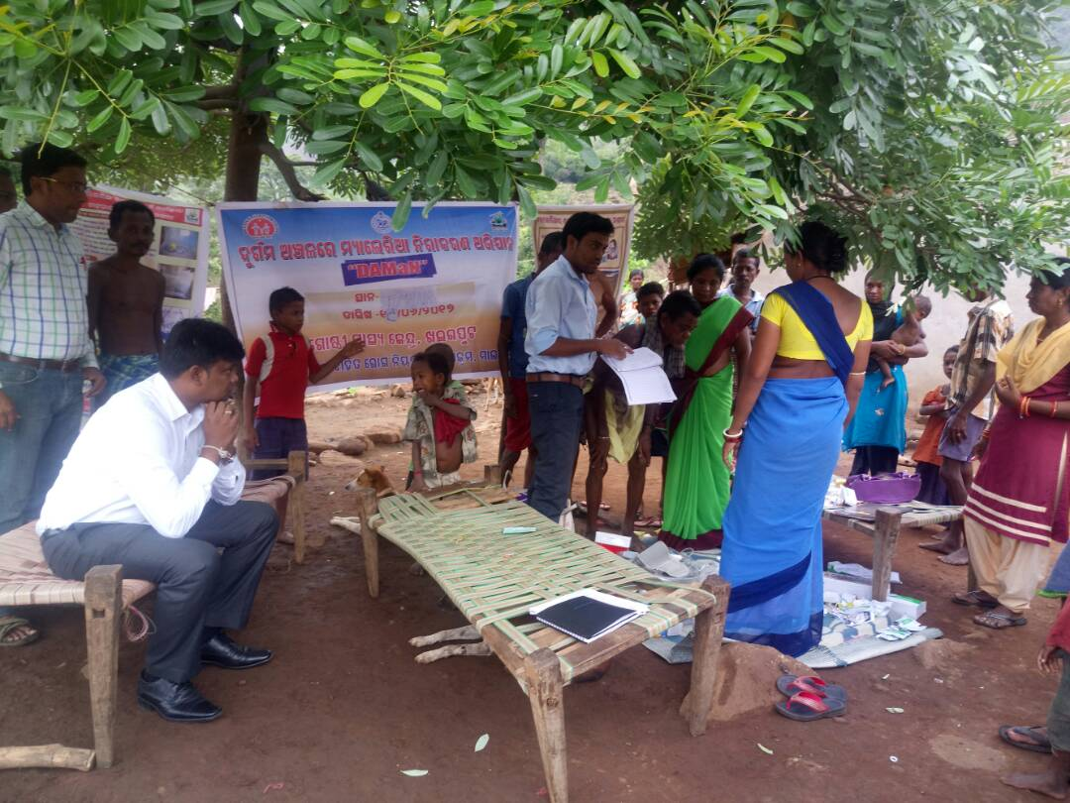
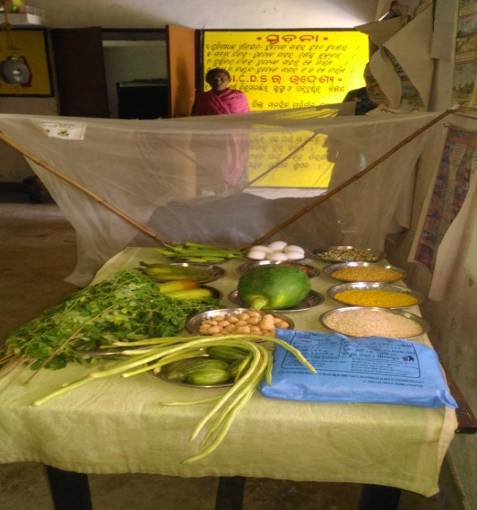
HOW WE KILLED MALARIA– GLIMPSES OF THE DRIVE
ASHAs and Health Workers moved to hardest to reach villages
ASHA and HWs set up DAMAN camp and screened all members of the underserved community for malaria.
District Collector motivating the drive
Demonstration Corner for showing local nutritious food & use of LLIN
Addressing malaria in Tribal residential Schools

Slide 18
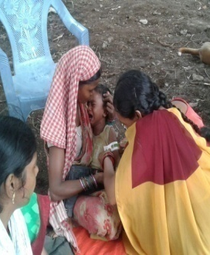
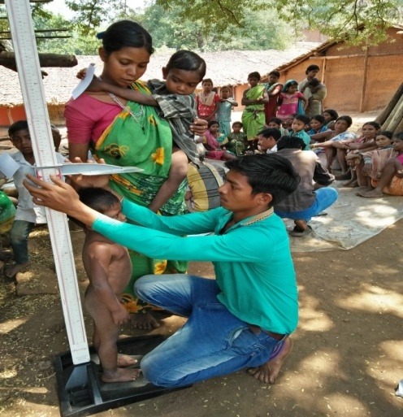
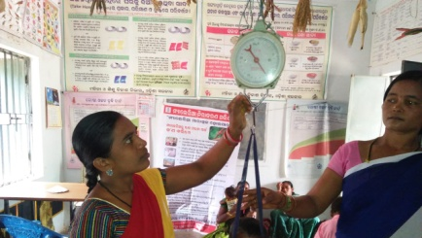
We Prioritized services for pregnant women and young children
We screened PW for anemia
We screened children for undernutrition.

Slide 19
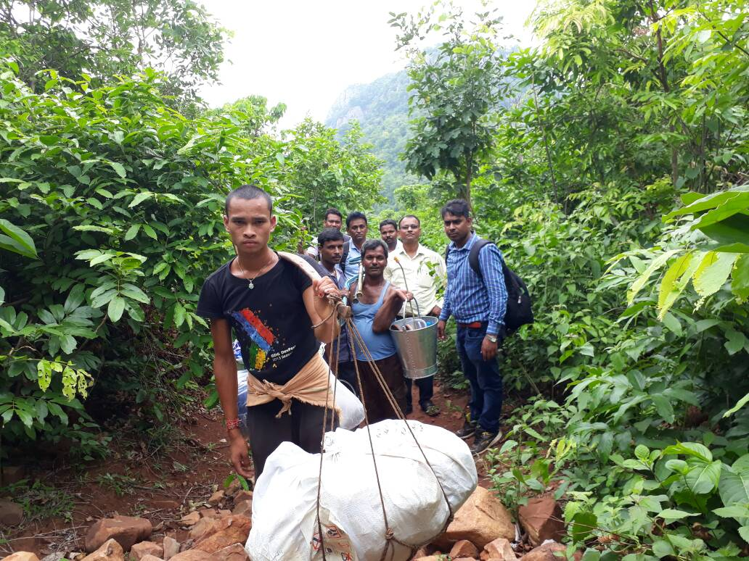
DAMAN CAMPS
Distribution of DAMaN villages
1st round health camp ( April – May)
Malaria Mass screening + Health check of <5 children + Preg & Lactacting mothers
First round IRS followed by LLIN & intensified routine programme
2nd round camp ( September – October )
Malaria Mass screening +Health Check up of <5 children + Pregnant & lactating mothers
Second round followed by IRS & intensified routine programme
3rd round health camp ( Jan– Feb)
Malaria screening + Health check of <5 children + Preg & Lactacting mothers
All supportive activities – Training, IEC BCC, M&E , OR, Intersectoral coordination etc
Establishment of Non-ASHA FTD
Inaccessible villages / hamlets having infrequent visit of ASHA
Accessible villages/hamlets getting regularASHA service

Slide 20
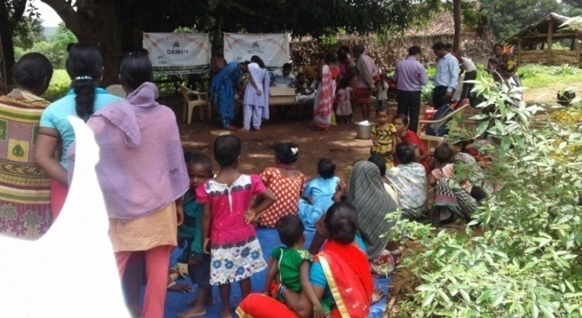
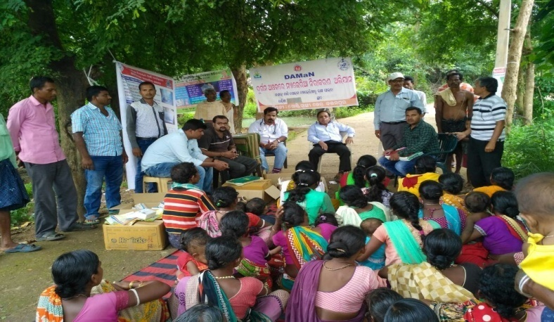
Achievement of DAMaN after First Round
Total DAMaN Camps | Camps conducted | Total DAMaN Population (Completed Camps) | Population screened | Total Positive | With Fever | No fever | % PW found Severe Anemic | % U5 with Severe Anemic
4155 | 3485 (80%) | 8 lakh | 70% | 34,925 | 30% | 70% | 22% | 10%
Overall Findings
Non fever malaria cases ranged from 8-100%.
In most of the DAMaN villages ( except a few), malaria positive cases declined. drastically (as per the report of under routine surveillance).
After DAMaN there was close monitoring on these villages / hamlets.
The rate of decline is higher in DAMaN than the corresponding Non DAMaN villages of the Sub-centre.

Slide 21
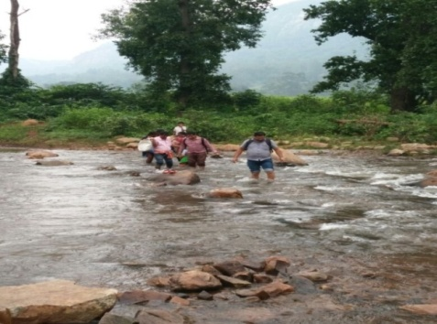


Significant Outcomes
Community residing in the remote and inaccessible pocket got improved access to services
Population having asymptomatic (a febrile) malaria were identified and treated
Nutritional deficiency and low haemoglobin count were identified in under five children and pregnant women.
63% decline in malaria positive cases was witnessed in DAMaN areas in 2018 compared to 2017.
58% decline of afebrile malaria cases was also observed in DAMaN areas.
Test Positivity Rate (TPR) in DAMaN areas have gone down to 2.93% from 6.28 %
Other fringe benefits:
  Treatment of minor ailments like cold& cough, body ache,
  Addressing non communicable diseases like diabetes and hypertension,
  Disinfection of drinking water sources and defunct tube wells,
  Repair of roads and culverts,
  missed immunizations etc.

Slide 22
Potential Strategies with Stratification
High Endemic
EDCT with strengthened surveillance
Integrated monitoring
Moderate Endemic
EDCT
Data Validation, Entomological Survey
Universal coverage of LLIN
Intensified IEC
Universal coverage of LLIN
Low Endemic
Strengthening of surveillance including case based surveillance
Validation of data and reporting
Risk mapping
Mass screening and integrated vector control in high risk areas
Cross-cutting: Advocacy, Strategic Communication, Multi-sector coordination, Private health sector engagement, Last mile service delivery, Increased microscopic facility.

Slide 23
Risk Mitigation
Current Strategy | Risk | Mitigation Plan
Combined approach of LLIN/ IRS | Insecticidal resistance due to selection pressure Uncertain replacement frequency Waning off of Community motivation | Advocacy and resource mobilization to sustain vector control interventions Entomological research (for best combination model, 6-monthly effectiveness evaluation of LLINs, identification of suitable insecticides) Assessment of community awareness and engagement of PRI
Case Management | Presumptive treatment in private health sector Drug compliance across communities Drug Resistance | Assessment of practices and determination for malaria case management in private health sector Engagement of formal private health sector and capacity building and orientation of informal private health sector Assessment of community awareness and IEC/BCC Therapeutic Efficacy studies
Surveillance | Demotivation among HW under incentive based approach in low endemic areas Scarcity of staffs for active surveillance and case based surveillance | Strategies and operations needed to sustain commitment of frontline health worker Strategic innovations and technology for improving Active Surveillance and Case based surveillance
Programme Management and Resourcing | Cessation of GF support starting 2018 | Media analysis and advocacy Operational Research

Slide 24
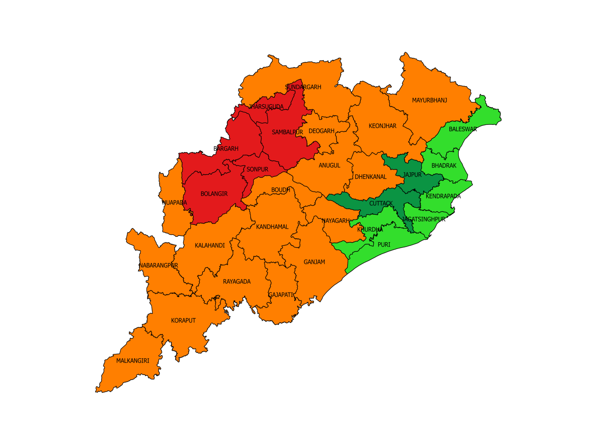
P. vivax Burden in Odisha
District-wise Stratification of Pv Burden
Elimination Phase Dists Having Pv% < 30%
Elimination Phase Dists Having Pv% >= 30%
Control Phase Dists Having Pv% < 30%
Control Phase Distss Having Pv% >= 30%

Slide 25
P. vivax Strategy for Elimination Setting
Low Pv Burden
High Pv Burden
Sentinel surveillance for detection of severe Pv cases and Pv trend
Ward based risk mapping and engagement of ULBs
Surveillance and Epidemic Response
Case Management
Integrated Vector Management
Surveillance & Epidemic Response
Case Management
Integrated Vector Management
Mapping of Active Foci and Identification of Pv Clusters
Mass screening of all Pv Clusters
4, 8 and 15th day Follow up through Treatment Card
Microscopic verification of negative cases in mass screening in high burden clusters
Source reduction and larval management in urban areas
Sentinel surveillance for detection of severe Pv cases
Treatment initiation within 2 hours
Inter-sectoral Coordination
Engagement of formal private sector for reporting of cases
Engagement of Professional Bodies for continuous advocacy across private health sector
Mass screening through microscopy for all hotspots having pilgrims, seasonal workers, construction sites, etc.
Microscopic verification of negative cases in mass screening in high burden clusters
Source reduction and larval management in urban areas
Inter-sectoral Coordination
Ward based risk mapping and engagement of ULBs
Orientation of informal private sector
Treatment initiation within 2 hours
4, 8 and 15th day Follow up through Treatment Card
Engagement of formal private sector for reporting of cases
Engagement of Professional Bodies for continuous advocacy across private health sector

Slide 26
P. vivax Strategy for Control Setting
Low Pv Burden
High Pv Burden
Follow up of hotspots for 14 day treatment completion
Mass Screening of Pv outbreak settings
Active Surveillance through Fever Survey of all Pv hotspots
Engagement of ULBs
Strengthening of UVBDCS
Strengthening of UVBDCS

Slide 27
Coordination and Partnership Strategy
State VBD Task Force
LLIN Steering Committee
District Malaria and MCH Task Force
COORDINATION
Chaired by Secy, Health
Interdepartmental Coordination
Inter-sectoral Coordination
Representation of administration of all levels & stakeholders
Under Planning
On-boarding of NGOs/CSOs, International Agencies, Experts, Professional Bodies (IMA, IAP, etc.)
State driven coordination platform for malaria
Onboarding of Private Health Sector
Landscape analysis of Private Health Sector for Malaria
Onboarding of investors
Demonstration of resource need and advocacy
Orientation of Private Health Institutions
Engagement of Private Health Provider Network
Mobilizing additional resources through flexible financing
PARTNERSHIP

Slide 28
Regional Medical Research Centre
Malaria No More
UNICEF
Research hub for malaria elimination in Odisha
Strategic Support Unit
Malaria Action Coalition
Supply of RDTs
Communication and advocacy
Launching support for Malaria in pregnancy and childhood
Completed Comprehensive Case Management Programme– the precursor of DAMAN
Supporting implementation and innovation in hard-to-reach villages
Medicines for Malaria Venture
Tata Trusts

Slide 29
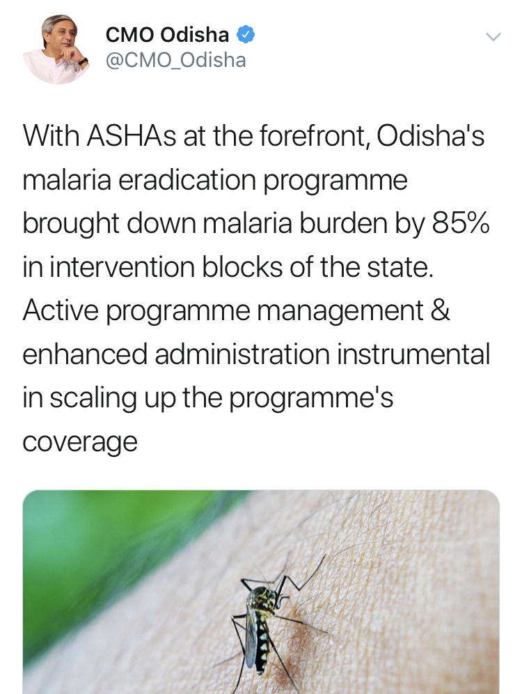
Proud MOMENTS

Slide 30
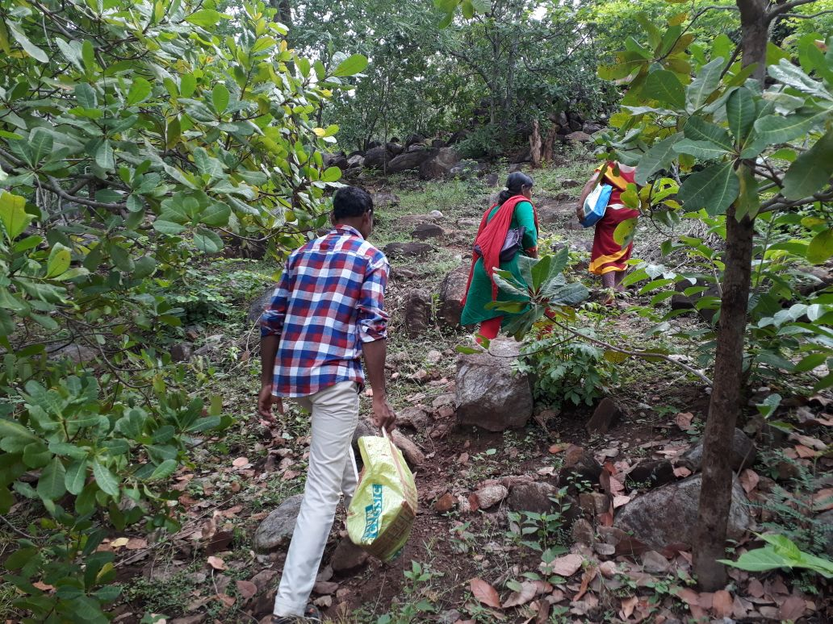
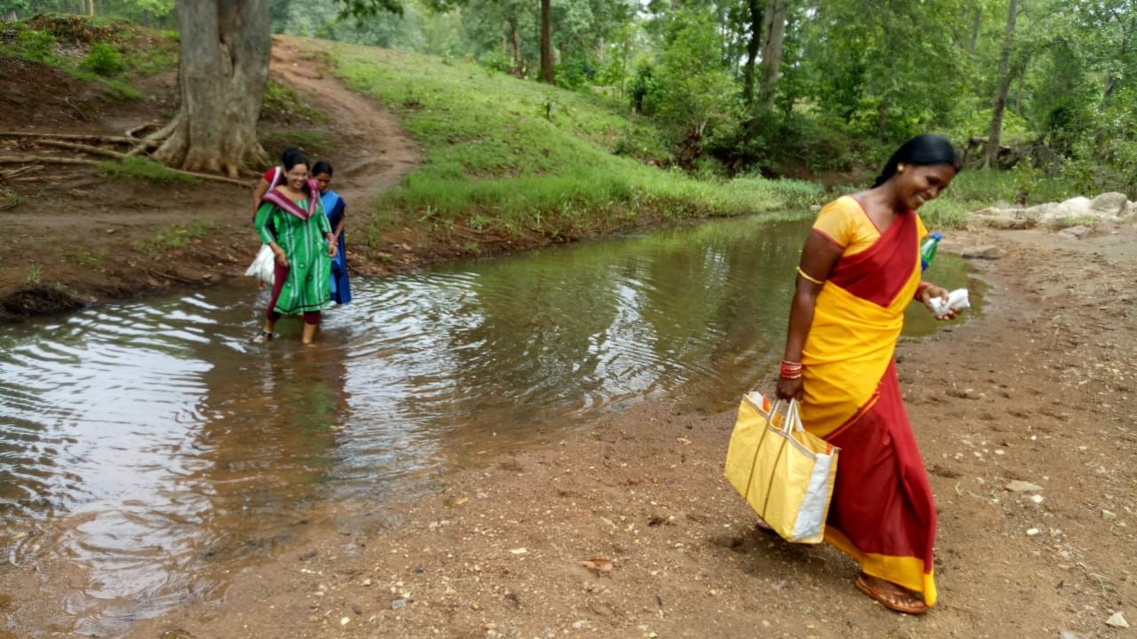
THANK YOU
END MALARIA
Miles to go before we sleep…...…

