Slide 1

Opioid Surveillance Webinar Series
Rapid surveillance of overdose morbidity: Developing case definitions, building queries, and analyzing results
Presenters:
R. Matthew Gladden & Alana Vivolo-Kantor
Division of Unintentional Injury Prevention
CDC
June 15, 2017

Slide 2
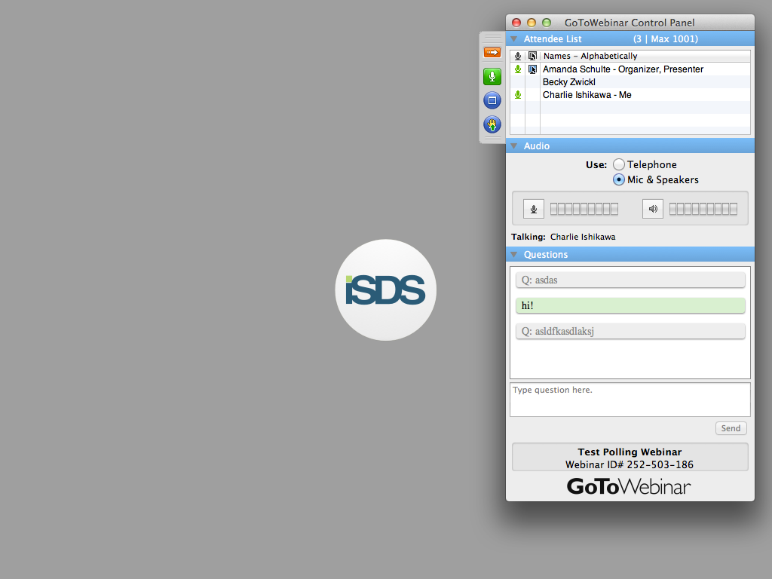
Send us live feedback
SEND US YOUR QUESTIONS / TOPICS
Raise Your Hand to Speak
  Click the “hand raise” button
Use the Question Panel
  Type and then send questions using the question box

Slide 3
Next in the webinar series…
Opioid Surveillance Webinars
2) RADARS System
Presenter: Richard Dart
Date & Time: June 29, 12 pm – 1 pm ET
3) Presentations by Yushiuan Chen & David Atrubin
Presenter 1: Yushiuan Chen
Title: Syndromic Surveillance Case Definition for Monitoring Opioid Related ED visits in the Colorado North Central Region (CO-NCR), State of Nebraska, and Marion County, Indiana
Presenter 2: David Atrubin
Title: Drug Overdose Surveillance in Florida Using Death Record, Poison Control, and Emergency Department Data
Date & Time: July 13, 3 – 4:30 pm ET

Slide 4
Announcements
Upcoming ISDS Events:
Analytic Solutions Committee Meeting
Thursday, June 15, 2 pm – 3 pm ET
Quarterly Research Committee Call
Monday, June 19, 11 am – 12:30 pm ET
Quarterly One Health Surveillance Committee Call
Monday, June 26, 12 pm – 1 pm ET
R Group for Biosurveillance Meeting
Monday, June 26, 1 pm - 2 pm ET
ISDS Surveillance CoP Call
Tuesday, June 27, 3 pm – 4:30 pm ET

