Slide 1
National Syndromic Surveillance Program Community of Practice (NSSP CoP) Expert Panel – Part II:
Facilitating Groups & Meetings
Panelists:
Charlie Ishikawa Eric Bakota
Teresa Hamby Amanda Morse
February 26, 2019

Slide 2
Announcements
Upcoming ISDS Events:
R Group for Biosurveillance Meeting
Thursday, February 28, 1 – 2 pm ET
SPHERR Committee Practice Exchange Call
Friday, March 1, 2 – 2:45 pm ET
Syndrome Definition Committee Call
Wednesday, March 6, 1 – 2 pm ET
Data Quality Committee Call
Friday, March 8, 12 – 1 pm ET
Recommendations for Surveillance of EMS Data for Opioid Overdoses
Presenters: Mike Thompson, Sara Cinquegrani Cappiello, Silvia Verdugo, Todd Stout
Thursday, March 21, 2 – 3:30 pm ET - RESCHEDULED

Slide 3

2019 ISDS Conference
Post-Conference Survey Coming Soon!

Slide 4
NSSP CoP Expert Panel – Part I: Leading Community Groups
Presented February 13, 2019.
In this webinar, we addressed what it means to be a "Chair" and what is involved in terms of leadership. We also discussed how members can build from their experiences and attain the confidence to serve as leaders for their respective community groups.
Panelists
  Joe Gibson, 2019 ISDS Board of Directors, President
  Krystal Collier, NSSP CoP Steering Committee, Chair
  Howard Burkom, Research Committee, Chair
We are in this to improve public health and it doesn’t happen unless people step up to make what’s important happen. Don’t think of yourself as stepping up to decide what goes on. Think of yourself as stepping up to link people together to facilitate making things happen.” – Joe Gibson
Notes:
https://www.surveillancerepository.org/national-syndromic-surveillance-program-community-practice-nssp-cop-expert-panel-part-i-leading

Slide 5
Agenda/Questions
NSSP CoP Overview & Introductions
What are some of the key responsibilities/tasks involved in being a Chair/Co-Chair (beyond agenda creation and moderating the meeting)?
What best practices/lessons learned can you share around encouraging engagement among group members both during and outside of meetings?
What key strategies do you implement to lead group members through the decision making process and to make sure projects continue moving forward?
What recommendations would you give to someone considering starting a new group? What advice can you provide to help them define the mission and vision of the group?
What resources would you recommend to help with meeting/group facilitation, keeping track of project timelines and goals, connecting with group members, etc.?

Slide 6
Learning Objectives
Describe at least one concrete action you can experiment with to enhance your engagement work.
Compare and contrast approaches to engaging communities and members.
Methods, tools and resources to start your own workgroup/community group

Slide 7
What is a CoP?
A Community of Practice (CoP) is defined as “a group of people who share a concern, a set of problems, or a passion about a topic, and who deepen their knowledge and expertise by interacting on an ongoing basis.¹”
The three distinct elements that comprise a CoP are:
A community that enables interaction (such as discussions, collaborative activities, and relationship building);
A shared domain of interest (such as such as syndromic surveillance);
A shared practice of experiences, stories, tools, and ways of addressing recurring problems
This approach enables public health professionals to grow and mature while focusing on efforts to share knowledge and solve problems.
Notes:
NSSP CoP: https://www.healthsurveillance.org/NSSPCOP

Slide 8
NSSP
Community of Practice
Mission:
The NSSP CoP serves the needs and interests of the Syndromic Surveillance (SyS) community through leveraging the expertise and resources of its members and strengthens health surveillance capabilities nationwide by advancing SyS practice and the utilization of SyS platforms (including the NSSP BioSense Platform).
“It can be very rewarding and you can do so much more when you are connected to people who have complementary skills and connections.” – Howard Burkom

Slide 9
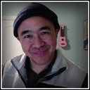
Today’s Panelists
Charles Ishikawa
President
Kahuina Consulting
Syndromic Surveillance and Public Health Emergency Preparedness, Response and Recovery Committee (SPHERR), Co-Chair
Notes:
Profile: https://www.healthsurveillance.org/members/?view=0&id=44007776&pubview=

Slide 10
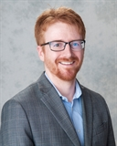
Today’s Panelists
Eric Bakota
Public Health Analyst
Harris County
Houston, TX
2019 ISDS Board of Directors, Co-Treasurer
R Group for BioSurveillance, Past Chair
Notes:
Profile: https://www.healthsurveillance.org/members/?id=44007645

Slide 11
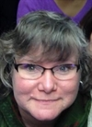
Today’s Panelists
Teresa Hamby
Research & Evaluation Analyst
New Jersey Department of Health
Trenton, NJ
NSSP CoP Steering Committee, Past Deputy Chair
Notes:
Profile: https://www.healthsurveillance.org/members/?id=44007744

Slide 12
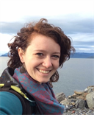
Today’s Panelists
Amanda Morse
SyS Outreach & Policy Coordinator
Washington State Department of Health
Shoreline, WA
NSSP CoP Steering Committee, Deputy Chair
Notes:
Profile: https://www.healthsurveillance.org/members/?id=44007645

Slide 13
Questions
What are some of the key responsibilities/tasks involved in being a Chair/Co-Chair (beyond agenda creation and moderating the meeting)?

Slide 14
Questions
What best practices/lessons learned can you share around encouraging engagement among group members both during and outside of meetings?

Slide 15
Questions
What key strategies do you implement to lead group members through the decision making process and to make sure projects continue moving forward?

Slide 16
Questions
What recommendations would you give to someone considering starting a new group? What advice can you provide to help them define the mission and vision of the group?

Slide 17
Questions
What resources would you recommend to help with meeting/group facilitation, keeping track of project timelines and goals, connecting with group members, etc.?
Virtual Meeting Space(s)
Easy communications
  Shared email accounts among leadership
  Online forums, blogs, etc.
Project Management Tools
  Smartsheet
  Basecamp

Slide 18
Questions
Questions and Final Comments

Slide 19
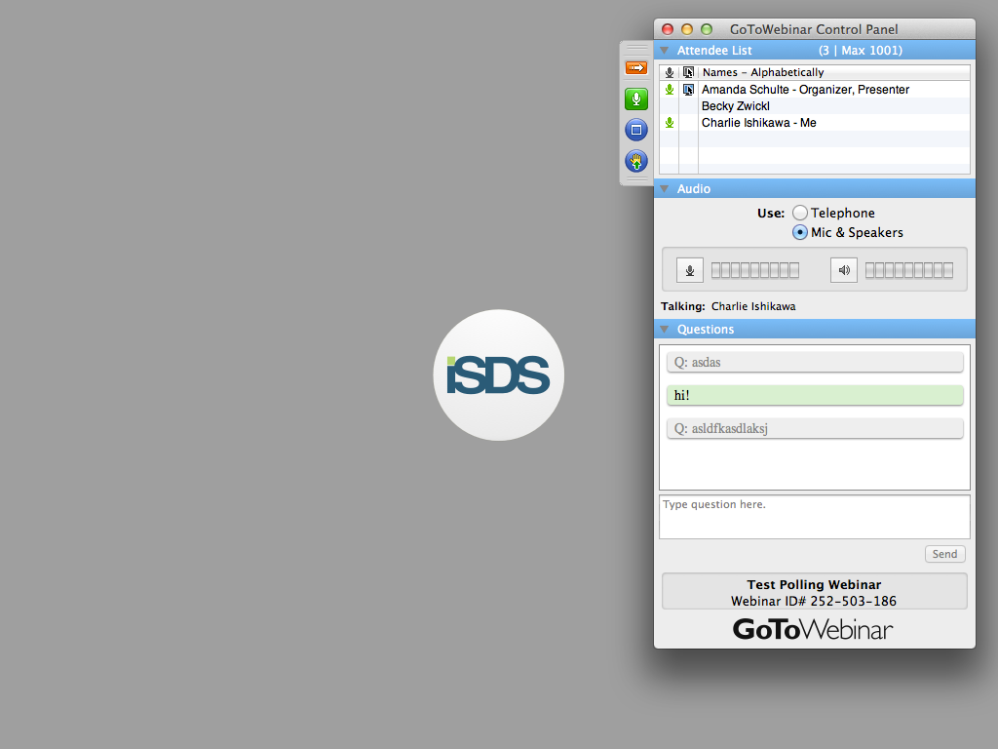
Final Thoughts/Comments
SEND US YOUR QUESTIONS / TOPICS
Raise Your Hand to Speak
  Click the “hand raise” button
Use the Question Panel
  Type and then send questions using the question box

