Slide 1
National Syndromic Surveillance Program Community of Practice (NSSP CoP) Expert Panel – Part I:
Leading Community Groups
Panelists:
Joseph Gibson Krystal Collier Howard Burkom
February 13, 2019
Notes:
Panelists:
Joe Gibson, 2019 ISDS Board of Directors, President
Krystal Collier, NSSP CoP Steering Committee, Chair
Howard Burkom, Research Committee, Chair
Outline/Proposed Questions:
Introductions and overview of leadership experience (past or present). What kind of group? What size? What partners were involved? Mission/Goals?
How did you come into your role? Were you asked to chair a group or was it a more natural evolution? Did you feel like there was any specific expertise required?
How did you prepare to take on a leadership role? Did you speak to a past chair? Was there any research/training involved?
What would you estimate the time-commitment is for leading a community-driven group? Does this change over-time? How can you share this workload among other group members?
What are some of the challenges you faced that slowed progress and what suggestions do you have for over-coming them? When the group was working together well, what factors contributed to the progress?
What would you say to someone who is considering taking on a leadership role in a community driven group?

Slide 2
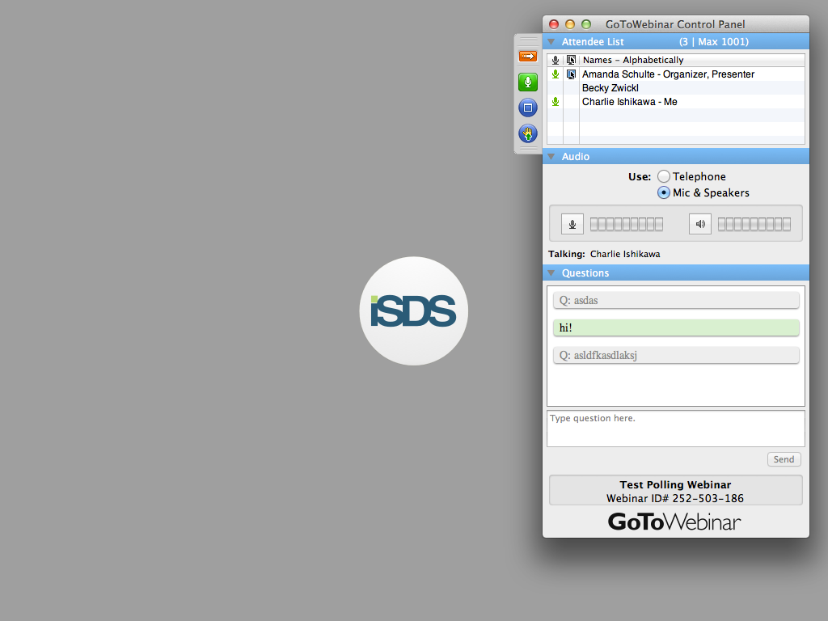
Send us live feedback
SEND US YOUR QUESTIONS / TOPICS
Raise Your Hand to Speak
  Click the “hand raise” button
Use the Question Panel
  Type and then send questions using the question box

Slide 3
Announcements
Upcoming ISDS Events:
Data Quality Committee Call
Friday, February 15, 12 pm – 1 pm ET
SPHERR Committee Practice Exchange Call
Friday, February 15, 2 pm – 2:45 pm ET
NSSP Community of Practice Call
Topic: Cardiovascular Disease Surveillance
Tuesday, February 19, 3 pm – 4:30 pm ET
Recommendations for Surveillance of EMS Data for Opioid Overdoses
Presenters: Mike Thompson, Sara Cinquegrani Cappiello, Silvia Verdugo, Todd Stout
Thursday, February 21, 3 – 4:30 pm ET - TO BE RESCHEDULED
NSSP CoP Expert Panel, Part 2: Facilitating Groups & Meetings
Panelists: Charlie Ishikawa, Eric Bakota, Teresa Hamby, Amanda Morse
Tuesday, February 26, 12 – 1:30 pm ET

Slide 4

2019 ISDS Conference
Post-Conference Survey Coming Soon!

Slide 5
Agenda/Questions
Introductions
How did you come into your role? Were you asked to chair a group or was it a more natural evolution? Did you feel like there was any specific expertise required?
How did you prepare to take on a leadership role? Did you speak to a past chair? Was there any research/training involved?
What would you estimate the time-commitment is for leading a community-driven group? Does this change over-time? How can you share this workload among other group members?
What are some of the challenges you faced that slowed progress and what suggestions do you have for over-coming them? When the group was working together well, what factors contributed to the progress?
What would you say to someone who is considering taking on a leadership role in a community driven group?

Slide 6
Agenda/Questions
Introductions

Slide 7

Today’s Panelists
Joe Gibson, MPH, PhD
Director of Epidemiology
Marion County Public Health Dept.
Indianapolis, Indiana
2019 ISDS Board of Directors, President
BioSense Governance Group, Past Chair
NACCHO Informatics Workgroup, Past Chair
Notes:
Member Profile: https://www.healthsurveillance.org/members/?id=44007732

Slide 8
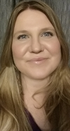
Today’s Panelists
Krystal Collier, BA
Health Program Manager I
Arizona Department of Health Services
Phoenix, AZ
NSSP CoP Steering Committee, Chair
Data Quality Committee, Past Chair
Notes:
Member Profile: https://www.healthsurveillance.org/members/?id=44017880

Slide 9
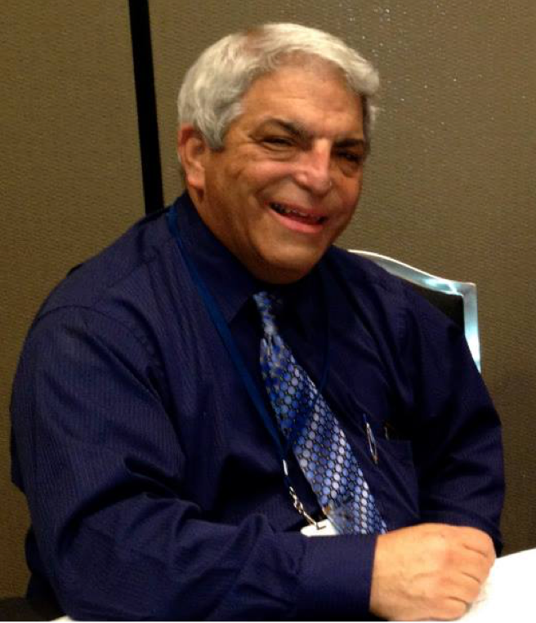
Today’s Panelists
Howard Burkom, PhD
Principal Professional Staff Mathematician
Johns Hopkins University Applied Physics Laboratory
Laurel, MD
Research Committee, Chair
ISDS Board of Directors, Past Member
Notes:
Member Profile: https://www.healthsurveillance.org/members/?id=44007669

Slide 10
Agenda/Questions
Introductions
How did you come into your role? Were you asked to chair a group or was it a more natural evolution? Did you feel like there was any specific expertise required?

Slide 11
Agenda/Questions
Introductions
How did you come into your role? Were you asked to chair a group or was it a more natural evolution? Did you feel like there was any specific expertise required?
How did you prepare to take on a leadership role? Did you speak to a past chair? Was there any research/training involved?

Slide 12
Agenda/Questions
Introductions
How did you come into your role? Were you asked to chair a group or was it a more natural evolution? Did you feel like there was any specific expertise required?
How did you prepare to take on a leadership role? Did you speak to a past chair? Was there any research/training involved?
What would you estimate the time-commitment is for leading a community-driven group? Does this change over-time? How can you share this workload among other group members?

Slide 13
Agenda/Questions
Introductions
How did you come into your role? Were you asked to chair a group or was it a more natural evolution? Did you feel like there was any specific expertise required?
How did you prepare to take on a leadership role? Did you speak to a past chair? Was there any research/training involved?
What would you estimate the time-commitment is for leading a community-driven group? Does this change over-time? How can you share this workload among other group members?
What are some of the challenges you faced that slowed progress and what suggestions do you have for over-coming them? When the group was working together well, what factors contributed to the progress?

Slide 14
Agenda/Questions
Introductions
How did you come into your role? Were you asked to chair a group or was it a more natural evolution? Did you feel like there was any specific expertise required?
How did you prepare to take on a leadership role? Did you speak to a past chair? Was there any research/training involved?
What would you estimate the time-commitment is for leading a community-driven group? Does this change over-time? How can you share this workload among other group members?
What are some of the challenges you faced that slowed progress and what suggestions do you have for over-coming them? When the group was working together well, what factors contributed to the progress?
What would you say to someone who is considering taking on a leadership role in a community driven group?

Slide 15
Final Thoughts/Comments
SEND US YOUR QUESTIONS / TOPICS
Raise Your Hand to Speak
  Click the “hand raise” button
Use the Question Panel
  Type and then send questions using the question box

