Slide 1
Web-based Biosurveillance Decision Support Tools: AIDO and RED Alert
Los Alamos National Laboratory
LA-UR-17-24383

Slide 2
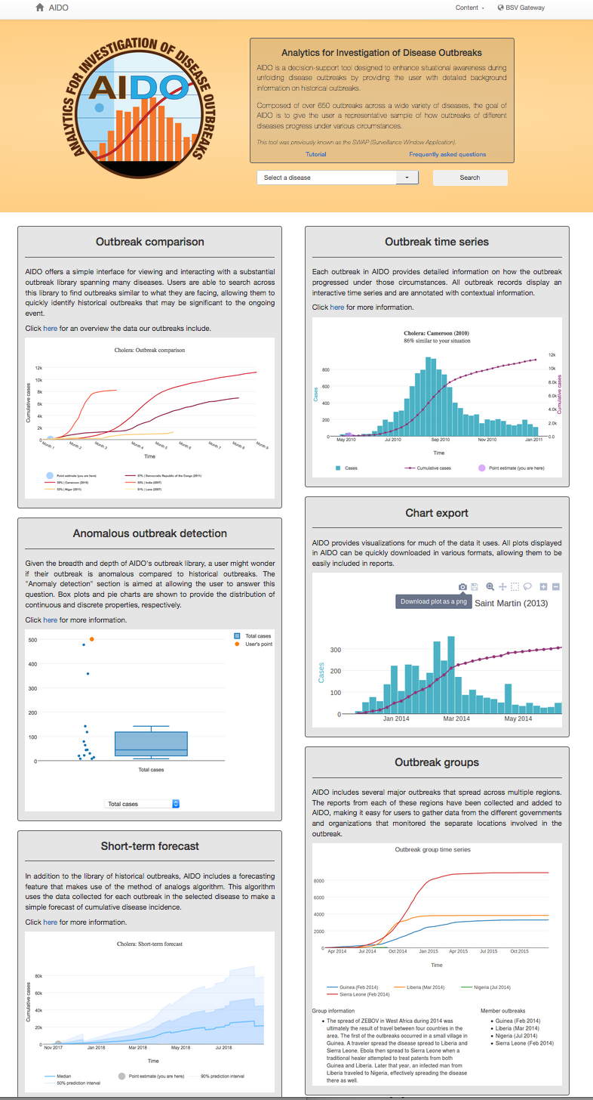
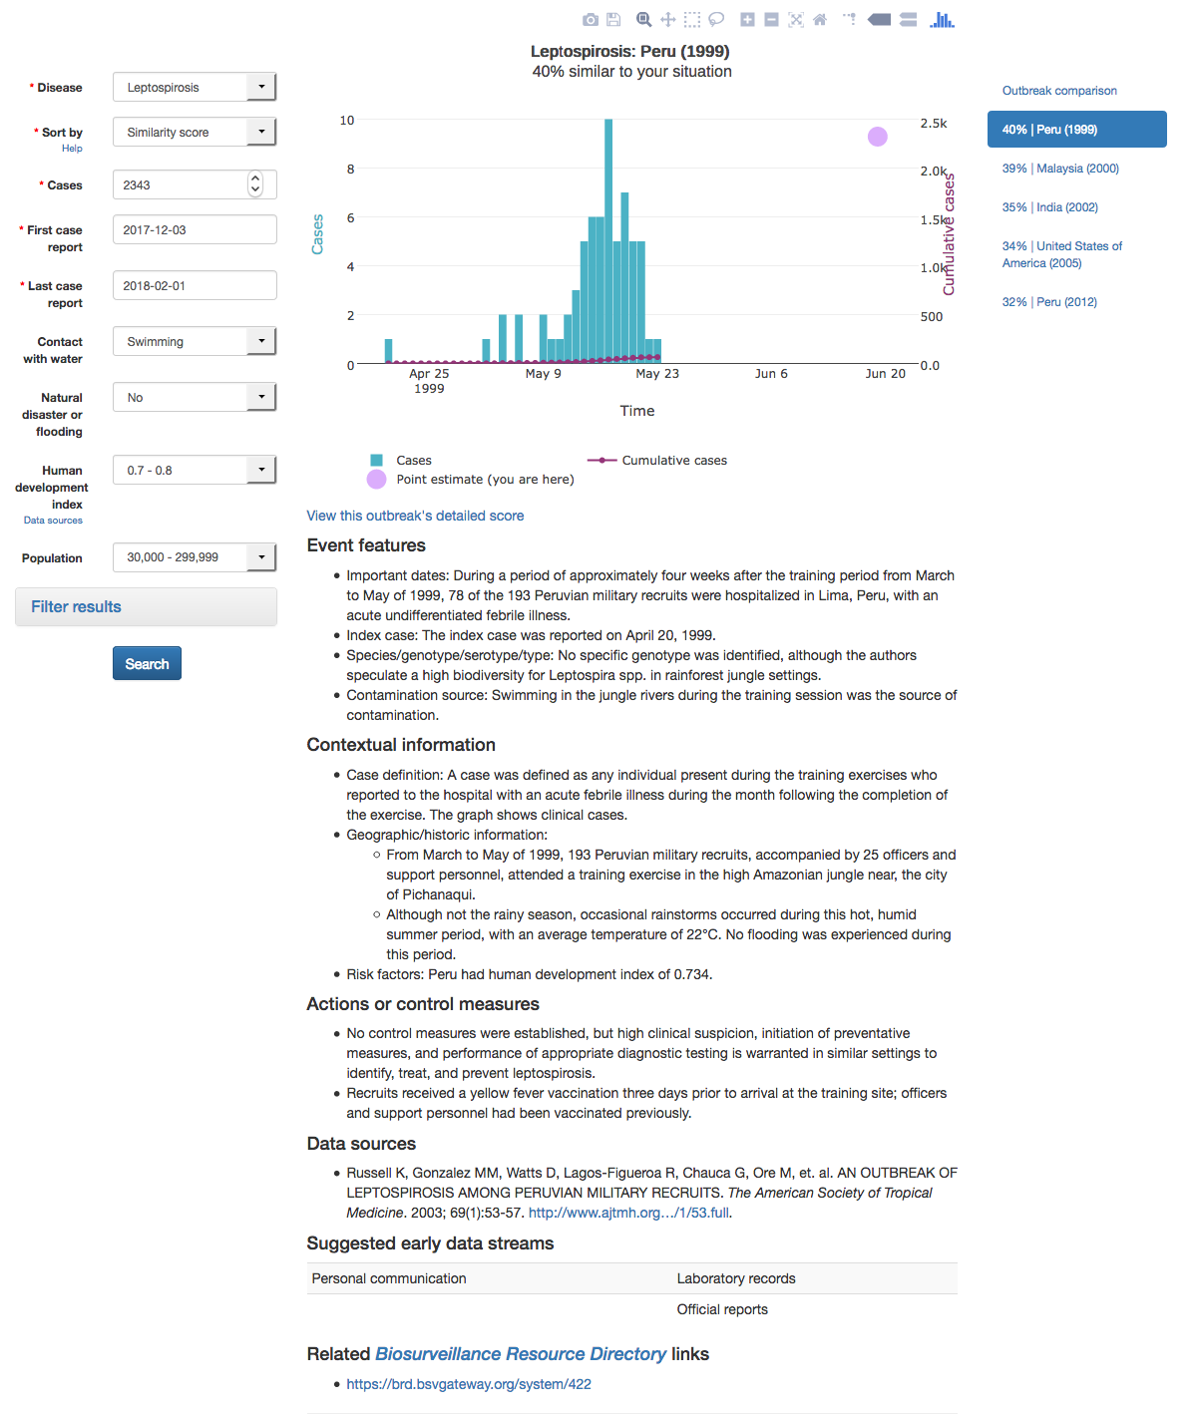
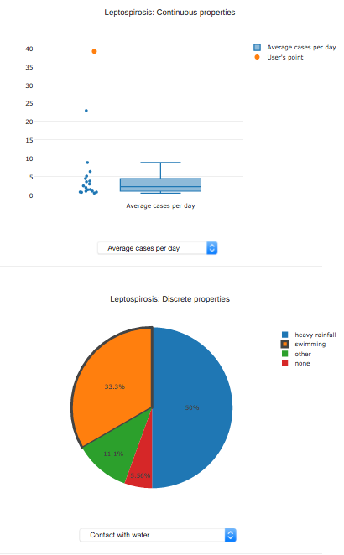
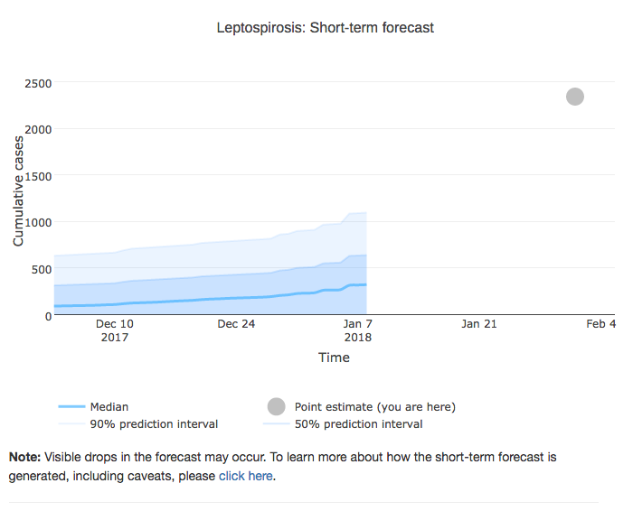
AIDO Analytics for Investigation of Disease Outbreaks
Decision-support tool designed to enhance situational awareness during unfolding infectious disease outbreaks by providing detailed information and comparisons with historical outbreaks.
Features:
39 diseases featuring over 500 outbreaks in our manually curated historic libraries
Short-term forecasting
Anomaly detection feature
Exportable images/text

Slide 3
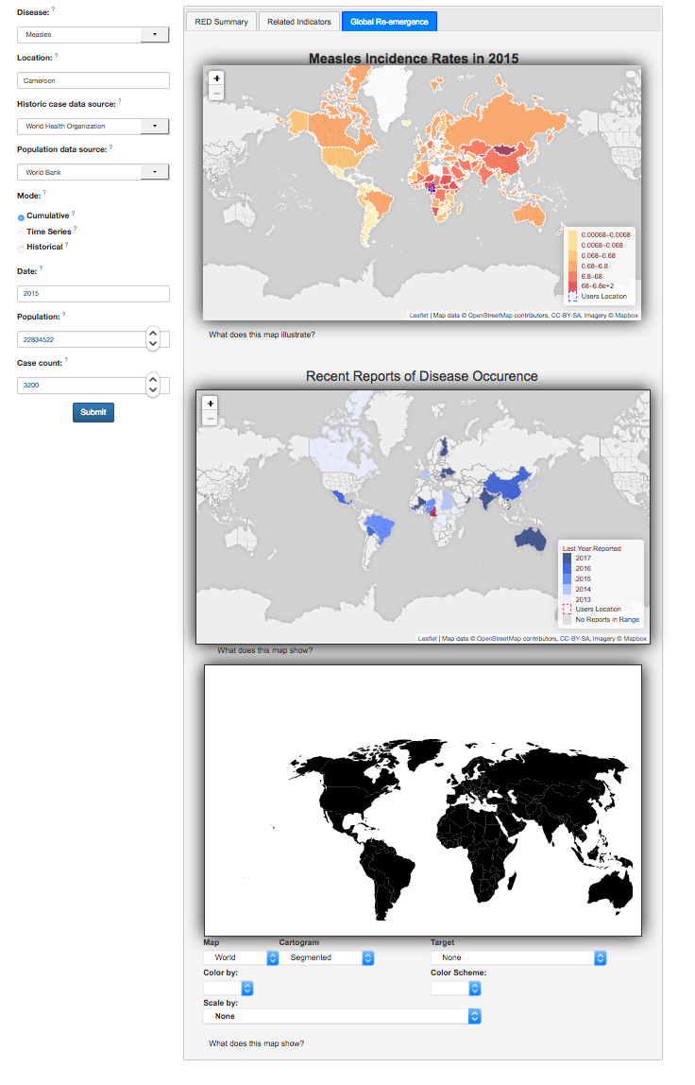
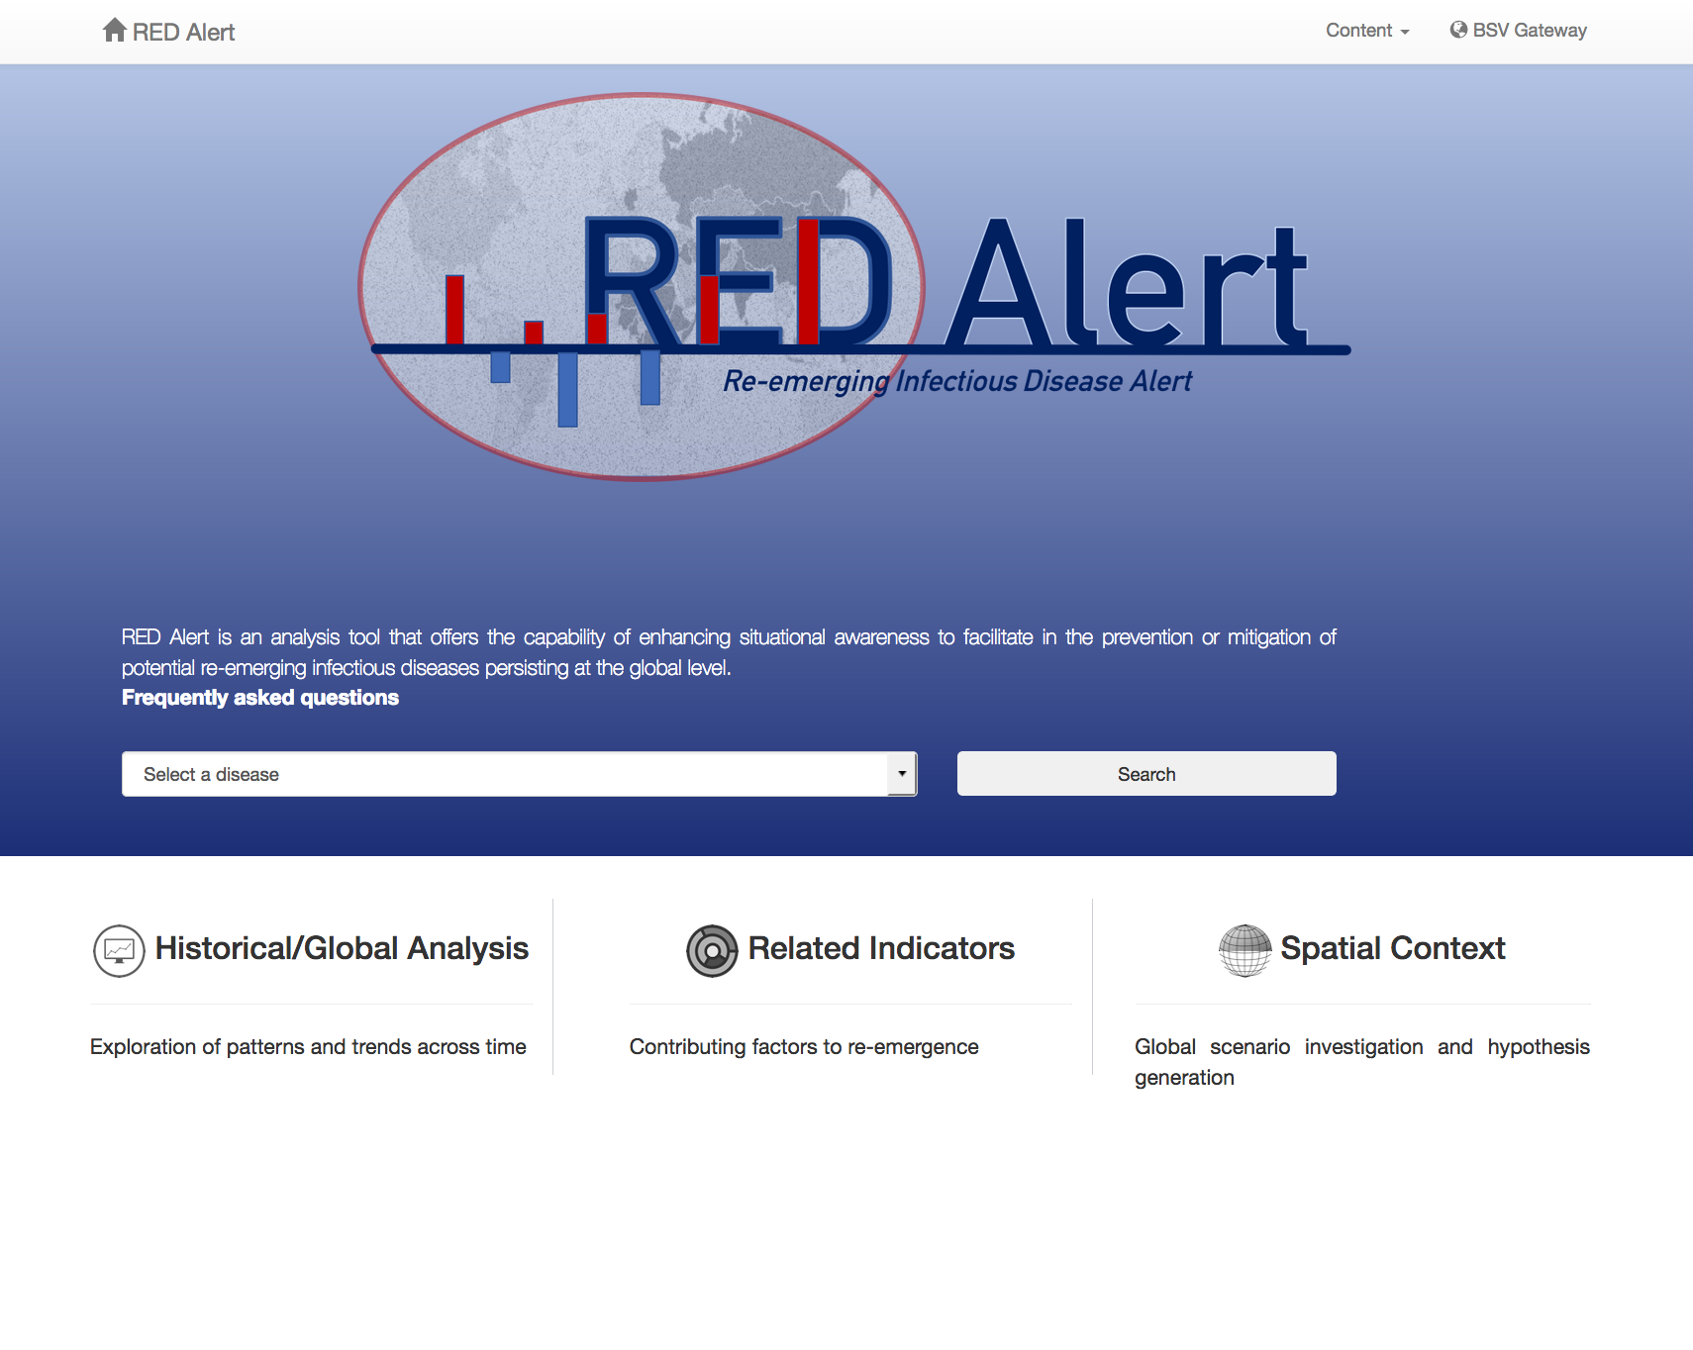
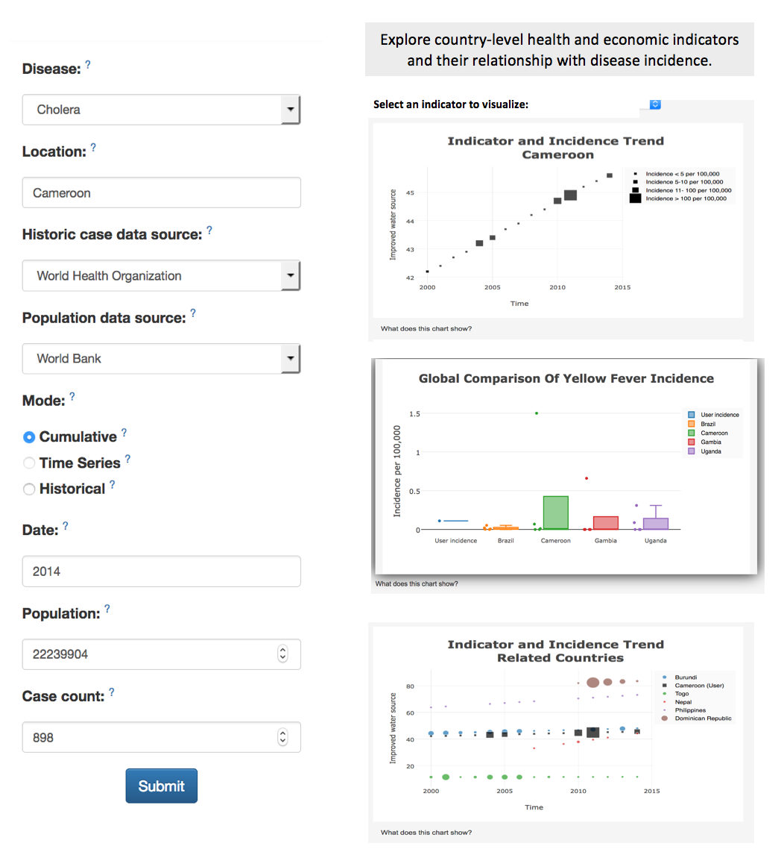
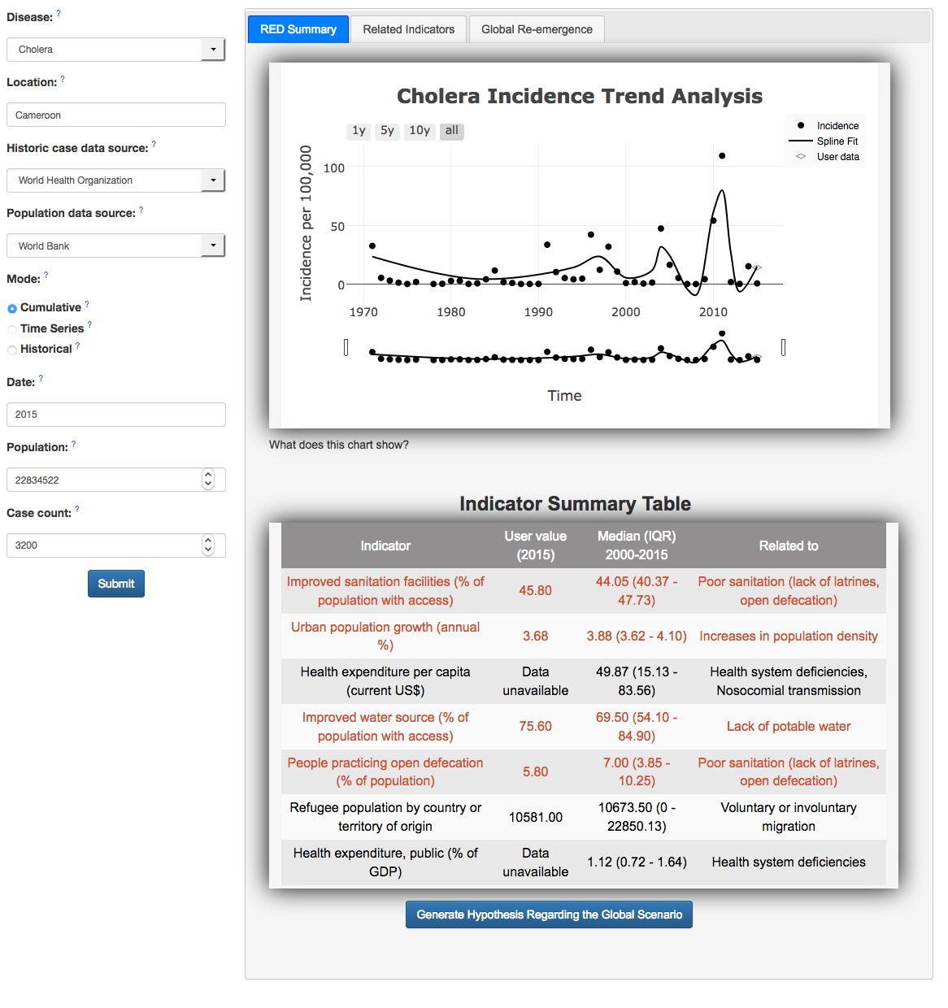
RED Alert Re-Emerging Infectious Disease Alert
Web-based tool designed to provide decision support for long-term planning of local infectious disease re-emergences
Features:
Quantifiable re-emergence indicator
Multiple data visualizations
Interactive maps
Exportable images/text

