Slide 1
Center of Excellence in
Refugee Health:
_________________
Wanted: National ICD Perspectives

Slide 2
Our goals and vision
Create a multi-state/site refugee health surveillance system with the goal of protecting the public health and improving the health of refugees
Empower stakeholders to:
Respond to the changing landscape of refugee health in near real-time
Spend more time asking questions of your data
Spend less time cleaning and managing your data

Slide 3
Partnership Map
Surveillance Network Partners
WA
ID
ME
ND
MN
MI
NY+NYC
CA
IA
PA+TJU
IL
IN*
OH
UT
CO
KS
KY
AZ
NM
TN
TX
GA
Confirmed / MOU Signed
Committed / MOU in Process
Tentative / Internal Dialogue
Initial Discussions Underway
Cannot Participate
*Marion County, IN
Notes:
24 states
3

Slide 4
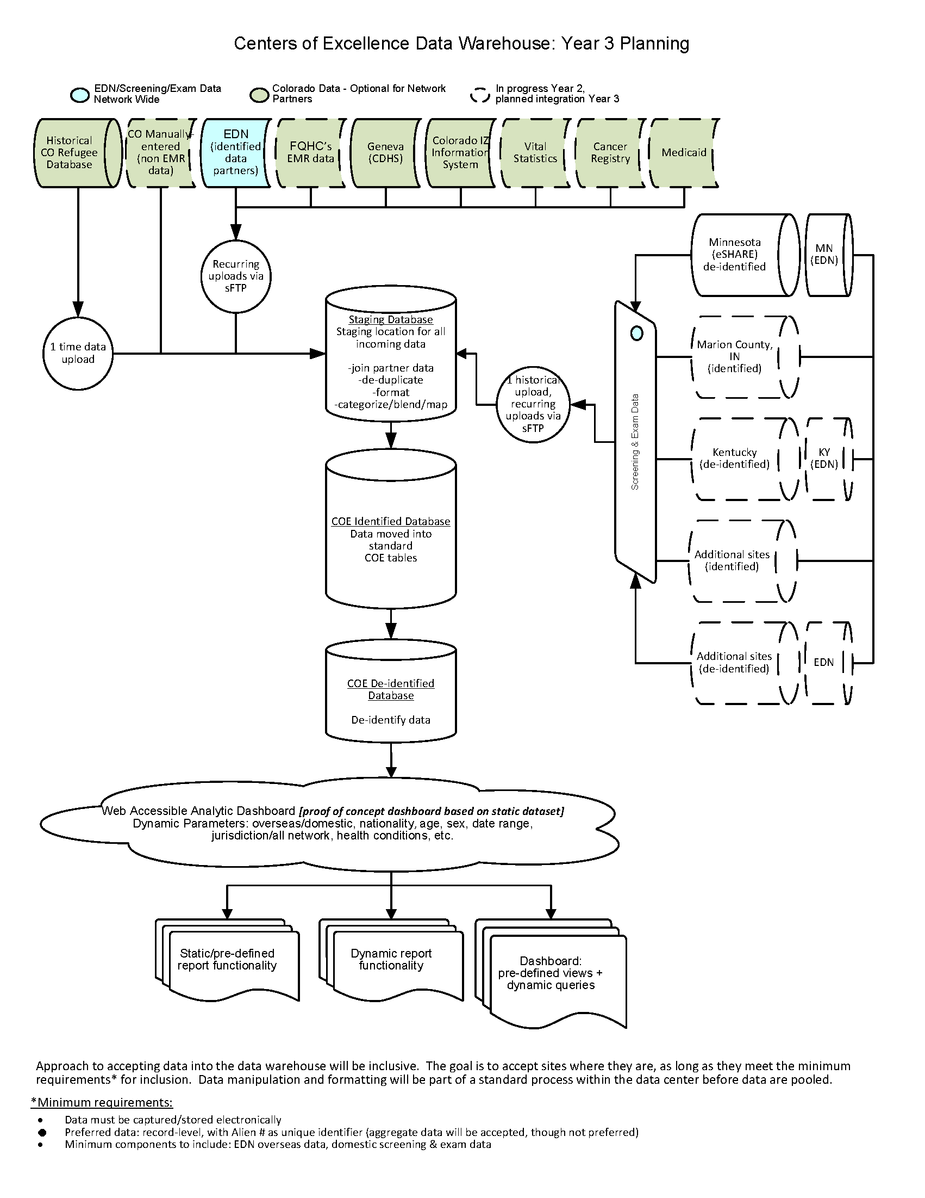
Data warehouse diagram
Notes:
Technical aspects
Our model is to take your screening data in its current state. The burden of processing your data will be on our end.
A typical model: sites organize their data to match ours (you do the work)
Our model: sites send data “as-is”, we match it to ours (we do the work)
We believe our model will create efficiencies
We learn about + process + standardize your data once, then automate
Receive a one-time download of your data (CO back to 2009, partner sites: as far back as you are comfortable sharing with us)
CO works with your data, gives you an opportunity to view/provide feedback, then create a routine data transfer
Automate processing: join overseas (EDN) data to domestic screening data, process, standardize and clean
Auto populate visualizations in near-real time: aggregate data available by site in more detail, and across the network using the lowest common denominator for compare/contrast-ability

Slide 5
Next Steps | Create Indicators
Reported to Health Department
Referral to specialist
Indicators/signals toward disease or condition
Lab/diagnostically-confirmed cases
Lab/diagnostic tests for organism/dz
Diagnostic codes / Medicaid claims
Screened for disease or condition
Lab/diagnostic tests ordered
Persons seek care
Adapted from Tauxe et al. https://doi.org/10.1016/j.ijfoodmicro.2009.10.01

Slide 6
ICD-9, 10 indicators work
(ICD codes will contribute to public health indicators for refugee health)
Lookup tables and methods we are considering
Syndromes & Microsyndromes
Master Mapping Reference Table
Research studies that have validated by condition
Do strategies exist that we are unaware of?
How do others grapple with non-standardized ICD data?

Slide 7
Want more information?
Our website hosts resources (overview, technical, legal) and documentation for interested and current partners to view.
https://sites.google.com/state.co.us/refugeecoe/
PROGRAMMATIC
Carol Tumaylle, MPH (carol.tumaylle@state.co.us, 303-863-8211)
TECHNICAL
Lori Kennedy, MSPH (lori.kennedy@state.co.us, 303-692-2624)
Deborah Aragon, MSPH (deborah.aragon@state.co.us, 303-692-2762)

