Slide 1


Identifying Current Practical Analytic Challenges – the Analytic Solutions Committee
Presenters
Ian Painter
Teresa Hamby
September 21, 2017

Slide 2
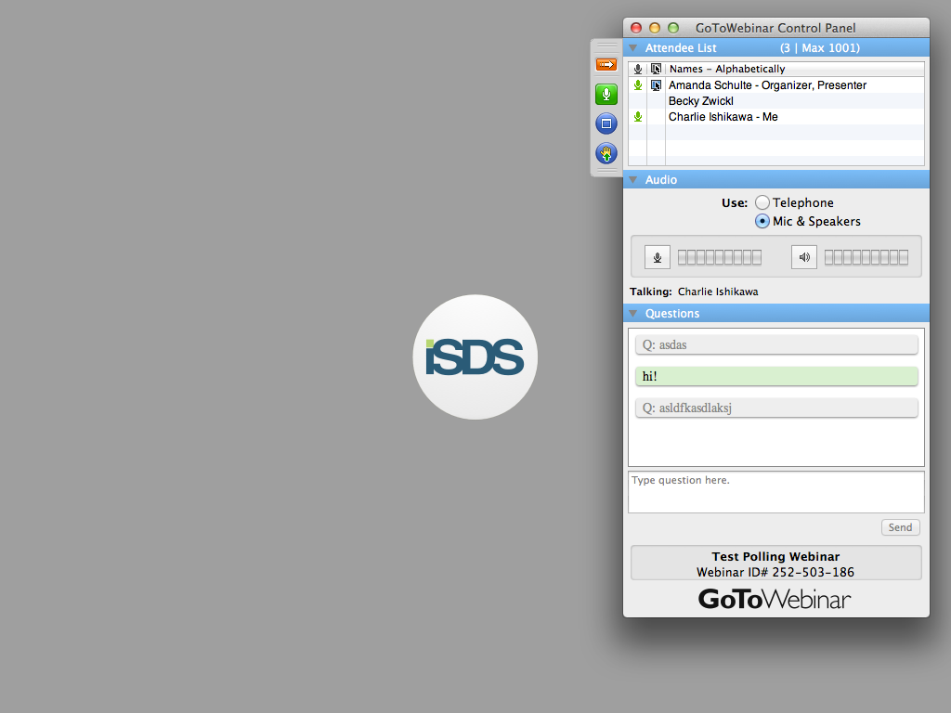
Send us live feedback
SEND US YOUR QUESTIONS / TOPICS
Raise Your Hand to Speak
  Click the “hand raise” button
Use the Question Panel
  Type and then send questions using the question box

Slide 3
Announcements
Upcoming ISDS Events:
Surveillance Community of Practice Call
  Tuesday, September 26, 3 - 4:30 pm ET
Overdose Surveillance Committee Meeting
  Friday, October 6, 1 – 2 pm ET
Urgent Care Justification Workgroup Call
  Tuesday, October 10, 12:30 – 1:30 pm ET
Data Quality Committee Meeting
  Friday, October 13, 12 - 1 pm ET
Save the Date! 2018 ISDS Conference
  January 30 – February 2, 2018 in Orlando, FL
  Abstract deadline: September 29, 11:59 pm ET
  Student Abstract Award Application: October 27, 11:59 pm ET

Slide 4
Agenda
Overview of ASC
Description of use case process
Brief discussion:
  Use cases that never took off and past activities
  Continuing research priorities
  Forum review
  ‘Ask ASC’

Slide 5
Analytic Solutions Committee
Goal: facilitate the development, evaluation, and implementation of analytic solutions for public health surveillance.
Broad range of scientific challenges facing public health practitioners, such as:
How can we describe the timing, extent, and burden of seasonal influenza this year?
How can we monitor incidence of new influenza strains, suspected mosquito and tickborne disease, and other novel threats in our target population?
How can we improve awareness of health threats resulting from mass gatherings, and from extreme weather events and other natural disasters?
What methods will improve collaboration with other departments monitoring noninfectious threats including chronic disease, mental health, and drug overdoses?
And how can we obtain methods compatible with our existing systems to address these issues?

Slide 6
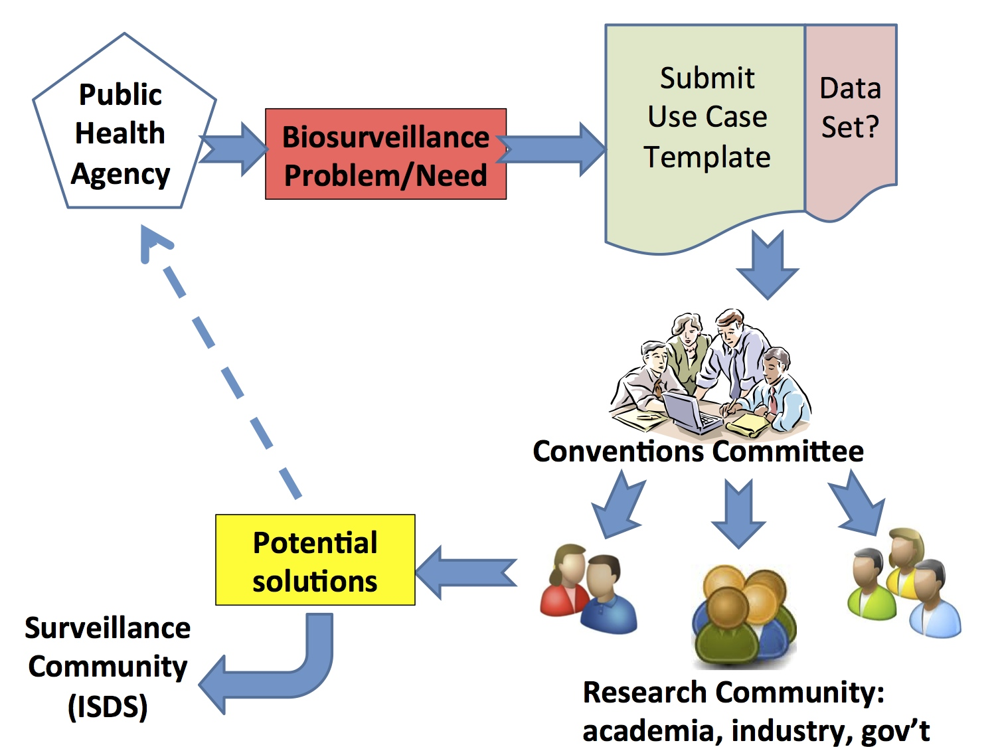
ASC – Analytic Solutions Committee
Analytic Solutions Committee

Slide 7
Brief History
Technical Conventions Committee
DTRA grant – Analytic Solutions Advisory Group (ASAG)
Rebranding as ASC

Slide 8
Process: Identifying & Refining Analytic PH Needs, Methods
Problem identification: may pertain to only one local health department, or to a group of health departments, state/province, or larger region
Use case development
  - Determine goals; propose requirements of desired methods
Identify potential solution providers
Establish strategy for completing the process
  - Meeting of all stakeholders to develop solution
  OR virtual conference where meeting not feasible
Implementation support

Slide 9
Use Case Template
USE- CASE/PROBLEM TITLE
CONTACT INFORMATION
PROBLEM DESCRIPTION
Summarize the problem:
SOLUTION REQUIREMENTS (Optional)
Describe the type of solution you are seeking (e.g., anomaly detection, signal validation, data quality characterization):
Describe how the solution should help you with your work:
ADDITIONAL NOTES (Optional)
Additional comments (I.e. financial concerns, budget constraints, potential limitations, other related issues or solutions):

Slide 10
Previous Use Cases
Use Case | Conference Call | Webinar | Consultancy | Usecase available | Consultancy Paper | Previous Driver/ Attendee institutions | Dataset available
Asyndromic Cluster Detection |  |  | √ | √ | √ | North Carolina, New York City, Boston | √
Infectious Disease Forecast Modeling |  | √ | √ |  |  | Dept. of Defense, CDC
Models for Forecasting Asthma Exacerbations |  |  | √ |  | √ | City of Boston, New York City | √
Arboviral disease surveillance |  |  | √ | √ |  | Arizona, Tennessee
Negation in free-text classification |  |  | √ |  | √ | Univ. Utah, North Carolina, Georgia, Tennessee | √
Surveillance under changing test types | √ |  |  | √ |  | New York City
Data Quality | √ |  |  | √ |  | Washington; Marion County, Ind.
Notes:
Takeaways: Use case can be broad or specific; involve one or many health departments/regions
Give opportunity for feedback from participants

Slide 11
Undeveloped Use Cases
Use Case | Conference Call | Webinar | Consultancy | Usecase available | Consultancy Paper | Previous Driver/ Attendee institutions | Dataset available
Formation/validation of ICD-10 syndromes |  | √ |  |  |  | Multiple
Overdose surveillance (opioid +) methods | √ | √ |  |  |  | Multiple
Social media surveillance methods | √ |  |  |  |  | Multiple
Special Event Surveillance |  | √ |  | √ |  | Multiple
Extreme Weather |  | √ |  | √ |  | Single
Norovirus, rotavirus, other GI infections |  |  |  |  |  | Single
Mental health or suicidal ideation surveillance |  |  |  |  |  | Single
Surveillance methods for avoidable lab errors/accidents |  |  |  |  |  | Single

Slide 12
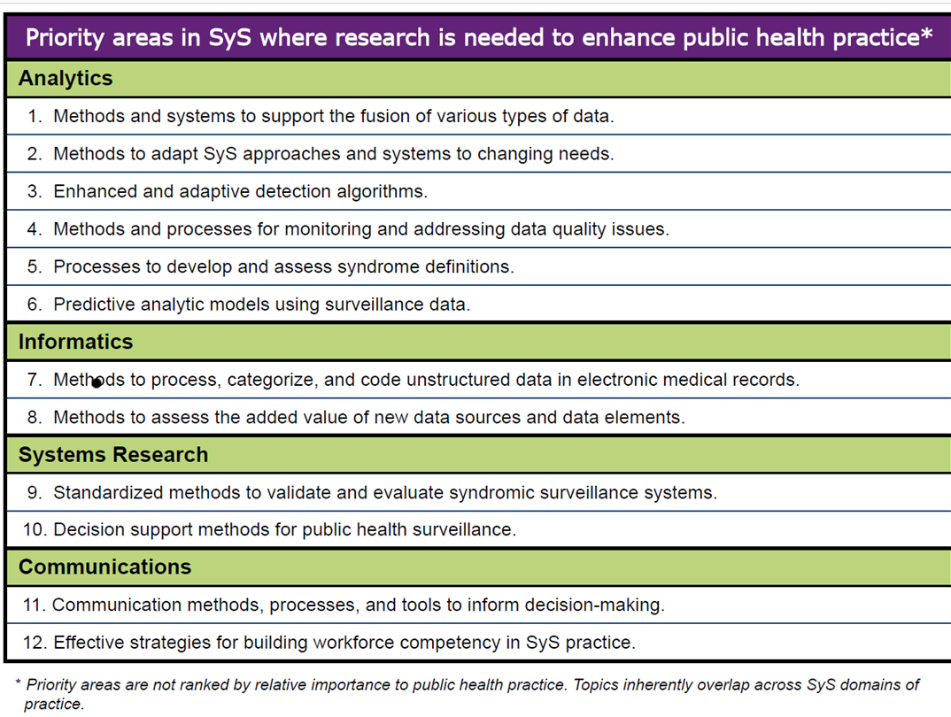
Continuing Research Priorities
A Practitioner-Driven Research Agenda for Syndromic Surveillance
http://journals.sagepub.com/doi/full/10.1177/0033354917709784
Notes:
Add research priority graphic (last years round table abstract)
Include link to paper

Slide 13
Forum review
Thread type
How are you doing this?
Informational
Do you do this?
Are you seeing this issue?'
Comment
Reporting technical problems
Request for case definition/query
Specific research needs:
Peer reviewed articles on how this is being done (climate surveillance)
Research areas
Lack of specificity in data
Continuity when transitioning coding schemes (ICD9 to ICD10) /
Determining value of data elements
Non ID surveillance
Notes:
Testing idea of looking at forums
Not looking at closed regional forums, but if forum admins think it would be appropriate then we could look at these as well

Slide 14
“Ask ASC”
Questions or ideas?
How can we improve process
How can we connect with developers
Use case ideas
Other thoughts
  ASC blog?
Notes:
Connecting with developers – how to develop network; if you know of developers we can connect to…

Slide 15
Analytic Solutions Committee
Goal: facilitate the development, evaluation, and implementation of analytic solutions for public health surveillance.
Broad range of scientific challenges facing public health practitioners, such as:
How can we describe the timing, extent, and burden of seasonal influenza this year?
How can we monitor incidence of new influenza strains, suspected mosquito and tickborne disease, and other novel threats in our target population?
How can we improve awareness of health threats resulting from mass gatherings, and from extreme weather events and other natural disasters?
What methods will improve collaboration with other departments monitoring noninfectious threats including chronic disease, mental health, and drug overdoses?
And how can we obtain methods compatible with our existing systems to address these issues?

Slide 16
Contacts
ASC forum
http://www.healthsurveillance.org/members/member_engagement/groups.aspx?code=ASC
Ian Painter
206-245-0227
ipainter@uw.edu
Teresa Hamby
609-826-5964
teresa.hamby@doh.nj.gov
Howard Burkom
Howard.Burkom@jhuapl.edu
Notes:
Connecting with developers – how to develop network; if you know of developers we can connect to…

