Slide 1
Facility Administration Tool
MFT User Interface Review
May 18, 2017
2:00 PM to 3:00 PM EDT
Presented By Millie Linville, MPH
CDC Contractor
NSSP Support Team

Slide 2
Agenda
Master Facility Table (MFT) Facility Administration Tool: What is it?
View and Discuss User Interface and Functionality
Questions and Answers

Slide 3
Purpose
Provide the look and feel of what the proposed Facility Administration Tool user interface could look like
Describe the functionality and rationale behind the Facility Administration Tool
Answer questions related to the proposed Facility Administration Tool
Receive comments on the user interface and proposed functionality of the tool

Slide 4
Overview
All data received by NSSP contains unique facility identifier
Sites must register unique identifier with NSSP prior to data submission
Legacy system used facility tables
Current platform uses the MFT

Slide 5
Terminology
MFT: Contains current facility information for facilities submitting data through a site
ADM_Crosswalk: Contains history of facility IDs
Operational_Crosswalk:
Maps legacy (or historic) facility IDs to current IDs and agnostic ID by using the MFT and ADM_Crosswalk
Is used for data processing
ESSENCE tables: Are used by ESSENCE

Slide 6
Current MFT Update Process
Site administrator will update MFT Excel spreadsheet and submit to NSSP Service Desk
Onboarding team will:
Make necessary changes to server tables
Create updated Excel spreadsheet
Return updated spreadsheet to site administrator
Close ticket submitted to NSSP Service Desk

Slide 7
Facility Administration Tool

Slide 8
Facility Administration Tool
User interface that will replace Excel spreadsheet update process
Support provided through Access & Management Center, allowing sites to view, add, and edit facility information
System automatically updates server tables as appropriate based on defined business rules
Visible only to site administrators and super administrators

Slide 9
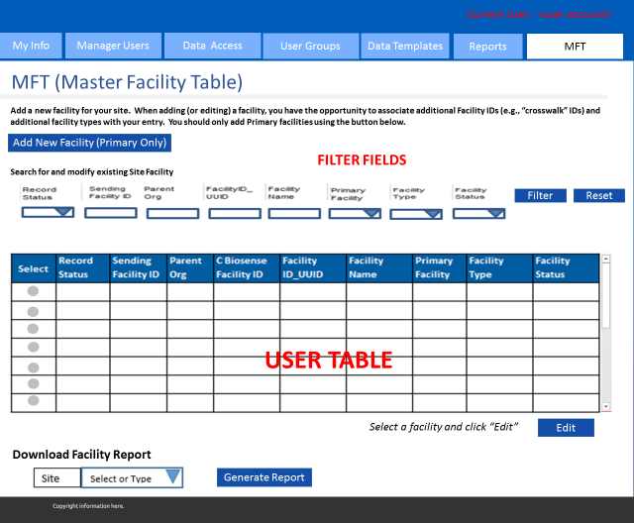

Slide 10
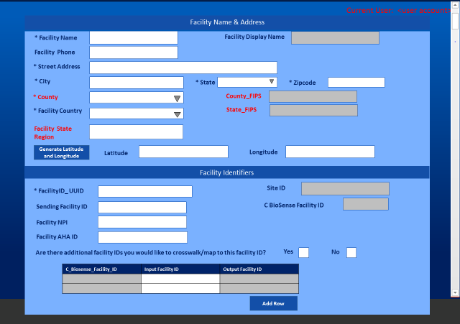

Slide 11
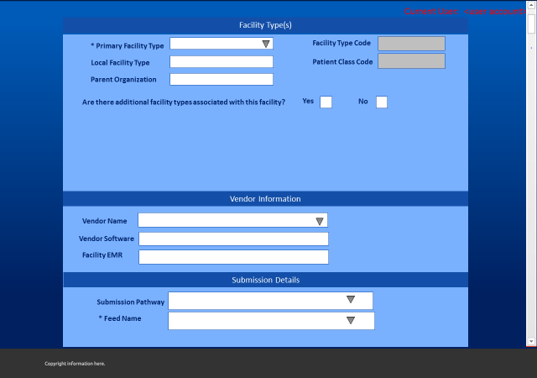

Slide 12
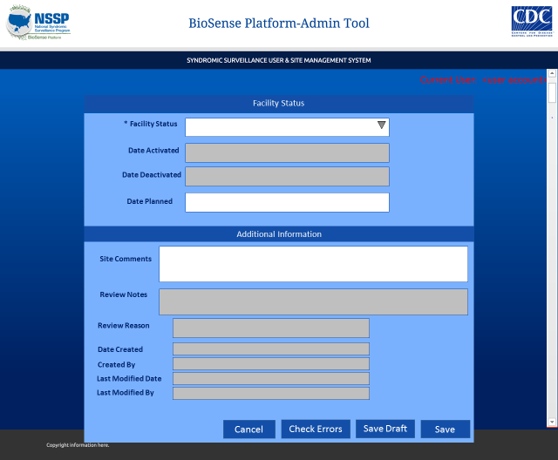

Slide 13
What Fields are Required?
FacilityID_UUID
Status
Facility_Type
Primary_Facility
FacType_Primary
Feed_Name
Vendor_Name*
Facility_Name
Facility_Street_Address
Facility_City
Facility_State // State_FIPS
Facility_Zip
Facility_County // County_FIPS
Facility_Country

Slide 14
Example: Add a Primary Facility

Slide 15
Notes:
The first example is to add a primary facility. To do so, you will click “Add New Facility”.

Slide 16
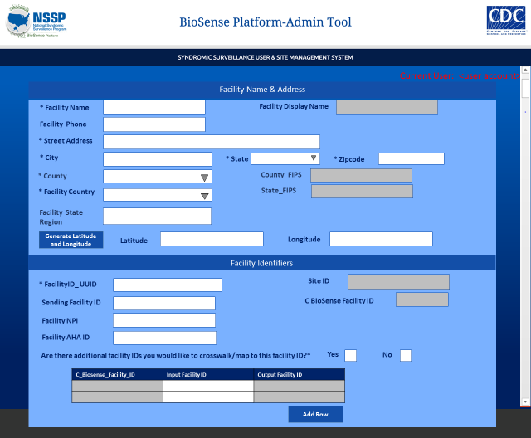
Generic Hospital
1 Hospital Ln
Atlanta
GA
30301
Fulton
US
33.862282
-84.394587
222
Notes:
Enter your details in the fields. Then, click the generate latitude and longitude button to populate the lat/long for you.

Slide 17
Generic Hospital
1 Hospital Ln
Atlanta
GA
30301
Fulton
US
33.862282
-84.394587
123
222
X

Slide 18
Emergency Care
Hospital
Hospital Group
X
Cerner
Health Sentry
GAFeed

Slide 19
A Note About Standardizing Vendor Names
Discussions are taking place between the NSSP Analytic Data Management Team and Data Quality Workgroup
Once vendor names are standardized, then a drop-down menu can be added to the vendor information screen
Initial release of Facility Administration Tool may require manual entry of vendor name
Vendor information is important for generating data quality reports by vendor

Slide 20
Onboarding
Required fields
Does facilityID_UUID already exist?
Does facility_name exist?

Slide 21
Error Checking
Required fields
Does facilityID_UUID already exist?
Does facility_name exist?

Slide 22
Active |  | Group | 1 | 123 | Generic Hospital | Y | Emergency | Onboarding
Notes:
When done correctly, saving the new primary facility will then show up in the table. You see here that the record status is active.

Slide 23
Review Key Fields for Data Processing
FacilityID_UUID
Unique facility ID within site
HL7 field EVN-7.2, MSH-4.2, or MSH-4.1
Primary_Facility
Identifies facility record to be used when processing of incoming messages
C_Biosense_Facility_ID
‘Agnostic’ system-generated unique facility identifier
Does not change

Slide 24
Review Key Fields for Data Processing
Facility_Status
Active
Inactive
Onboarding
Planned
Not Planned
Facility_Type
Emergency Care
Urgent Care
Primary Care
Inpatient Practice Setting
Medical Specialty

Slide 25
Example: Add a Primary Facility
The Facility_Master table:
The Operational_Crosswalk table:
Facility_ Name | FacilityID_ UUID | Primary_ Facility | C_Biosense_Facility_ID | Facility_ Status | Facility_Type
Generic Hospital | 123 | Y | 1 | Onboarding | Emergency Care
Input_FacilityID_UUID | Output_FacilityID_UUID | Facility_ Status | C_Biosense_Facility_ID | Facility_ Type
123 | 123 | Onboarding | 1 | Emergency Care
Notes:
So, what happens on the back-end of the system? This represents the rows that would be created in the Facility Master Table and the operational crosswalk.
Remember in our example we added the primary facility generic hospital. This is how it would show up in the Facility master table.
Another record will then also be added to the operational crosswalk for the FacilityID_UUID (remember this is the primary key between the two tables) and where all of the mapping happens.

Slide 26
Example: Add a Primary Facility
ESSENCE facility information:
Site_ID | Facility_Display_Name | Hospital | Facility_Type
222 | GA-Generic Hospital | 1 | Emergency Care
Notes:
On the ESSENCE side, the ESSENCE tables will be updated with the SITE_ID, the concatenated name of the facility – this will be displayed and the Facility Type
(the number 1 shows the C_BIOSENSE_ID )

Slide 27
Review Key Fields for Data Processing
FacilityID_UUID
Unique facility ID within site
HL7 field EVN-7.2, MSH-4.2, or MSH-4.1
Primary_Facility
Identifies facility record to be used when processing of incoming messages
C_Biosense_Facility_ID
‘Agnostic’ system-generated unique facility identifier
Does not change

Slide 28
Review Key Fields for Data Processing
Facility_Status
Active
Inactive
Onboarding
Planned
Not Planned
Facility_Type
Emergency Care
Urgent Care
Primary Care
Inpatient Practice Setting
Medical Specialty

Slide 29
Example 2: Update FacilityID_UUID

Slide 30
1
Active |  | Group | 1 | 123 | Generic Hospital | Y | Emergency | Onboarding
2
Notes:
Here’s another example of how to update a facilityID_UUID. Remember that the Facility ID_UUID lets us know that the messages for that facility are approved to be processed and we only let data into the system with registered UUIDs. Sometimes, SiteID_UUIDs need to be changed, for example some SITE IDs are tied to NPI and when NPI changes the FACILITY ID UUID needs to be change. This example will describe how Site Administrators will be able to do this using the proposed UI.
To edit a facility’s information, you can select the record row and click edit

Slide 31
Generic Hospital
GA-Generic Hospital
1 Hospital Ln
Atlanta
GA
30301
Fulton
13121
US
13
33.862282
-84.394587
123
222
1
X
1
123
123
Notes:
Clicking Edit will show you the details of the facility. Since we are updating the Facility ID UUID, we will go to the field, and change it to the new Value. We’ll use 456. You’ll notice here, too, what is in the grey fields that cannot be changed – the Display name, FIPS for county and state, Site ID, and the C Biosense Facility ID

Slide 32
Generic Hospital
GA-Generic Hospital
1 Hospital Ln
Atlanta
GA
30301
Fulton
13121
US
13
33.862282
-84.394587
123 456
222
1
X
1
123
123

Slide 33
Onboarding
2017-01-26
BIOSENSE\fnaz
2017-01-26
BIOSENSE\fnaz
Notes:
Scroll down and Save. You’ll also see some statistics on the created by so that there is a trail.

Slide 34
Active |  | Group | 1 | 456 | Generic Hospital | Y | Emergency | Onboarding
Notes:
When you save, you notice that the Facility ID_UUID for the facility has changed to 456 on the user view.

Slide 35
Example 2: Updating FacilityID_UUID
The Facility_Master table:
The Operational_Crosswalk table:
Facility_ Name | FacilityID_ UUID | Primary_ Facility | C_Biosense_Facility_ID | Facility_ Status | Facility_Type
Generic Hospital | 456 | Y | 1 | Onboarding | Emergency Care
Input_FacilityID_UUID | Output_FacilityID_UUID | Facility_ Status | C_Biosense_Facility_ID | Facility_Type
123 | 456 | Onboarding | 1 | Emergency Care
456 | 456 | Onboarding | 1 | Emergency Care
Notes:
So what happens on the back end. You’ll notice that the Facility Master Table shows the updated Facility ID UUID wheras there is a new row added to the Operational Crosswalk that maps former facility IDs to current IDs and the agnostic ID.
(Maps legacy (or historic) facility IDs to current IDs and agnostic ID by using the MFT and ADM_Crosswalk
Is used for data processing)

Slide 36
Example 2: Updating FacilityID_UUID
The ESSENCE table:
Site_ID | Facility_Display_Name | Hospital | Facility_ Type
222 | GA-Generic Hospital | 1 | Emergency Care
Notes:
On the ESSENCE side, nothing changes since the detail is really necessary on the BioSense Platform side when we send the data to the ESSENCE ingest database.

Slide 37
Generic Hospital
GA-Generic Hospital
1 Hospital Ln
Atlanta
GA
30301
Fulton
13121
US
13
33.862282
-84.394587
456
222
1
X
1
123
456
1
456
456
Notes:
Once the information is saved, you will notice that the table at the bottom of the screen shows the crosswalk information similar to what we have on the operational crosswalk on the backend.

Slide 38
Example 3: Add a Non-Primary Facility

Slide 39
1
Active |  | Group | 1 | 456 | Generic Hospital | Y | Emergency | Onboarding
2
Notes:
This third example describes how a Site Administrator would add a non-primary facility to an existing primary facility. Your table will show your active primary facilities. Select the primary facility to which you want to add the non-primary facility and then click Edit.

Slide 40
Generic Hospital
GA-Generic Hospital
1 Hospital Ln
Atlanta
GA
30301
Fulton
13121
US
13
33.862282
-84.394587
456
222
1
X
1
123
456
1
456
456
Notes:
You will see the information for that primary facility and scroll until you get to facility types section.

Slide 41
Emergency Care
Hospital
Hospital Group
X
Cerner
Health Sentry
GAFeed
Notes:
Before we had no non-primary facilities so the No box is checked. Now, we will update this by checking the Yes box.

Slide 42
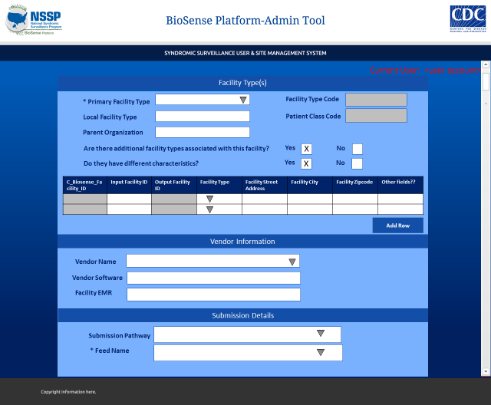
Emergency Care
Hospital
Hospital Group
456
456
Urgent Care
Cerner
Health Sentry
GAFeed
Notes:
Then, the user can indicate whether the non-primary facility has the same characteristics or not (like name, address, etc.) We’ll say Yes for this example. You will then add the information of the Input_Facility ID and the facility type to this table. Facility ID UUID is tied to primary facility so you can’t change that.

Slide 43
Onboarding
2017-01-26
BIOSENSE\fnaz
2017-01-26
BIOSENSE\fnaz
Notes:
Then scroll down and click save.

Slide 44
Active |  | Group | 1 | 456 | Generic Hospital | Y | Emergency | Active
Active |  | Group | 1 | 456 | Generic Hospital | N | UrgentCare | Active
Notes:
You’ll notice that the new non-primary facility has been added to the table.

Slide 45
Example 3: Adding Non-Primary Facility
The Facility_Master table:
The Operational_Crosswalk table:
Facility_ Name | FacilityID_ UUID | Primary_ Facility | C_Biosense_Facility_ID | Facility_ Status | Facility_Type
Generic Hospital | 456 | Y | 1 | Onboarding | Emergency Care
Generic Hospital | 456 | N | 1 | Onboarding | Urgent Care
Input_FacilityID_UUID | Output_FacilityID_UUID | Facility_ Status | C_Biosense_Facility_ID | Facility_Type
123 | 456 | Onboarding | 1 | Emergency Care
456 | 456 | Onboarding | 1 | Emergency Care
Notes:
So what happens on the backend? You’ll notice that we have a new row in the Facility Master table showing the non-primary facility, mapped to the same facilityID_UUID, with facility type urgent care. You’ll see that we did not change the Operational Crosswalk at all

Slide 46
Example 3: Adding Non-Primary Facility
The ESSENCE table:
Site_ID | Facility_Display_Name | Hospital | Facility_ Type
222 | GA-Generic Hospital | 1 | Emergency Care
Notes:
And the ESSENCE table also does not change.

Slide 47
MFT Approvals

Slide 48
Approval
Key updates require review and approval before accepting
A facility appears to exist in another site
American Hospital Association (AHA) ID,* National Provider Identifier (NPI), Sending_Facility_ID, or FacilityID_UUID
Facility status has changed to Active or from Active
An Emergency Care facility is missing AHA ID
User chooses “Other” option from Feed_Name drop down
* Note. NSSP Representativeness Report includes site-specific AHA reports for identifying the AHA ID. Use WinSCP to access the Reports/Production folder on datatrans.biosen.se server
Notes:
There are times when we will need approvals before the MFT is updated with information you input through the UI. Those times are:
When it seems like the same facility appears in another site (by looking at AHA ID, NPI ID< Sending Facility ID or Facility ID UUID)
When you change to or from and ACTIVE status
When Emergency care facility is missing it’s AHA ID
Or you choose Other from the Feed Name drop down for a primary facility
TALKING POINT: Mention when discussing the AHA that ADM Team has created a helpful reference to identify a facilities AHA ID. The NSSP Analytic Data Management Team has provided Site specific AHA reports that can serve as helpful reference (as needed) to identify the AHA ID. The reports are located in the If anyone wants us to resend the Data Representativeness Report, please reach out to the NSSP Help Desk or Access this report using WinSCP to access the Reports/Production folder on datatrans.biosen.se server

Slide 49
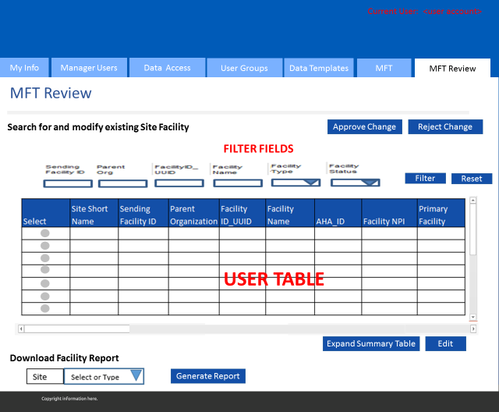
Notes:
On the Super User side, we have this UI to approve and reject changes.

Slide 50
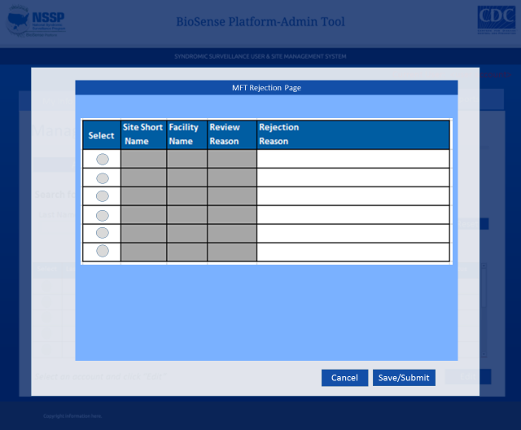
Notes:
When we reject this is the screen we’ll see. I’m going to provide an example in the next few slides.

Slide 51
MFT Approvals Example

Slide 52
1
Active |  | Group | 1 | 456 | Generic Hospital | Y | Emergency | Onboarding
2
Notes:
A site admin can change the status for this facility by opening this record.

Slide 53
Onboarding
2017-01-26
BIOSENSE\fnaz
2017-01-26
BIOSENSE\fnaz
Notes:
And scrolling to the Facility Status at the very bottom of the page, and changing the status from onboarding to Active

Slide 54
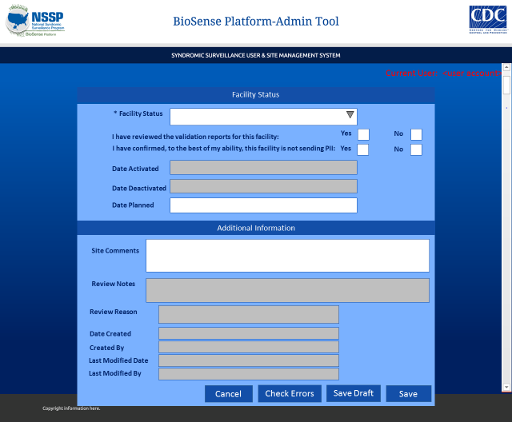
Active
X
X
2017-01-26
BIOSENSE\fnaz
2017-01-26
BIOSENSE\fnaz
Notes:
When the user changes the status, these two statements will show and the Site Administrator is asked to indicate Yes or No to “reviewing the validation report” and confirming that there is no PII transmission”. The Site Admin will then click Save

Slide 55
Review |  | Group | 1 | 456 | Generic Hospital | Y | Emergency | Onboarding
Notes:
On the main MFT tab, the user then sees the Record Status change to Review.

Slide 56
2
1
GA |  |  | 456 | Generic Hospital |  |  | Y
Notes:
The Onboarding Team will then review the information in the table and can approve or reject based on the table columns. This facility is a primary facility missing an AHA_ID, so we are going to reject it to send back to Site Administrator.

Slide 57
GA | Generic Hosp | AHA_ID | Please input AHA_ID for facility
Notes:
We will then see a modal window pop open allowing us to add a comment. Saving will then update the status on the Site Admin’s view.

Slide 58
1
Rejected |  | Group | 1 | 456 | Generic Hospital | Y | Emergency | Onboarding
2

Slide 59
Active
Please input AHA_ID
05: Missing AHA_ID
2017-01-26
BIOSENSE\fnaz
2017-01-26
BIOSENSE\fnaz
Notes:
The site administrator can see the review notes in the facility record and make the necessary updates.

Slide 60
Generic Hospital
GA-Generic Hospital
1 Hospital Ln
Atlanta
GA
30301
Fulton
13121
US
13
33.862282
-84.394587
456
222
1
606189
X
1
123
456
1
456
456

Slide 61
Active
Please input AHA_ID
05: Missing AHA_ID
2017-01-26
BIOSENSE\fnaz
2017-01-26
BIOSENSE\fnaz

Slide 62
GA |  |  | 456 | Generic Hospital |  |  | Y

Slide 63
Active |  | Group | 1 | 456 | Generic Hospital | Y | Emergency | Onboarding

Slide 64
Questions?

