Slide 1
Challenges and Implications of Postmarketing Surveillance of Prescription Opioids
June 29, 2017
Richard C. Dart, MD, PhD
Director, Rocky Mountain Poison and Drug Center, Denver Health and Hospital Authority
Professor of Emergency Medicine, University of Colorado Health Sciences Center

Slide 2
Outline
Challenges of Rx Drug Abuse Surveillance
  Product specificity
  Confounders and biases
RADARS System
Observations from RADARS and other programs
  Decreasing prescription opioid abuse, increasing heroin/ fentanyl
  IR v. ER
  Economics of opioid abuse
  Opioids with abuse deterrent properties
Summary

Slide 3
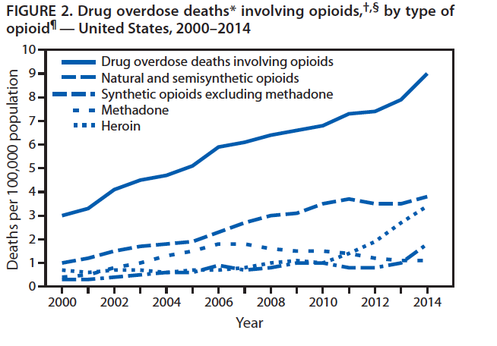
One Problem?
Rudd et al. MMWR Morb Mortal Wkly Rep. 2016 Jan 1;64(50-51):1378-82.
Notes:
I’m not going to spend much time defining the problem, we are all aware of the epidemic of opioid deaths in the United States.
This problem is particularly tough because it constantly changes. This is a huge problem for our political and public health systems that tend to define a problem and then attack the problem. This works well for many infectious diseases. If I take handle off the pump, then I may be able to cure cholera, but this doesn’t work for opioids.
Now that I have your interest, let’s go on.

Slide 4
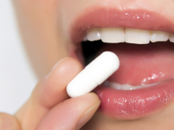
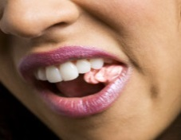
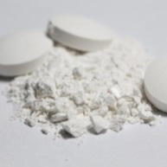
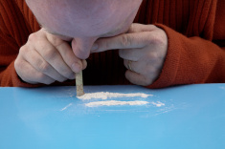
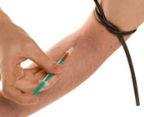
Progression of Rx Drug Abuse
Filling the Balloon
Person in Pain
Susceptible
Person
Outcomes
Intact
Chewed
Crushed
OUD
Recreational Abuser
Overdose
Abuse of Other Drugs
Death
Notes:
Every analysis and discussion that we have about prescription drug abuse has underlying assumptions. A fundamental concept in causation is biological plausibility.
A small percentage of persons treated appropriately for their pain will develop abuse and in some cases the outcomes of overdose, addiction or death. I’m going to focus on persons in pain today although I think similar considerations apply to the recreational abuser.
Now, what happens between this initial exposure and these outcomes?
[CLICK]
Most people start by swallowing intact pills. For those so inclined, it is a short step to chewing and swallowing the drug and then crushing and swallowing the drug. This speeds up absorption and gives them a faster high.
[CLICK]
A small percentage will go on snorting and injection for the same reasons.
[CLICK]
Importantly, users often switch back and forth between products and routes of use.
[CLICK]
All 3 of these routes can produce the outcomes of overdose, addiction or death - and for INTRAVENOUS abuse, the long-term consequences of HIV and Hepatitis C.
So, over the past 30 years, we have filled a large balloon with persons who develop abuse behaviors.

Slide 5
Progression of Rx Drug Abuse
Emptying the Balloon
Person in Pain
ADF
ADF
Guidelines
PDMP
Outcomes
Susceptible
Person
Intact
Chewed
Crushed
OUD
Treatment
Recreational Abuser
ADF
N
Overdose
Abuse of Other Drugs
Death
ADF
Notes:
Every analysis and discussion that we have about prescription drug abuse has underlying assumptions. A fundamental concept in causation is biological plausibility.
A small percentage of persons treated appropriately for their pain will develop abuse and in some cases the outcomes of overdose, addiction or death. I’m going to focus on persons in pain today although I think similar considerations apply to the recreational abuser.
Now, what happens between this initial exposure and these outcomes?
[CLICK]
Most people start by swallowing intact pills. For those so inclined, it is a short step to chewing and swallowing the drug and then crushing and swallowing the drug. This speeds up absorption and gives them a faster high.
[CLICK]
A small percentage will go on snorting and injection for the same reasons.
[CLICK]
Importantly, users often switch back and forth between products and routes of use.
[CLICK]
All 3 of these routes can produce the outcomes of overdose, addiction or death - and for INTRAVENOUS abuse, the long-term consequences of HIV and Hepatitis C.
So, over the past 30 years, we have filled a large balloon with persons who develop abuse behaviors.

Slide 6
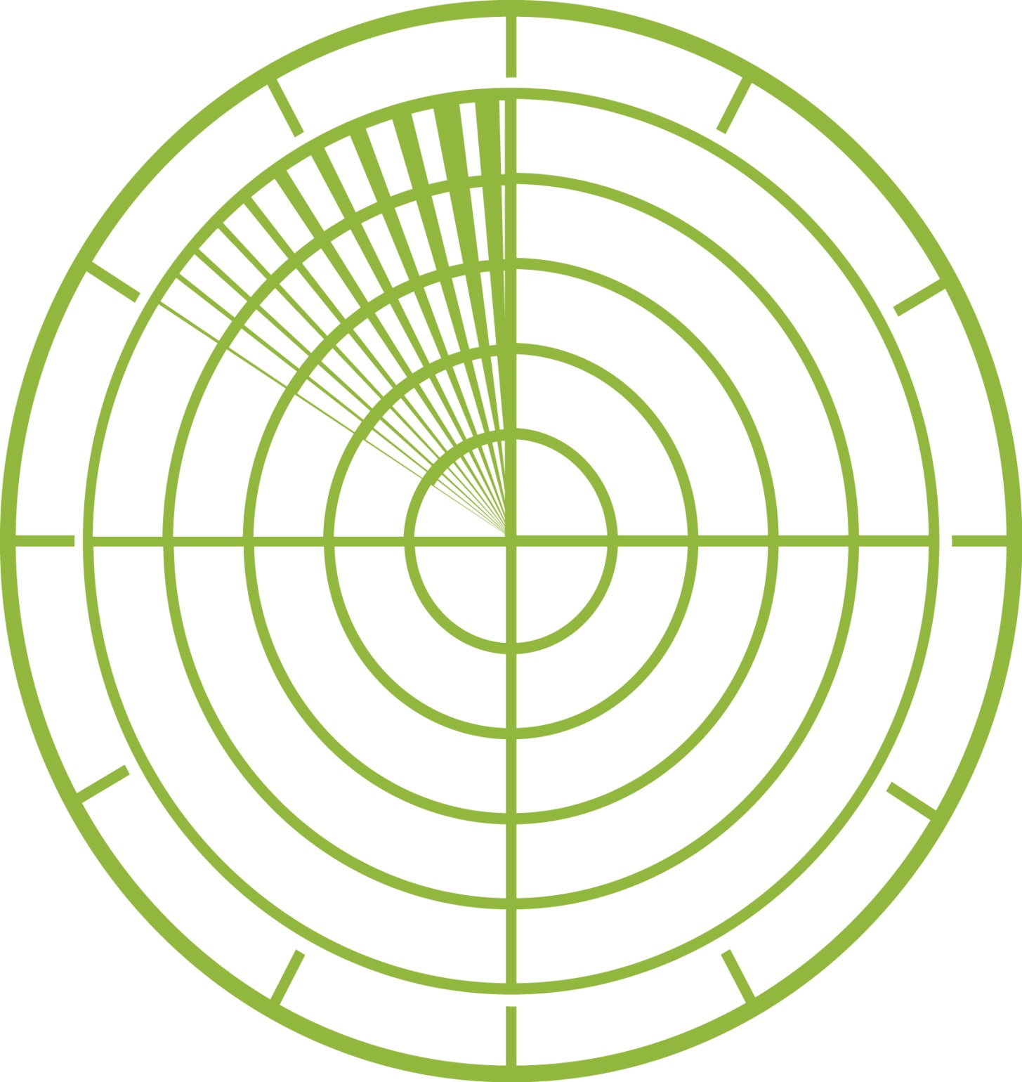

Challenges of Postmarketing Surveillance
Which Product?
Evasion
Other Substance
Switching
Dart RC. Monitoring risk: post marketing surveillance and signal detection. Drug Alcohol Depend 2009;105 Suppl 1:S26-32. doi: 10.1016/j.drugalcdep.2009.08.011
Notes:
So how can we measure these things? Postmarketing surveillance is always difficult because one can’t control the variables. But it is particularly difficult for substances of abuse because the abuser is actively trying to avoid detection.
Furthermore in the case of opioids there are the additional complications tremendous variation of abuse practices and the ease by which a person can simply switch between opioid drugs, both licit and illicit. Then there are the frequent other drugs that an abuser may use to modify or improve their experience. For opioids, alprazolam is probably the most common.
Besides these general issues, for postmarketing evaluation, we want to know the specific drug involved. Just knowing oxycodone is not enough. Is it OxyContin or is it single entity immediate release oxycodone? If possible, we want to know where the abuse occurs geographically. And of course we want to know it fast.

Slide 7
Mosaic Surveillance of Prescription Drug Abuse
Acute Health Events
Poison Center Program
Entering Treatment
Survey of Key Informants’ Patients
Drug Transactions
Drug Diversion Program
Survey of Non-Medical Use of Prescription Drugs (NMURx)
Opioid Treatment Program
Non-Medical
Use
Entering Treatment
StreetRx.com
Advanced Users/Targeted Investigations
Researcher & Patients Interacting Directly (RAPID)
Illicit Market Price
StreetRx Program
Web Monitoring Program
Internet
Chatter
Notes:
We do our best by examining the issue from multiple different angles.
Go through list – top level only
EXPLAIN:
OBS:
OUT:

Slide 8
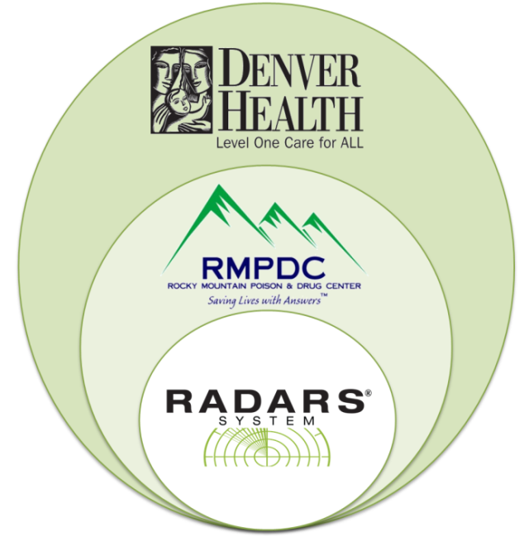
What is the RADARS® System?
History
  2002, launched by Purdue Pharma L.P.
  2006, Denver Health and Hospital Authority takes independent ownership
    Denver Public Hospital for 150 years
    State sanctioned independent authority
Conflict of Interest Statement
Most manufacturers of prescription opioids or stimulants subscribe to RADARS System.
RADARS System is the property of Denver Health and Hospital Authority, a political subdivision of the State of Colorado.
Subscribers receive information, but do not participate in developing the System, data collection, or analysis of the data. They do not have access to the raw data.
Employees are prohibited from personal financial relationships with any other company.
Notes:
IN: Today I’m going to tell where we stand right now. I’ll be focusing on a series of programs called the RADARS System, but I will be bringing in lots of other data as well because the mosaic concept applies to all data pertaining to the subject.
EXPLAIN:
OBS:
OUT:

Slide 9
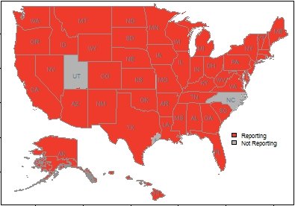
Poison Center (PC)
Population
  Young children, adolescents, young adults, adults, elderly
Definition/Type of Cases
  Spontaneous reports of intentional and unintentional exposure mentions of acute medical events associated with one or more prescription drug of interest
Coverage
  50 poison centers covering
  48 states
Reporting Timeframe
  Weekly
Period of Data Collection
  2003 - present
2016 coverage
Notes:
9

Slide 10
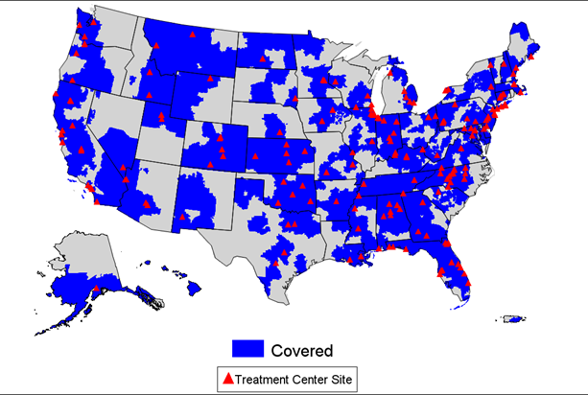
Opioid Treatment Program (OTP)
Population
  Opioid dependent persons seeking treatment at public and private opioid treatment programs
Definition/Type of Cases
  Self-reported use of prescription or illicit opioids to “get high” in the past 30 days
Coverage
  115 programs from 37 states
Reporting Timeframe
  Quarterly
Period of Data Collection
  2005 – present
AATOD
  Mark Parrino, MHA
2016 coverage – OTP and SKIP Combined
Notes:
10

Slide 11
Survey of Key Informant’s Patients (SKIP)
Population
  Opioid dependent persons seeking treatment at primarily private substance abuse treatment programs
Definition/Type of Cases
  Self-reported prescription or illicit opioid to “get high” in past 30 days
Coverage
  310 practices
Reporting Timeframe
  Quarterly
Period of Data Collection
  2008 – present
Washington University
  Ted Cicero, PhD
2016 coverage – OTP and SKIP Combined
Notes:
11

Slide 12


Survey of NMU of Rx Drugs (NMURx)
Population
  General adult population survey recruited through an online survey panel company
Definition/Type of Cases
  Self-reported lifetime use, as well as lifetime and recent non-medical use, of prescription drugs
    NMU: without a doctor’s prescription or any reason other than what was recommended by your doctor
Coverage
  30,000 respondents per launch from 50 states
Reporting Timeframe
  1st and 3rd quarters each year
Period of Data Collection
  3Q 2016 – Present
Denver Health
  Jody Green, PhD
Notes:
12

Slide 13
Web Monitoring
Qualitative measure of prescription drug abuse, misuse and consequences (addiction, overdose and death)
Early detection system to monitor new drug trends or emerging activities
Main sources:
  Twitter/Facebook, Blogs/Forums
Post Coding:
  Theme: diversion, detoxification, drug advice, ADF, side effects, pop culture, death, etc.
  Motive of use: unintentional or intentional misuse, abuse, potential misuse, etc.
  Key measures: addiction, overdose and death
  Co-ingestion
  Route/source
  Sentiment: negative, neutral and positive
13

Slide 14
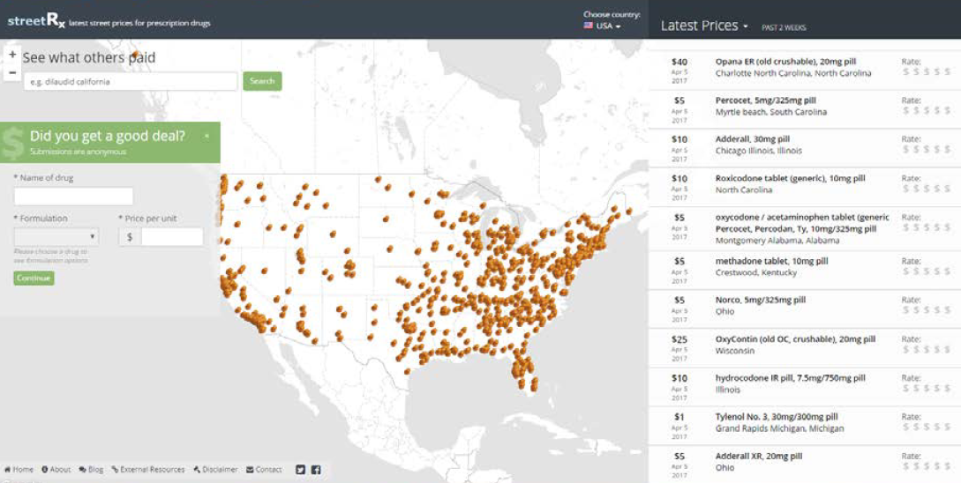
StreetRx (www.streetrx.com)
Population
  Any person in US with access to the internet
Definition/Type of Cases
  Utilize crowdsourcing methodology to calculate average price of specific prescription drug in particular location
  Validated by DD
Coverage
  All 50 states
Reporting Timeframe
  Quarterly
Data Collection
  2011 - present
14
Notes:
14

Slide 15
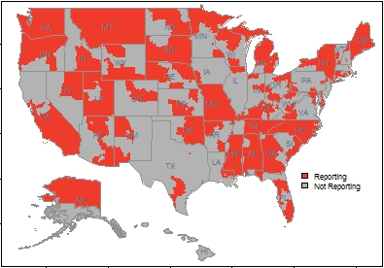
Drug Diversion (DD)
Population
  Cases of prescription drug diversion
Definition/ Type of Cases
  Number of new instances of
  pharmaceutical diversion investigated by
  drug diversion units or reported to state regulatory boards
Coverage
  664 reporters/49 states
Reporting Timeframe
  Quarterly
Period of Data collection
  2002 - present
2016 coverage

Slide 16
RADARS® System Limitations
Spontaneous reports (Poison Center, StreetRx, Web Monitoring): voluntary self-reporting of aberrant behaviors
Self-reporting (Poison Center, Opioid Treatment/SKIP, College Survey, StreetRx, Web Monitoring): cannot validate product identification or other reported behaviors
De-identified data (Poison Center, StreetRx, Web Monitoring): source cannot be verified, additional information cannot be obtained.
Geographical coverage is not universal across programs
Notes:
Incomplete coverage leads me to next slide
IN:
EXPLAIN:
OBS:
OUT:

Slide 17
What Can We Say About Prescription Drug Abuse?
Notes:
I’ve now loaded you down with a whole bunch of vague methodology and I’m sure you are dying to see some data
So just what can we say about prescription drug abuse. I’ve included some examples from a variety of analyses we have done. Please keep in mind that there are multiple programs and myriad issues. For example, data from at least one RADARS program are used in essentially every FDA advisory committee on opioid analgesics.

Slide 18
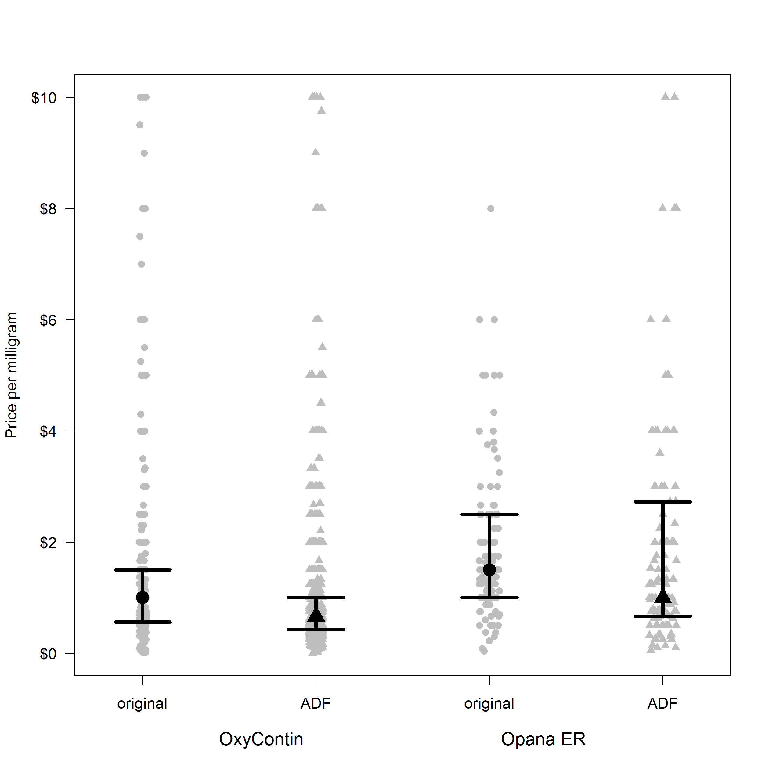
30,000 Feet: Prescription Opioid Abuse is Decreasing
StreetRx
Trends in Opioid Analgesic Abuse and Mortality in the United States.
N Engl J Med 2015;372:241-8
Notes:
Some of you may remember our paper, now 2 years old that proposed that prescription drug abuse was changing.

Slide 19
RADARS Poison Center Intentional Abuse, 2006 - 2016
HC
Resched
Per
100,000
population
Methadone
Bup
Notes:
Here we have just the poison center data which has been extended from 2013 through all of 2016. And this analysis is also more granular – What drugs account for those decreases?
Methadone has decreased about 30-40% since 2009! Interestingly, if one examines the NVSS data from CDC, the same phenomenon is clear.
In contrast, Buprenorphine is gradually increasing. I don’t see this as alarming because prescriptions are increasing as well and in high risk patients who are entering substance abuse treatment programs.
We see that most of the decrease is comprised of hydrocodone and oxycodone. However, they don’t show quite the same pattern. After dominating for many years, hydrocodone gave way to oxycodone in 2014 – at least in poison center cases.

Slide 20
Most Rx Opioids
Rudd et al. MMWR Morb Mortal Wkly Rep. 2016 Jan 1;64(50-51):1378-82.
Notes:
How can I say that opioid abuse is decreasing? Then why are deaths increasing? Why does the press constantly state the prescription opioid deaths are increasing.
Well, let’s go back to the slide I showed earlier.
WE see the increasing deaths, but these are total deaths.
When we look at the specific components of the deaths, we see that the main category “Natural and Semisynthetics” has been flat since 2011. In fact if we take out cases that involved heroin or fentanyl Combined with a natural or semisynthetic, the number of cases is decreasing nicely.

Slide 21
Poison Center Cases -Similar Observation
Deaths Involving Natural & Semisynthetic Opioids, 2003 to 2015
Notes:
Similarly, we calculated the correlation between deaths captured by poison centers and the National Vital Statistics System, or NVSS. Poison center deaths number about 5-10% of the opioid deaths reported to NVSS. One concern for poison center data involves opioid overdose die in the field and a poison center is never called. So the question is whether poison center mortality rates are a reasonable sample of the total number of deaths in the United States.
This slide shows that correlation for the NVSS category of Natural and Semisynthetic Opioids, which is the category containing the ER/LA REMS drugs, and poison centers was good with a correlation coefficient of 0.67.
One challenge is that NVSS does not report the specific product involved. Therefore it cannot analyze the ER/LA REMS drugs alone. Poison center data, while only a sample of total deaths, allows us to identify specific products and therefore we can identify the ER/LA REMS group of drugs.

Slide 22
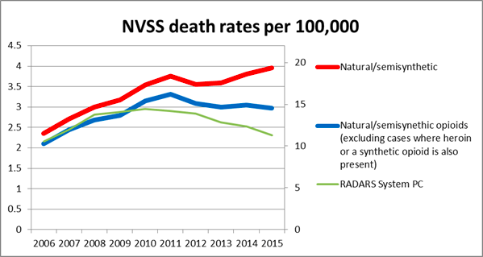
Role of Heroin and Synthetics in NVSS Death Rates
Notes:
This slide shows the effect on the natural/semisyntetic category when we take out the heroin and synthetics co-exposures, roughly a 10% reduction since 2011.

Slide 23
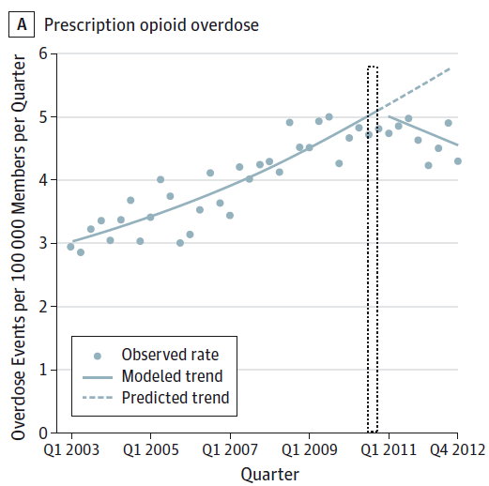
Other Data : Rx and Opioid Overdose Decreasing – Claims made Analysis
Larochelle, et al. JAMA Intern Med. 2015;175(6):978-987
Notes:
Other investigators are reporting similar results. Explain the slide
The issues are rapidly changing from prescription drug abuse to opioid abuse in general.

Slide 24
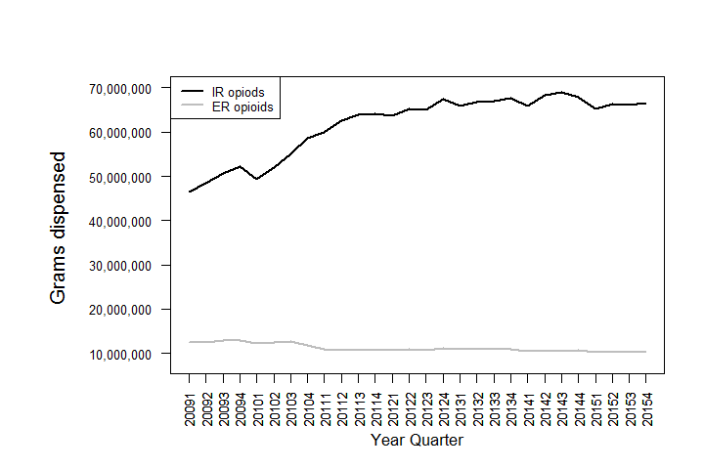
Only 15%-20% of Opioids Dispensed are Extended Release

Slide 25
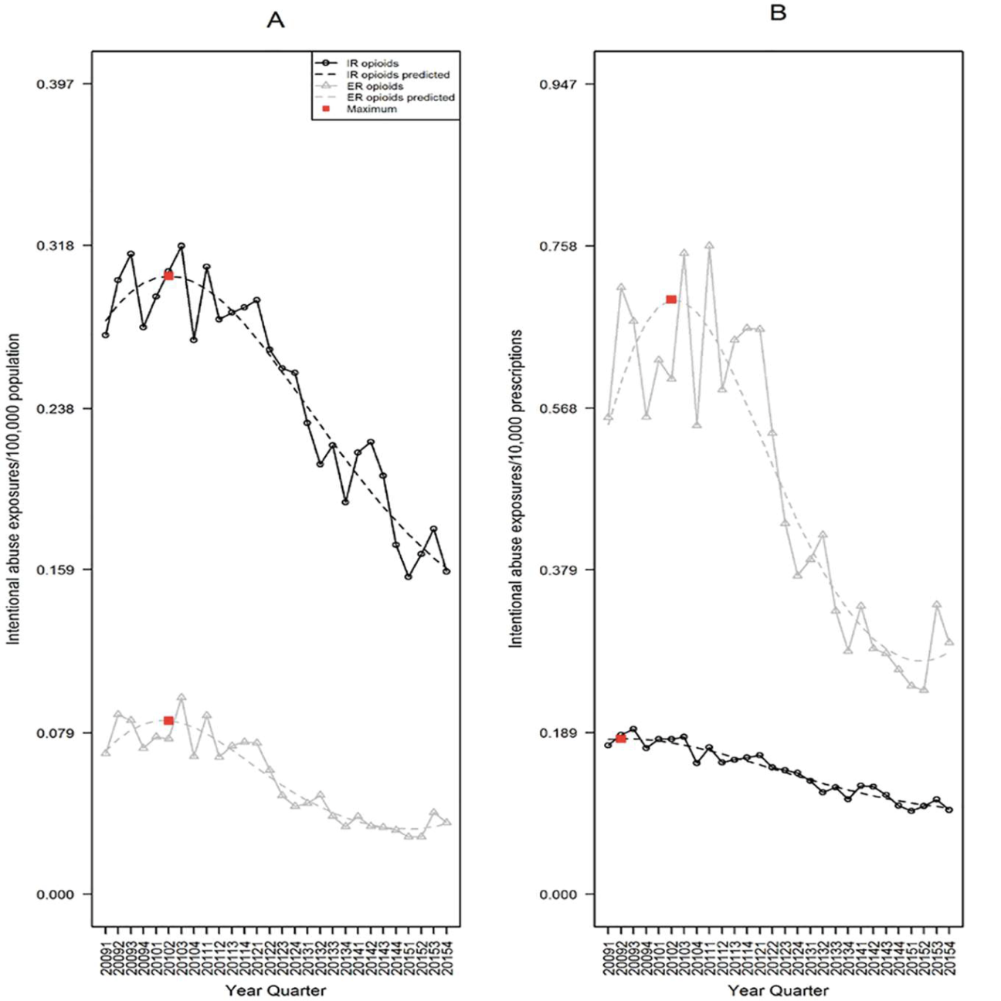
Poison Center Abuse Rate Greater for IR Formulations

Slide 26
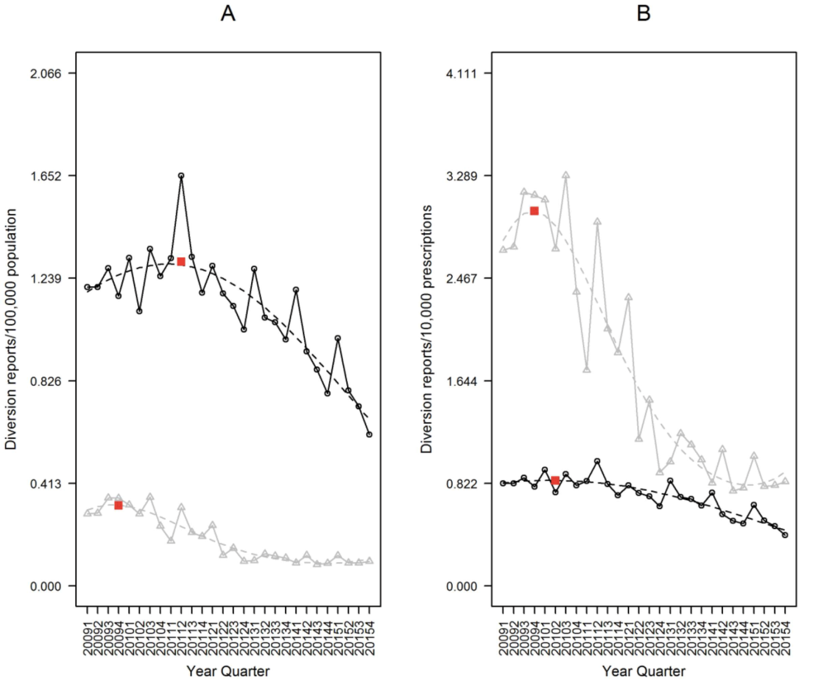
Opioid Treatment Program IR Also More Common

Slide 27
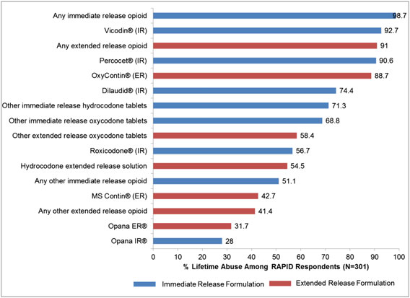
Experienced Drug Abusers Use Both ER and IR Products
Cicero et al. Pharmacoepidemiol Drug Safety 2017; 26: 56–62.

Slide 28
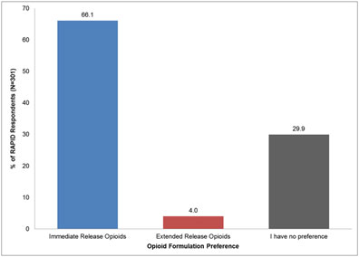
Experienced Abuser Now Prefer IR Opioid Analgesics
Cicero et al. Pharmacoepidemiology and Drug Safety 2017; 26: 56–62.

Slide 29
The IR Opioid Threat
IR products were always the most important part of the opioid problem
  Most people start on an IR opioid
  IR much more available
  IR cheaper in many cases
Targeting both IR and ER decreases “squeezing the balloon” effect

Slide 30
“Abuse Deterrent” Formulations
What is the evidence that opioid analgesics with abuse deterrent labeling improve outcomes (abuse, misuse, overdose, death)?
Systematic review
  44 reports on opioids with abuse deterrent labeling
  Hydrocodone (n=7)
  Morphine (n=5)
  Oxycodone (n=32)*
Hill Criteria
Also assessed confounding factors and bias
Dart, Iwanicki, Dasgupta, Cicero, Schnoll, 2017, submitted.

Slide 31
Bradford Hill Criteria
Factor | Description
Strength (effect size): | The larger the association, the more likely that it is causal.
Consistency (reproducibility): | “Has it been repeatedly observed by different persons, in different places, circumstances and times?”
Specificity | Causal relationship is supported by a very specific population at a specific site and disease with no other likely explanation
Temporality | The effect has to occur after the cause and after expected delay
Biological gradient | Greater exposure should generally lead to greater incidence.
Plausibility | A plausible mechanism between cause and effect
Coherence | Coherence between epidemiological and laboratory findings
Experiment | "… some preventive action is taken. Does it in fact prevent?”
Analogy | The effect of similar factors may be considered.
Additional Criteria
Confounding | Alternative explanations for the observed associations
Bias | Systematic artifacts of data collection or study design

Slide 32
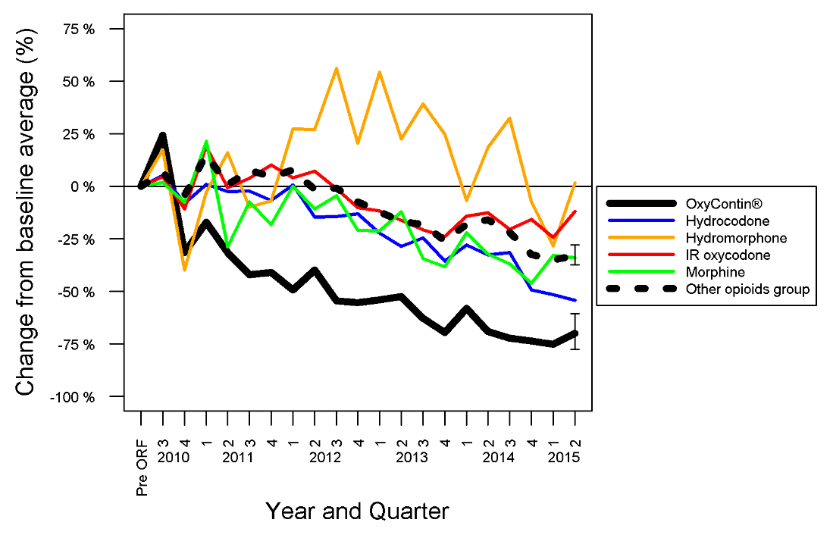
Cases Involving Intentional Abuse, Poison Center Program
Reformulation
Effect Size
Temporality
Specificity

Slide 33
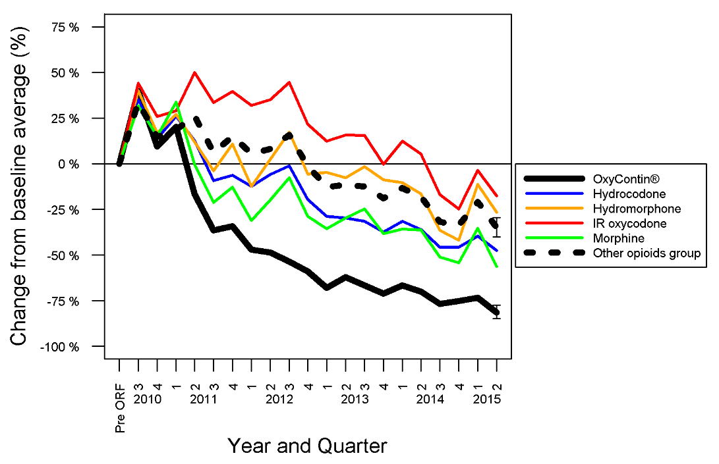
Investigations Opened, Drug Diversion
Reformulation
Effect Size
Temporality
Specificity

Slide 34
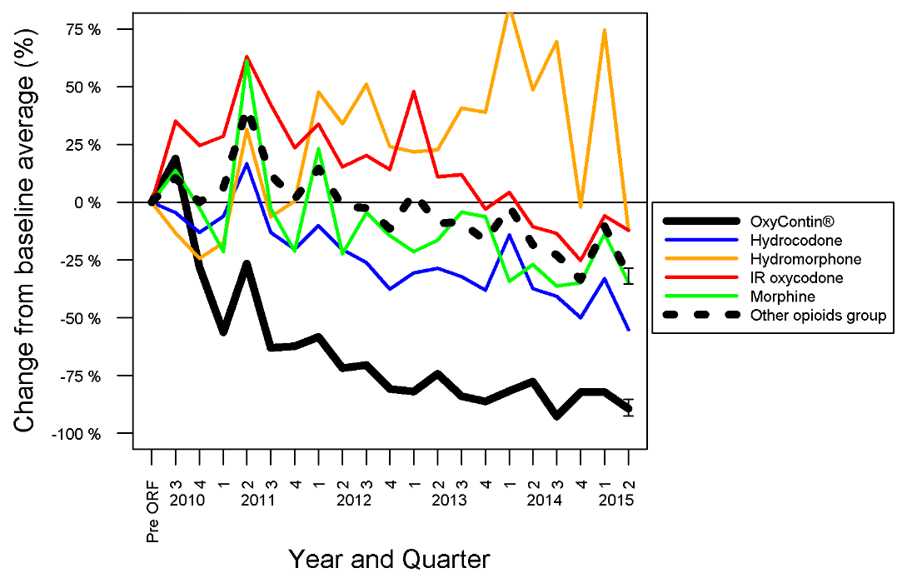
Drugs Used in Past 30 Days, Opioid Treatment Program
Reformulation
Effect Size
Temporality
Specificity
Consistency

Slide 35
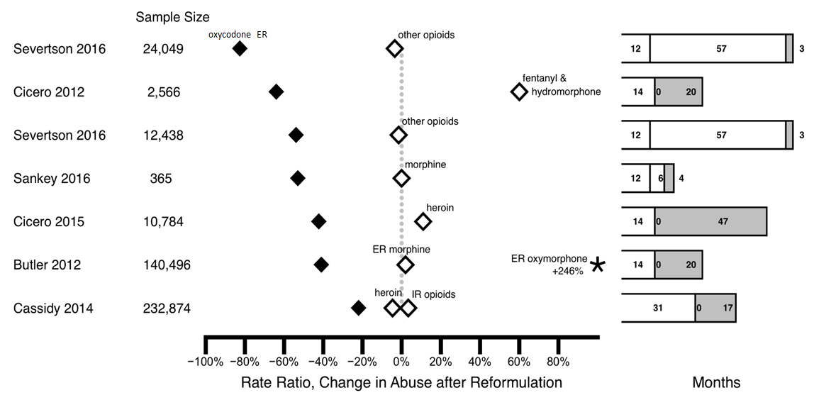

Reported Change in Treatment Measures of Abuse After Reformulation of Oxycodone ER

Slide 36
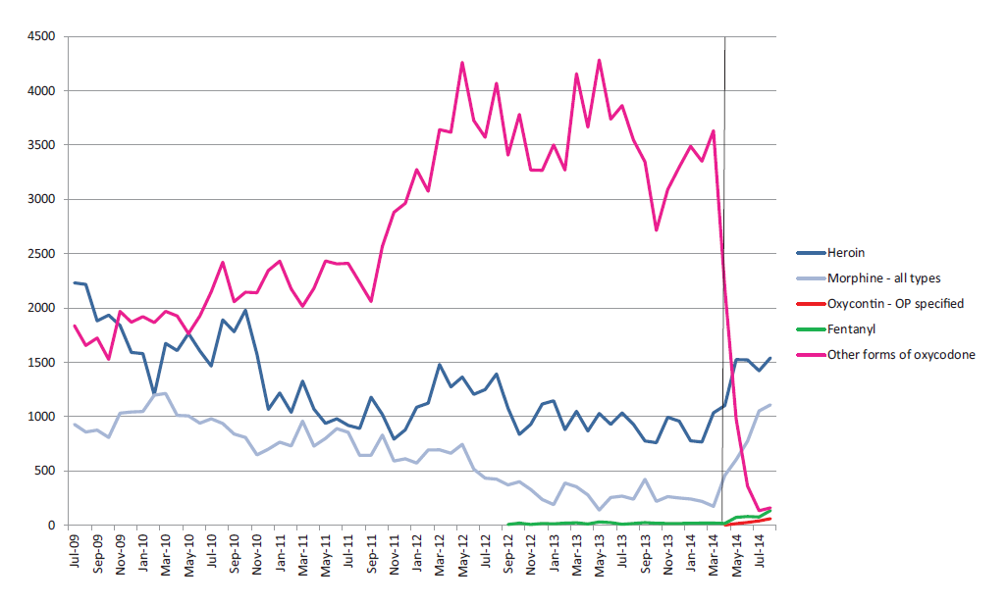

Sydney Medically Supervised Injecting
Centre (MSIC), July 2009–August 2014
Intro
OxyContin
Degenhardt et al., Drug Alc Dependence 2015; 151: 56-57.
Notes:
This slide shows the number of cases of INTRAVENOUS OXYCODONE abuse in Australia from 2009 to 2014.
[CLICK]
After reformulation, represented by the dotted line, cases of intravenous oxycodone abuse dropped from about 3500 per month to about ONE hundred.
[CLICK]
And the reformulated, abuse-deterrent oxycodone, shown in blue, had very few cases of IV abuse in the first few months after introduction.
[PAUSE]
This raises another point that should be addressed….that the introduction of abuse-deterrent opioids might lead to an overall INcrease in opioid prescribing.

Slide 37
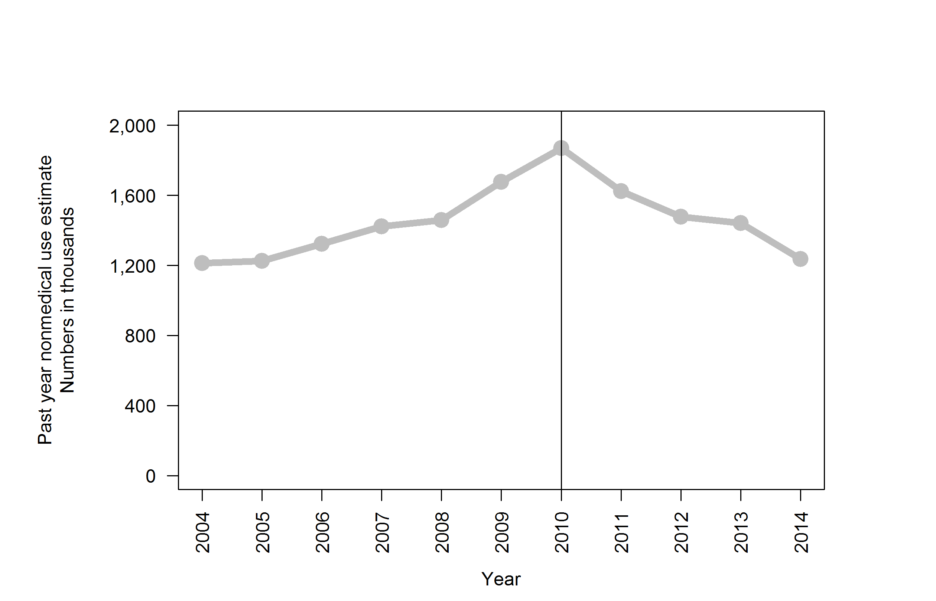
Nonmedical Use of OxyContin®, National Survey of Drug Use and Health, 2006 – 2014
Reformulation

Slide 38
Confounding Main Challenge to Interpretation of ADF Data
WA Rx Guidelines
Oxycodone ER
Reformulation
FL
TIRF REMS
ER/LA REMS
HC-APAP Tramadol
National Drug Take Back
CDC Pain Guideline
Oxycodone ER
PDMP
Other Opioids

Slide 39
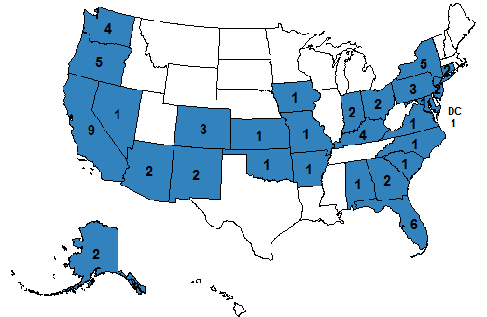
If the Prescription Drug Market is Decreasing, Where is the Drug Coming From?
Counterfeit Rx analgesics
  Fentanyl containing
Importation (Web, other)
Illicit Drug (Heroin)
4 months: 67 reports of Rx oxycodone from Canada reported to US StreetRx website.
  51 (76%) confirmed that the drug was acquired in the US.
  9 (13%) - the drug was acquired in Canada but used in the US.
  7 (10%) did not report the country of acquisition.
62 (92.5%) reports of crushable oxycodone products
5 (7.5%) reports of OxyNEO, the only difficult to crush (tamper-resistant) oxycodone product in our analysis.
Geographically diverse – Snowbirds?

Slide 40
The Big Box Effect on Street Prices
Drug | Formulation | Dosage strength mg/tablet | N | Median price US dollar/mg (IQR)
Oxycodone |  | Total | 5611 | 1.25 (1.18, 1.31)
 | Crush-resistant Reformulated OxyContin® | 15 or less | 665 | 1.00 ($0.50, $1.00)
 |  | 20 – 40 | 1487 | 0.63 ($0.38, $1.00)
 |  | 60 or more | 772 | 0.44 ($0.25, $0.63)
 | Crushable Original OxyContin®, generic ER, and IR | 15 or less | 896 | 1.00 ($0.60, $1.00)
 |  | 20 – 40 | 1548 | 0.83 ($0.50, $1.00)
 |  | 60 or more | 243 | 0.50 ($0.25, $0.75)

Slide 41
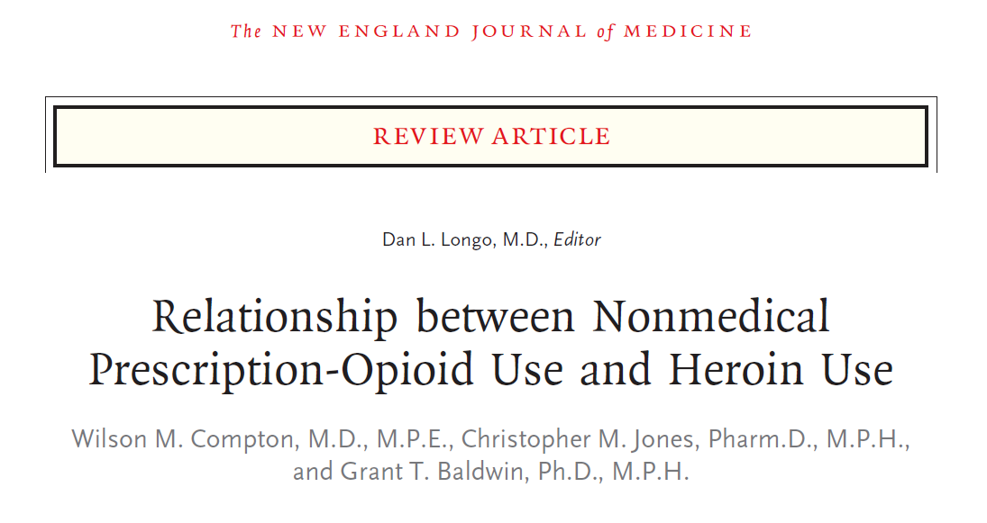
N Engl J Med 2016; 374:154-163
Notes:
To end, I’d like to take another hot topic – heroin.
First thing to say – you need to read this paper

Slide 42
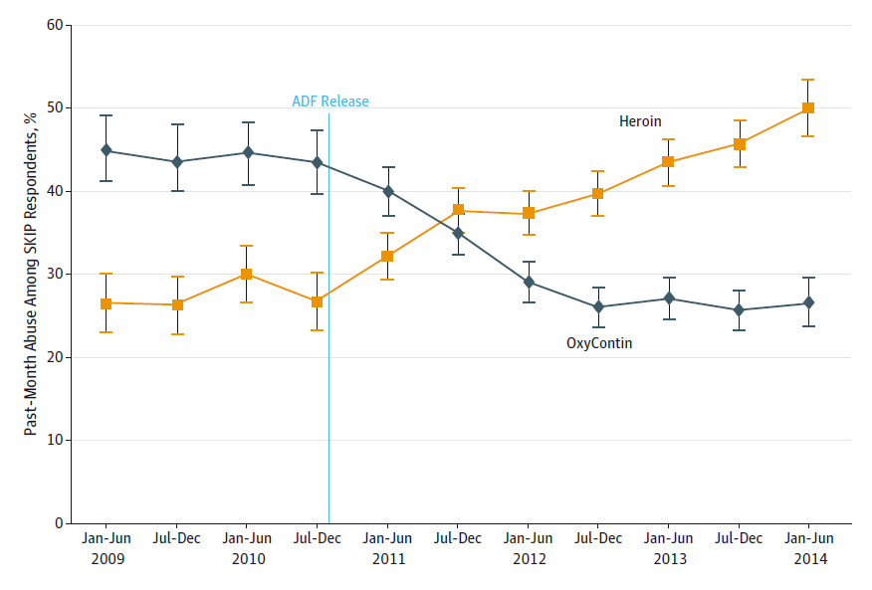
Past-Month Use of Oxycodone (OP) or Heroin Before and After Reformulation
OxyContin
OP
Heroin
Cicero & Ellis. doi:10.1001/jamapsychiatry.2014.3043
Notes:
Many of you will be aware of this paper. It shows…
It’s a bit misleading because it present OxyContin in isolation. There are many other factors…

Slide 43
Progression of Rx Drug Abuse
Filling the Balloon
Person in Pain
Susceptible
Person
Outcomes
Intact
Chewed
Crushed
OUD
Recreational Abuser
Overdose
Abuse of Other Drugs
Death
Heroin
Notes:
Basically, the theory is that if the balloon represents prescription drug abuse, one way out is to switch to heroin.

Slide 44
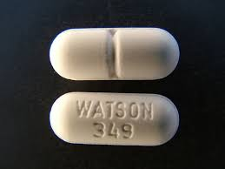
Other Factors
Cost
  Every $100 decrease in price of pure gram of heroin resulted in a 2.9% increase in number heroin overdose hospitalizations
  Price point phenomenon
Availability (Dreamland)
Many abusers use multiple opioids
Other opioids
  Hydrocodone-acetaminophen
  Oxycodone-acetaminophen
  Morphine
  Hydromorphone
  Oxymorphone
Other Drugs
Unick G. et al., Addiction. 2014;109:1889-98
Notes:
But there are other potential explanations

Slide 45
Heroin - Push? Or Pull?
Alcohol
Marijuana
Polysubstance Abuse
Opioid Abuse
Availability
Cost
Other factors
Heroin
Rx Opioid
Notes:
I honestly don’t think so. Here is my reasoning. The vast majority of people who end up using heroin have a long track record.
They typically started with alcohol, then abused marijuana and, often, other drugs as well. At some point they are make a conscious decision on whether to try an opioid. They make this decision similar to consumers of other products – availability, cost and in the case of drug abuse – setting.
Thus, the so-called push to heroin is actually a pull. Heroin is just the most available and cheapest form of opioid available today.

Slide 46
Summary
Abuse of prescription opioids is decreasing
Abuse and deaths from opioids are increasing
  Switching
  Heroin cheaper and quality alternative
Health Policy
  Optimize and minimize use of prescription opioids
  Heroin
  Fentanyl
  Other synthetic opioidsd

