Slide 1
ANTHRAX ASSIST: Modeling Tool for Decision Support during Early Days of an Anthrax Event
ISDS Webinar, April 24, 2018
Authors: Gabriel Rainisch¹, Nathaniel Hupert^{1, 2}, Martin Meltzer¹
Anthrax Advisors: Sean Shadomy³, William Bower³
¹Health Economics Modeling Unit (HEMU), NCEZID, CDC
²Weill Medical College of Cornell University, NY, USA
³Bacterial Special Pathogens Branch (BSPB), NCEZID, CDC

Slide 2
Outline
Why we built Anthrax Assist
Anthrax Assist Intro:
Summary of Models/Decisions Supported
Critical Assumptions
Limitations
Demonstration
Discussion/Feedback
Material in this talk adapted from:
Rainisch G, Meltzer MI, Shadomy SV, et al. Modeling Tool for Decision Support during Early Days of an Anthrax Event. Emerging Infectious Diseases. 2017;23(1):46-55. doi:10.3201/eid2301.151787.
3
Notes:
background material on anthrax disease progression, surveillance methods, and intervention options are included in the supplementary slides at the end of this presentation.
This overview and demonstration will not delve into calculations in the interest of time although I’m happy to take questions related to this topic after the presentation. I would also like to point out that detailed information on the calculations can be found in the free and publicly accessible manuscript published in CDC’s Emerging Infectious Diseases Journal to which a link was provided in the webinar invitation.

Slide 3
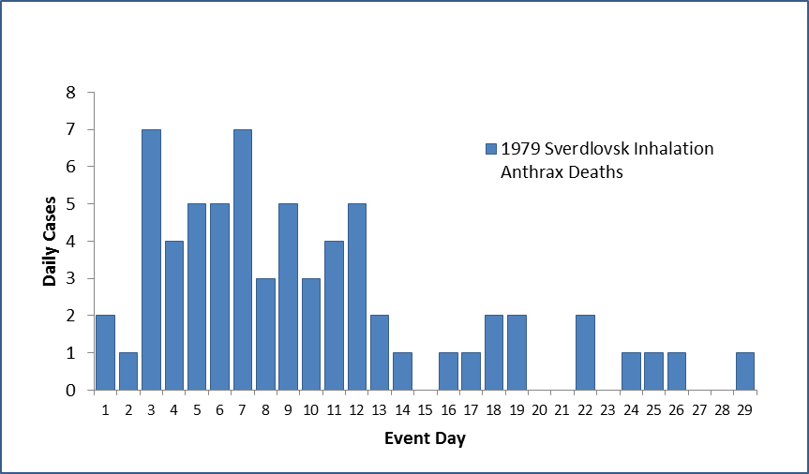
Why we built it (1 of 3)
In a population-wide Bacillus anthracis exposure event, response decisions must be made ahead of data becoming available
Questions:
1) How many more cases can we expect?
2) Do we act now or wait on more data?
3) What would be the impact of our actions?
4) What should we tell the public?
You are here
3

Slide 4
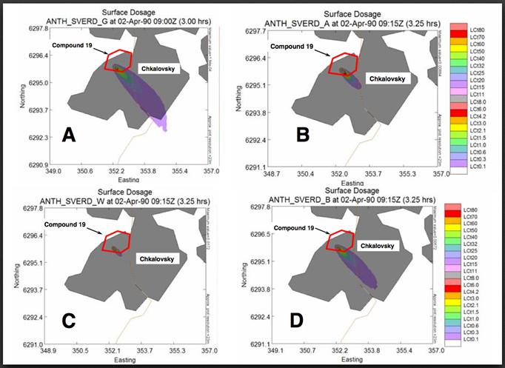
Why we built it (2 of 3)
Provide public health an alternative to “plume modeling” for caseload projections during an anthrax event
Will you have the data for plume modeling upon detecting the event?
Plume Models require knowledge (or estimation) of:
A release has occurred
Release location
Amount released
Weather (e.g. wind speed and direction)
Amount inhaled
Population’s whereabouts
4
Notes:
Plume models calculate the number of exposed persons by estimating the geographic spread of the spores which cause anthrax disease.

Slide 5
Why we built it (3 of 3)
3) State/Local public health lack:
Decision support tools for planning an anthrax response
Planning scenarios that are:
Locally-applicable
Drawn from the best-available scientific evidence
Nuanced in scale (i.e. not “all or nothing” responses)
5
Notes:
Locally applicable: event scale and the antimicrobial prophylaxis campaign are appropriate for a jurisdiction’s size and capabilities
Best-available evidence: such as items like the incubation period, treatment-seeking behavior of ill and/or public’s response to health messaging
Nuanced in scale: permits evaluation of scenarios where treatment capacity is stressed but decisions can be made to increase healthcare system efficiencies

Slide 6
Anthrax Assist Audience
Planners:
Generate realistic inputs for exercises
Evaluate the effects of PEP campaign implementation measures on health outcomes
Identify scenarios resulting in hospital capacity being exceeded:
triage throughput
resources (e.g. beds, ventilators)
Decision makers:
Play with “what-if” scenarios to examine the effects of different decisions or assumptions. Examples:
What is the estimated event size if our disease surveillance is missing X % of cases?
What if our messaging does a poor (or great) job at motivating the public to obtain antimicrobial prophylaxis?
7

Slide 7
Tool Structure
3 Models | Inputs | Output | Decision Informed
Epidemic Curve Model | Case counts by illness onset dates Incubation Period Distribution | Cumulative Caseload Unmitigated epidemic curve | Size of event How quickly people become ill
PEP Impact Model | Unmitigated epidemic curve Dispensing Plan Effectiveness Population needing prophylaxis | Cases Prevented by PEP PEP-mitigated epidemic curve | Initiate a PEP campaign & when to begin How much PEP to dispense Dispensing requirements
Health Care Model | Unmitigated epidemic curve, or PEP-mitigated epidemic curve Disease Progression Treatment-seeking behavior Treatment Effectiveness and availability | Hospital demand curves: ED Surge & Treatment Load Deaths curve Recovered curve | Standards of care Treatment guidance to public Set treatment priority Mobilize medical care resources
8

Slide 8
Critical Assumptions
Single, point source release
Uniform exposure dosage
Event is detected as a result of symptomatic persons seeking medical care
Re-aerosolization of spores accounts for a minimal fraction of cases
No inefficiencies or errors in diagnosing cases and initiating treatment
9

Slide 9
Limitations
Does not account for gastrointestinal and cutaneous forms of anthrax disease.
These forms may result in 20% more cases than currently estimated
Not applicable for multiple releases (“reload”)
Does not directly address the effects of competition for treatment resources by non-cases
Version 2 will address this
10

Slide 10
Summary: What Anthrax Assist Does
Provides Estimates of… | Yes / No
Event size & epidemic curve
Effects of antibiotics PEP campaign
Effects of Public Messaging
Cases’ Surge on Hospitals
Hospital Treatment Loads
Hospital Treatment Outcomes
Effects of Vaccine
Who was exposed & source
Non-Cases’ Surge on Hospitals
11

Slide 11
Anthrax Assist Demonstration

Slide 12
For more information:
Gabriel Rainisch: GRainisch@cdc.gov
Download Anthrax Assist: https://wwwnc.cdc.gov/eid/article/23/1/15-1787_article
The findings and conclusions in this report are those of the authors and do not necessarily represent the official position of the Centers for Disease Control and Prevention.

Slide 13
Supplementary Slides

Slide 14
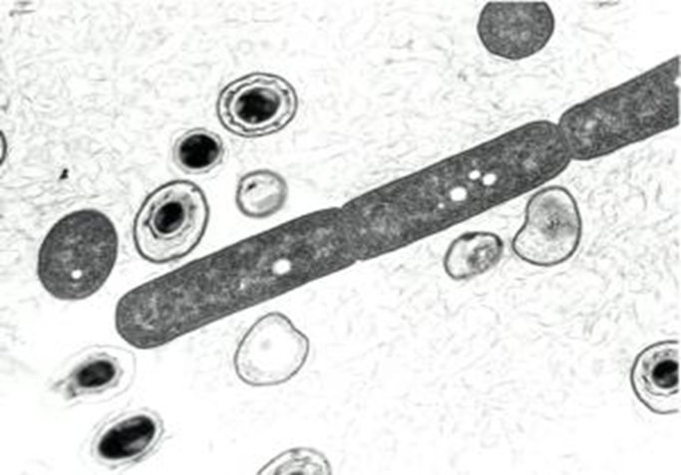
Anthrax Background
Anthrax Infection
Cutaneous
Gastrointestinal
Inhalational
CDC Category A agent
Disease Progression:
Incubation (1-60 days) →
Prodromal illness (1-5 days) →
Fulminant illness (1-18 days)→
Death or Recovery
Mortality (Inhalational):
45% with ICU care (2001 “Amerithrax” event)
95%+ without ICU care
Intervention: Post-exposure prophylaxis (PEP) = antibiotics +/-vaccine
Cities Readiness Initiative (CRI) Goal: 48h to PEP dispensation

Slide 15
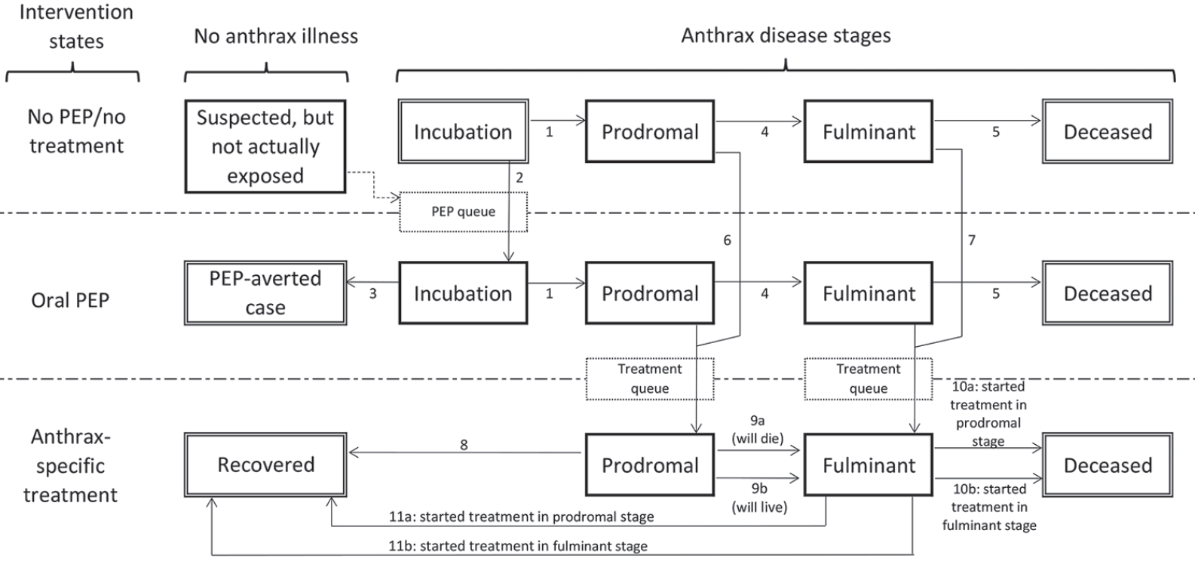
Disease stages, intervention states, & transitions modeled with Anthrax Assist
Persons begin in the top Incubation state and may transition via the numbered arrows from one state to another until they eventually reach an outcome state (doubled-walled boxes). All persons with untreated infection will progress to deceased. Recovery is possible only through effective oral PEP (averted case) or anthrax-specific treatment (recovered). Suspected, but Not Actually Exposed cases are shown here because of their role in diluting the incubating population seeking PEP (dashed transition arrow). PEP and Treatment queues (dashed outline boxes) are depicted to reflect the necessary interactions persons must have with the public health and healthcare systems to transition between treatment states.

