Slide 1
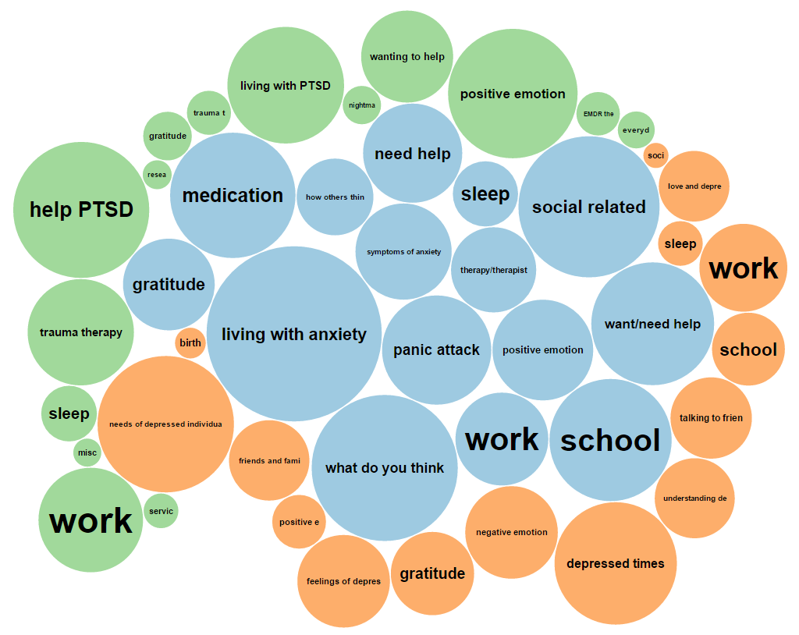

Albert Park, Ph.D.
Background: Public Health Informatics, Consumer Health Informatics, Data and Computational Science, Human-Computer Interaction, Social Computing
Research Interests:
  Focus: health concerns, health problems, patient experiences, social interactions
  Data: large social media datasets
  Methods: natural language processing, machine learning
Email: al.park@Utah.edu
Notes:
My background is in
My research is about understanding health problems, patient experiences, and social interactions using data from online environments, such as social media and online communities
by applying computational methods, such as natural language processing and machine learning

Slide 2



Related Publication
Park, A., Conway, M. (2017) Tracking Health Related Discussions on Reddit for Public Health Applications. Proceedings of the American Medical Informatics Association (AMIA) Annual Symposium. Washington DC
Park A., Zhu S.H., Conway M. (2017) The Readability of Electronic Cigarette Health Information and Advice: A Quantitative Analysis of Web-Based Information. Journal of Medical Internet Research Public Health and Surveillance 2017 Jan 6;3(1):e1.
Mowery D., Park A., Conway M., Bryan C. (2016) Towards automatically classifying depressive symptoms from Twitter data for population health. Proceedings of the Workshop on Computational Modeling of People’s Opinions, Personality, and Emotions in Social Media.
Park, A., Conway, M. (2017) Towards Tracking Opium Related Discussions in Social Media. Online Journal of Public Health Informatics. 2017;9(1):e73
Park, A., Conway, M. Opioid Surveillance using Social Media: Understanding how opioid URLs are shared among Reddit members. (2018) International Society for Disease Surveillance Conference
Park, A., Conway, M. Leveraging Social Media for Disease Surveillance: An Exploration of Electronic Cigarettes Discussion on Reddit. (2018) International Society for Disease Surveillance Conference
Park, A., Conway, M. (2017) Identifying Health Interests of the General Public using Social Media. Poster Presentation at the American Medical Informatics Association Annual Symposium.

